Slide 1

An overview of ‘Cognitive Functional Therapy’
Graeme Green
Pain Specialist Physiotherapist
20/06/25

Slide 2
Cognitive Functional Therapy
Developed by Prof Peter O’Sullivan + team in Curtain University, Western Australia
Physiotherapy led individualised behavioural intervention for the management of low back pain
Integrated body – mind approach
Bridging the gap: from pain & disability to living again

Slide 3
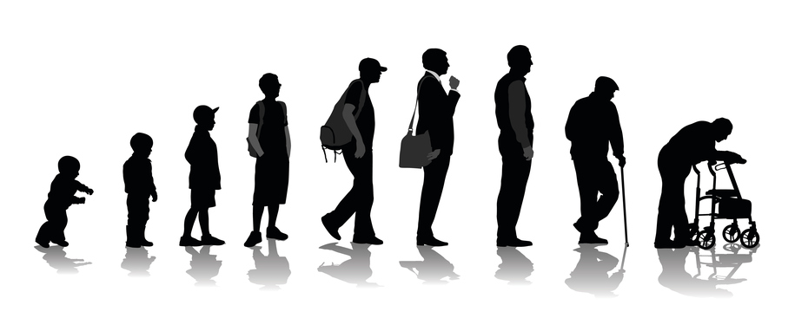

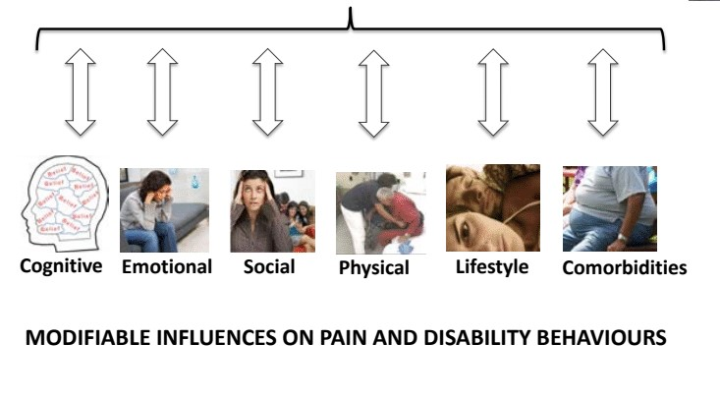
Multi-factorial LBP
BEHAVIOURAL RESPONSE TO PAIN
O’Sullivan et al. 2018

Slide 4
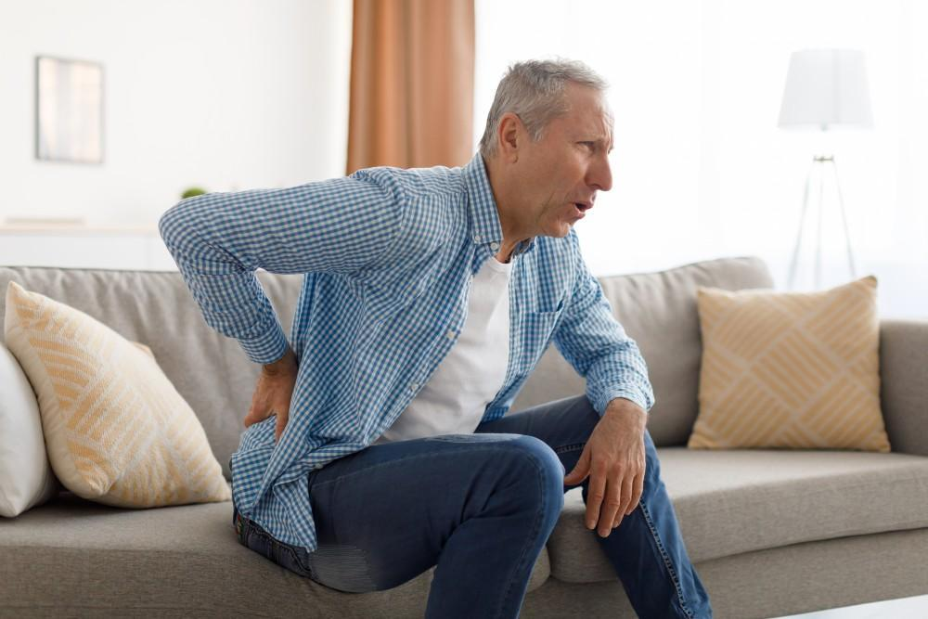
A common cycle of low back pain and disability?
-ve Health care interactions
Identity – Damage
Cause - injury
Consequence – disability
Timeline – never going to get better
Curability/control – No
Worsening pain and disability
Unhelpful Coping
Protect
Avoids & rest
Passive input
Influenced by
- Contextual factors
Previous experience of pain
Overall health – mental/general
Emotional Response
Fear
Worry
Depressed/anxious
O’Sullivan et al. (2018)

Slide 5
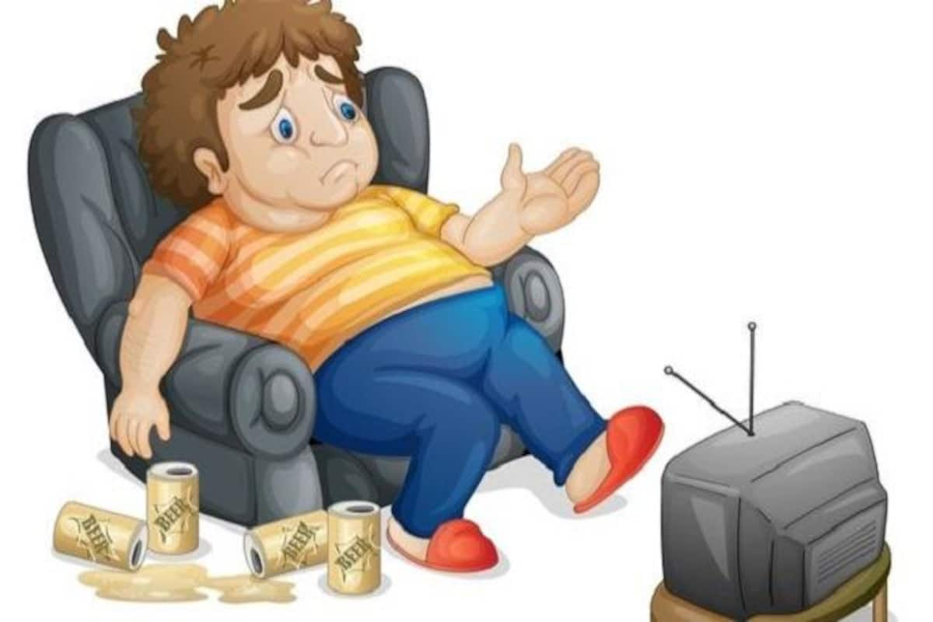
Behavioural Response to Fear – Avoidance
Avoidance
posture, movements, activity, social settings, work
Often advised by the health care system
‘ I avoided to control the pain, but the more I avoided the more disabled & fearful I became’
Bunzil et al. (2018)

Slide 6

Behavioural Response to Fear – Protection
Continuation of activity with protection
Sub-conscious: can’t relax/always feels tense
Conscious: I risk assess my movements, I move slow & check, I sit with a straight back, I tense my core before I move, I lift with a straight back
Wernil et al. (2022)
People with lower back pain move slower, more guarded and with less variability Nolan et al. (2019)

Slide 7
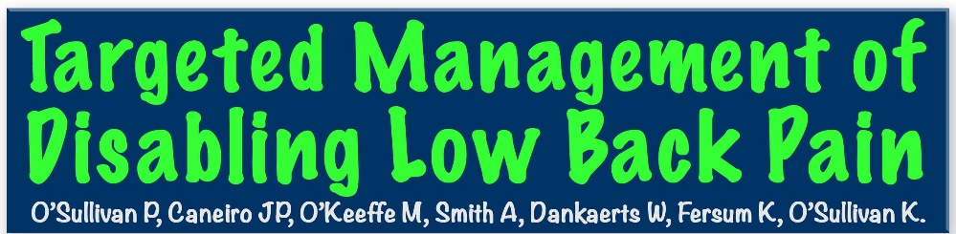



Slide 8
The Interview
Approach is based on the development of a strong therapeutic relationship between clinician and patient
Tell me your story?
Active listening
Validating
Empathy
Non-judgmental
Working in partnership – goal focussed
O’Sullivan et al. (2018)

Slide 9
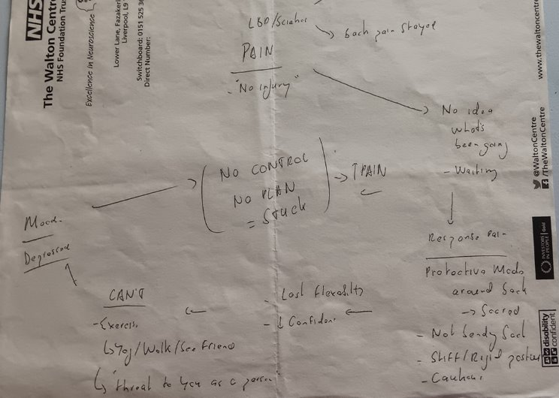
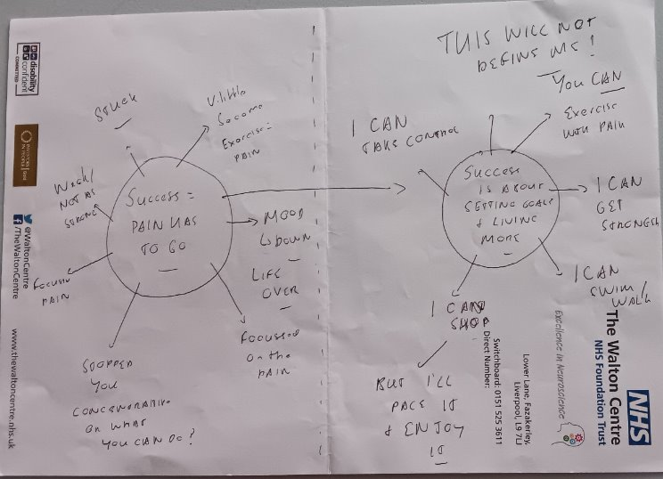
Making Sense of Pain
Developing a personalised BPS understanding of their pain presentation
Gently challenge unhelpful beliefs +/- resources
Explore new response to pain & fear
Goal focussed
O’Sullivan et al. (2018)

Slide 10
Exposure with control
Build confidence to move with pain control through behavioural learning
Behavioural experiments
Target feared/avoided/protective movements
Pain control strategies – body relaxation, movement control, discouraging pain behaviours
Intergrade new movements/behaviour into identified valued activities and chase goals (grandkids/gym/work)
Can only be delivered effectively through the development of a strong therapeutic alliance
O’Sullivan et al. (2018)

Slide 11
Lifestyle Changes
Build up physical activity levels: patient preference
Build up stress resilience: relaxation etc
Sleep hygiene
O’Sullivan et al. (2018)

Slide 12
Pain exacerbation plan
Really important
Opportunities to promote new behavioural & emotional responses to pain
Identify the triggers
Indefity old response and reinforce new response
Open appointment
O’Sullivan et al. (2018)

Slide 13
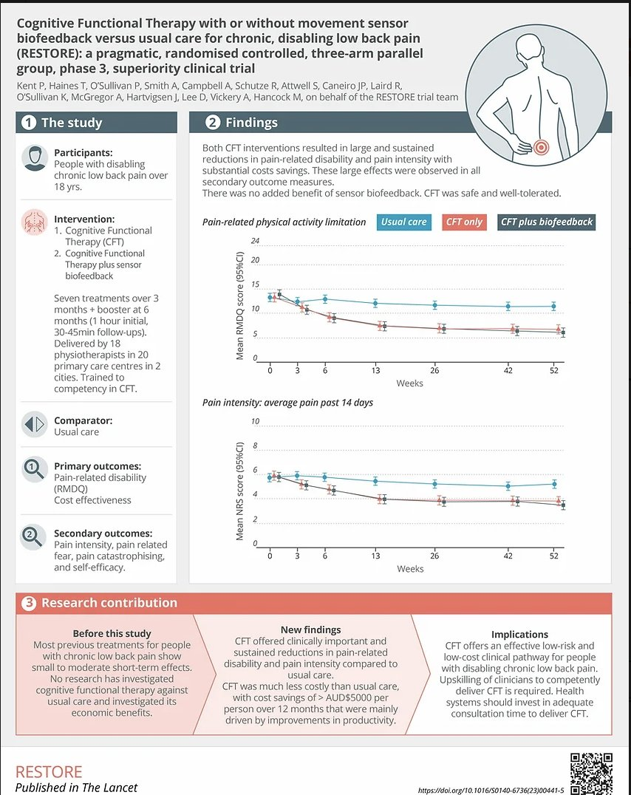

Slide 14
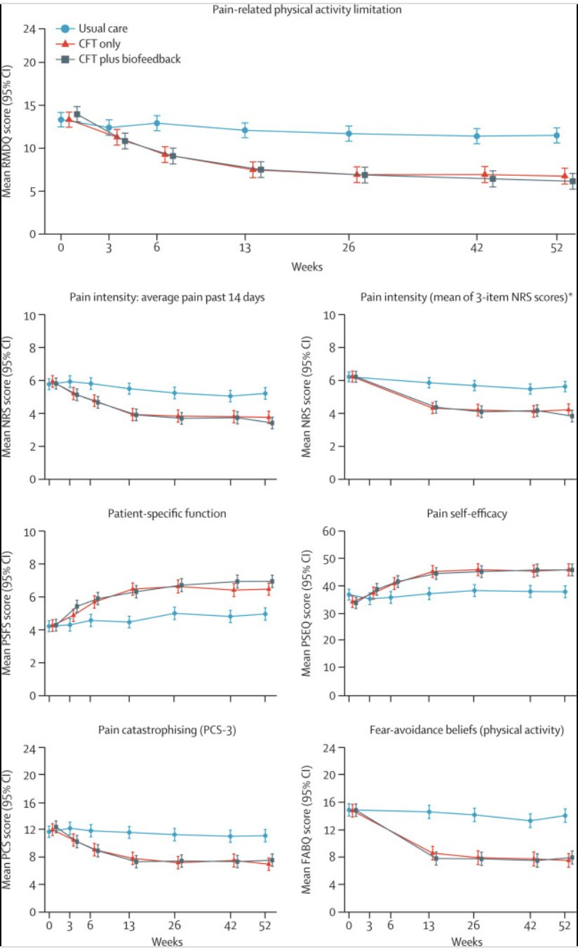

Slide 15
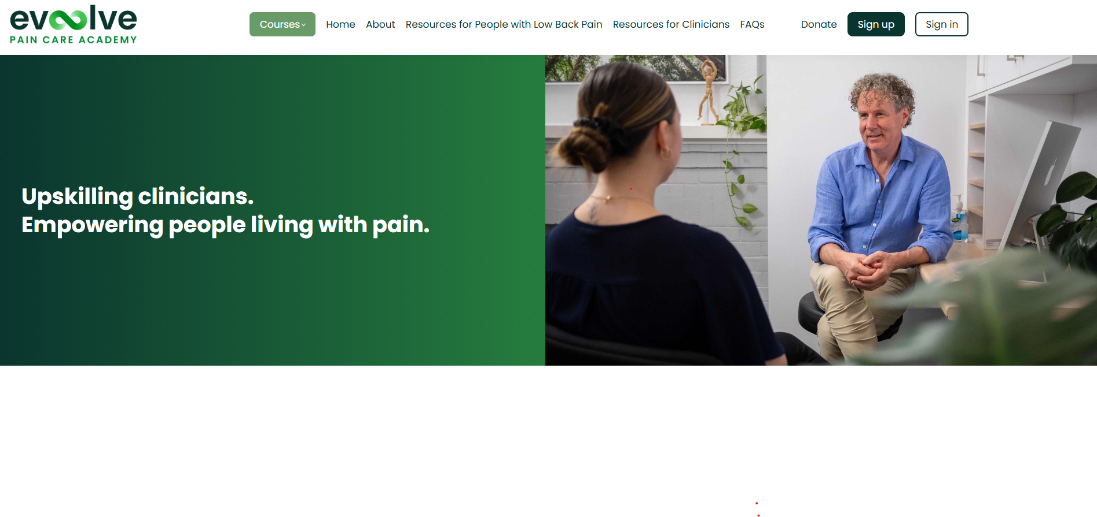
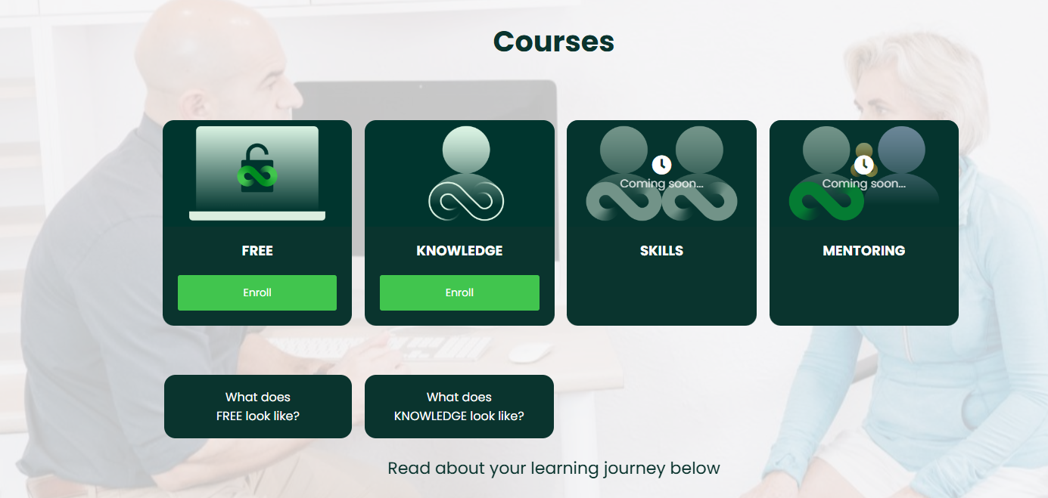

Tiered Training

Slide 16
Reference list
Kent, P., O’Sullivan, P., Smith, A., Haines, T., Campbell, A., McGregor, A.H., Hartvigsen, J., O’Sullivan, K., Vickery, A., Caneiro, J., Schütze, R., Laird, R.A., Attwell, S. and Hancock, M. (2019). RESTORE—Cognitive functional therapy with or without movement sensor biofeedback versus usual care for chronic, disabling low back pain: study protocol for a randomised controlled trial. BMJ Open, [online] 9(8), p.e031133. doi:https://doi.org/10.1136/bmjopen-2019-031133.
Nolan, D., O’Sullivan, K., Newton, C., Singh, G. and Smith, B. (2020). Are there differences in lifting technique between those with and without low back pain? A systematic review. Physiotherapy, 107, p.e76. doi:https://doi.org/10.1016/j.physio.2020.03.103.
O’Sullivan PB, Caneiro JP, O’Keeffe M, et al. Cognitive functional therapy: an integrated behavioral approach for the targeted management of disabling low back pain. Phys Ther. 2018;98:408–423. (2018). Physical Therapy, [online] 98(10), pp.903–903. doi:https://doi.org/10.1093/ptj/pzy087.
Wernli, K., Smith, A., Coll, F., Campbell, A., Kent, P. and O’Sullivan, P. (2022). From protection to non‐protection: A mixed methods study investigating movement, posture and recovery from disabling low back pain. European Journal of Pain, 26(10), pp.2097–2119. doi:https://doi.org/10.1002/ejp.2022.

