Slide 1

Anneka Field, RN NMP
June 2025

Slide 2

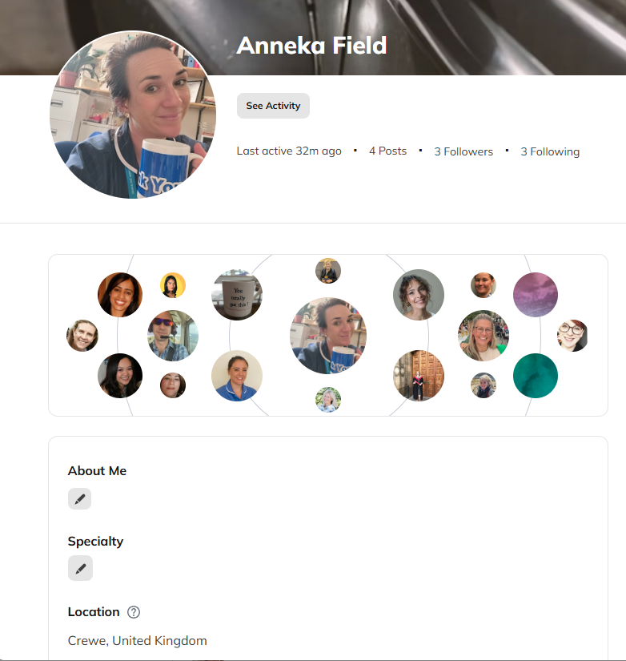
Supporting Specialist Pain
Nurses Across the UK and Beyond
Founded in 1993 as the London Pain Interest Group
Rebranded in 2020 to Pain Nurse Network, recruitment of members from UK, Ireland and Internationally
Mission to unite pain nurses for shared learning, peer support, and professional development

Slide 3
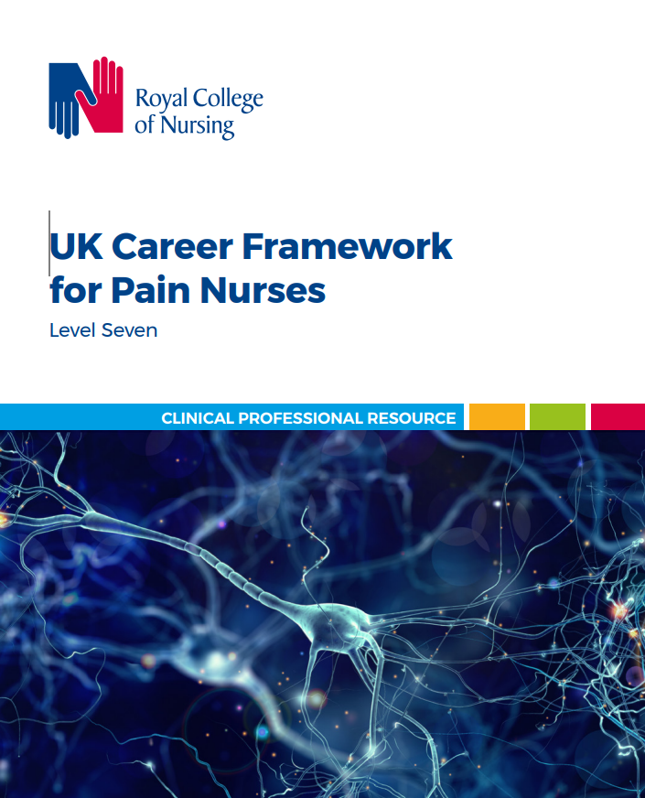
Leadership Team
Founders: Martin Galligan and Felicia Cox
Chair: Charlotte Sear
Vice Chair: Christina Gulberg
Secretary: Niamh Molloy
Treasurer: Suzanne Chapman
Acute Pain SIG: Katherine Wall and Anneka Field
Chronic Pain SIG: Morleen Chetuari, Sarah Lewis
Cancer Pain SIG TBC

Slide 4
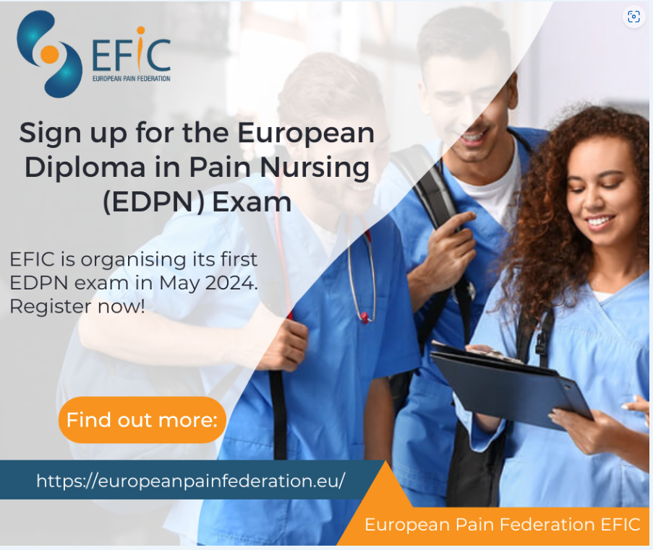
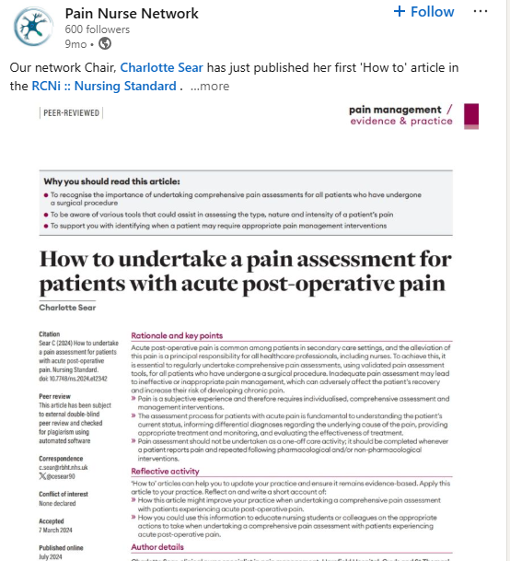
Core Objectives
Networking: Connecting with over 200 specialist pain nurses
Education: Access to events and resources promoting best practice
Support: Engage in a supportive community for career advice and development
Advocacy: Raise the profile of pain nursing nationally and internationally

Slide 5
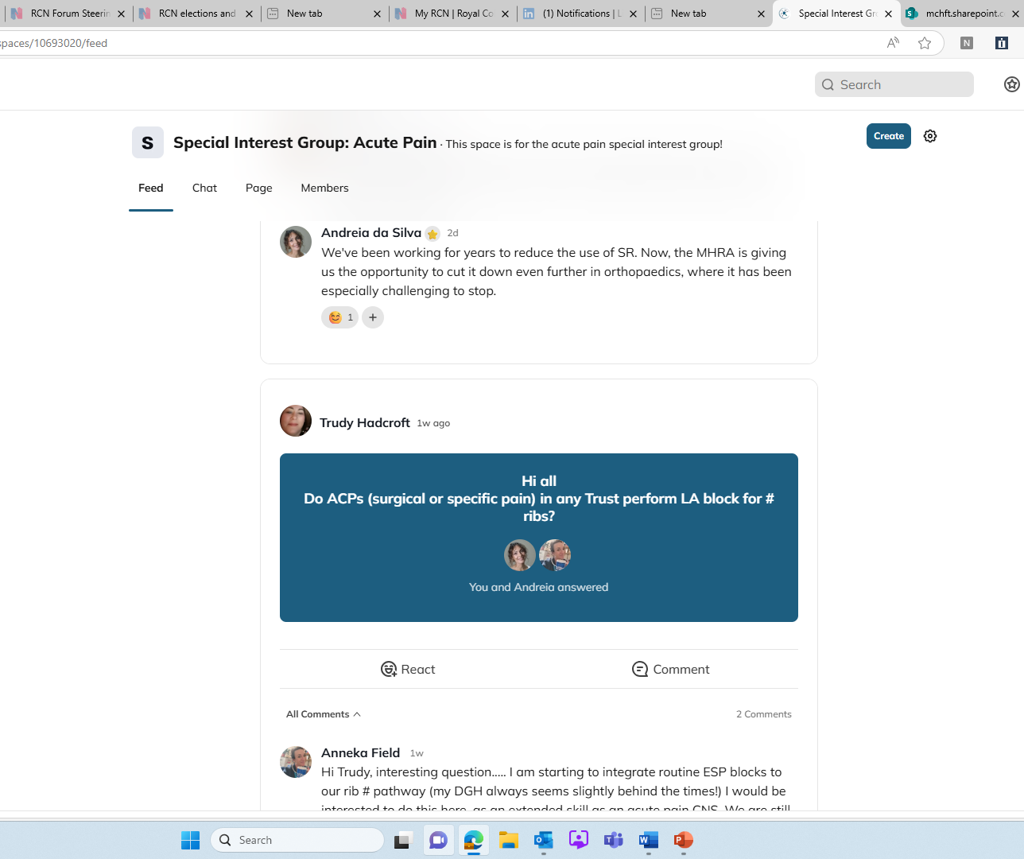
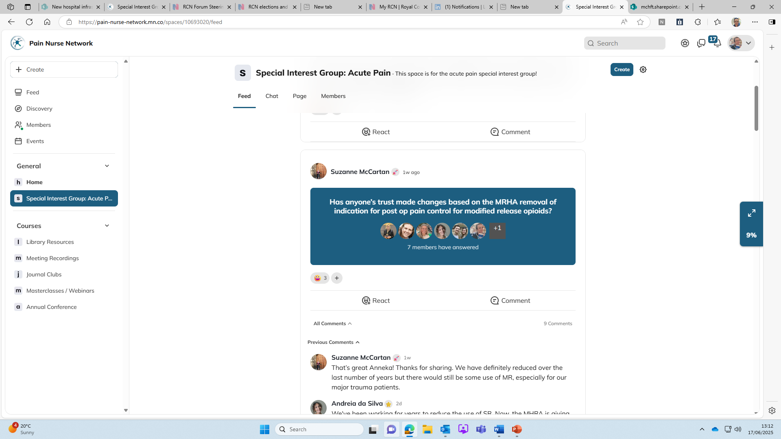
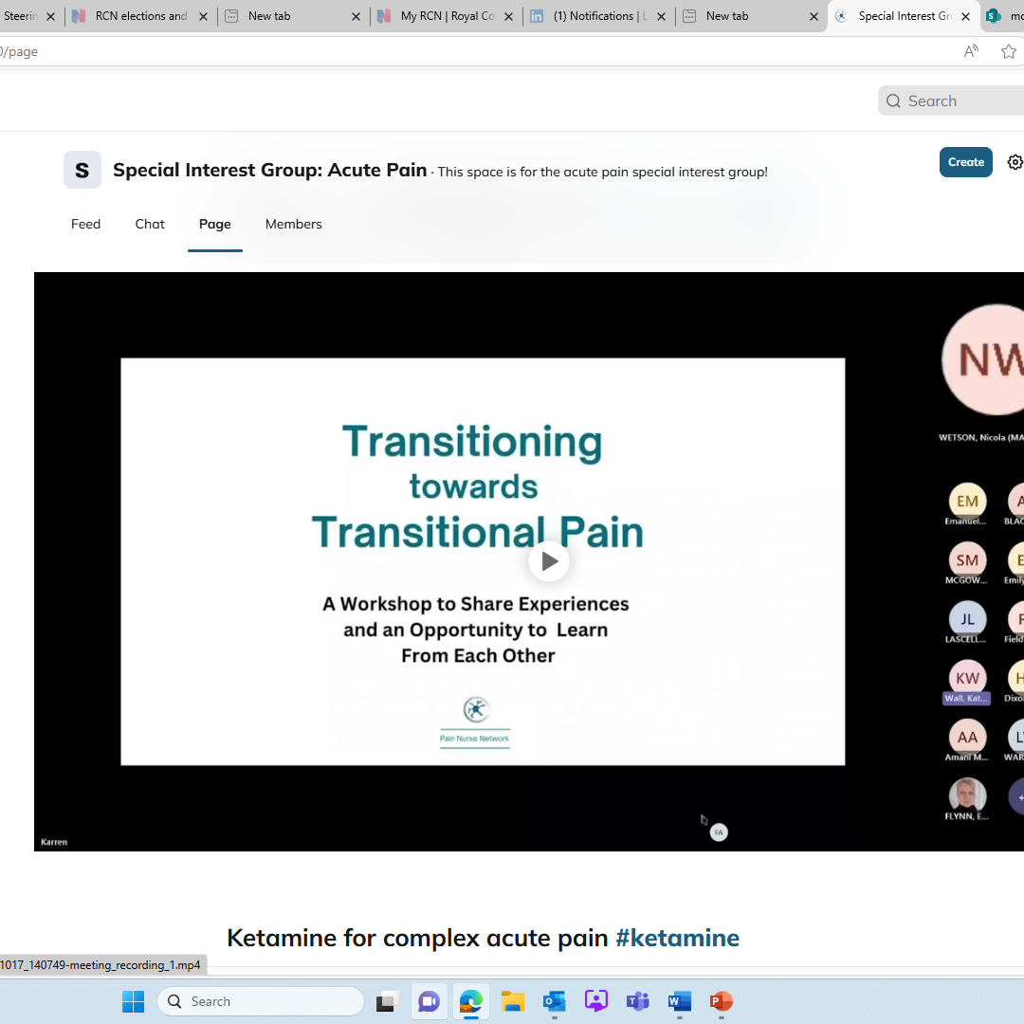
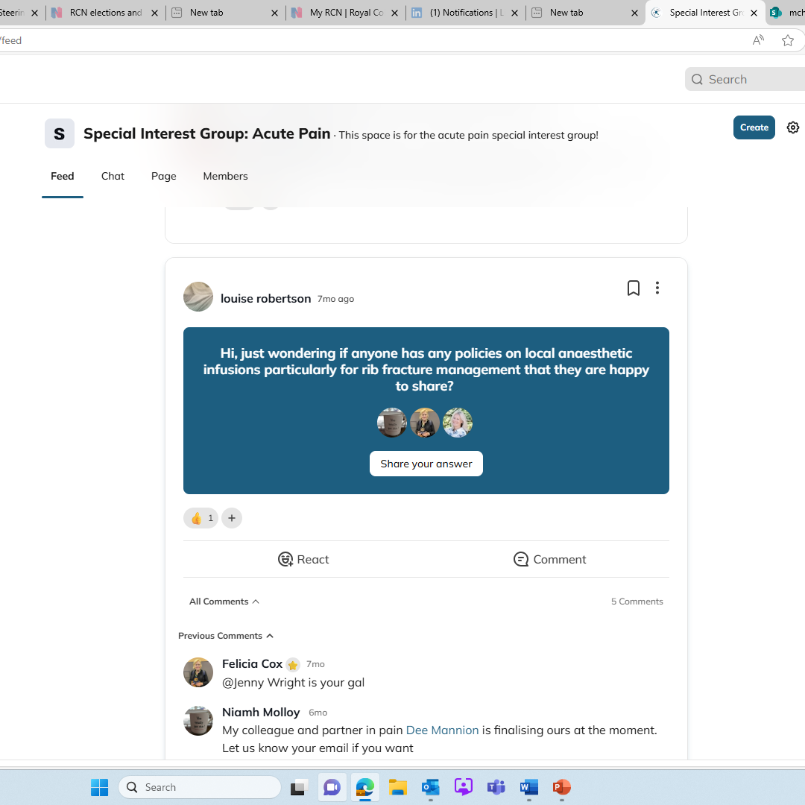
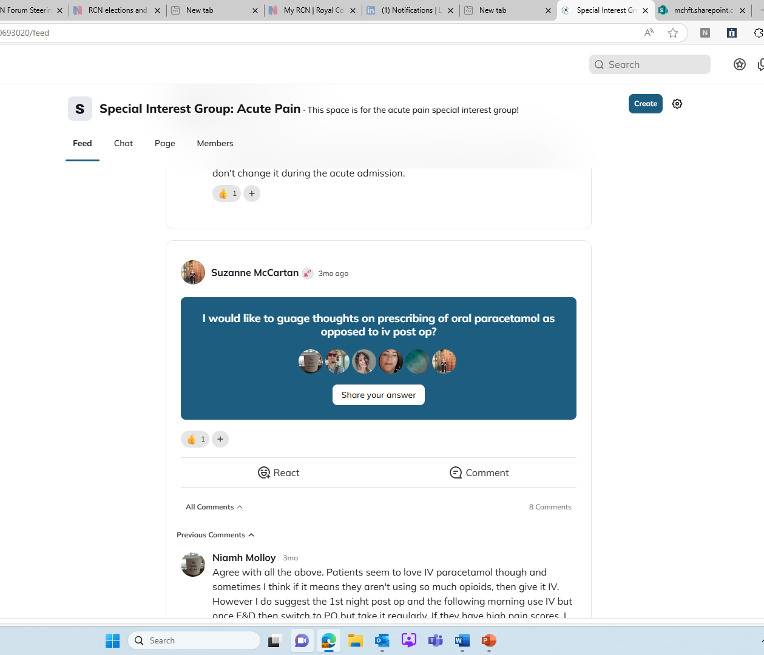
Membership Benefits
Exclusive Access: Knowledge Hub platform
Professional Development: Opportunities for learning and growth
Peer Support: Engage with a community of specialists
Recognition: Acknowledge achievements within the network

Slide 6
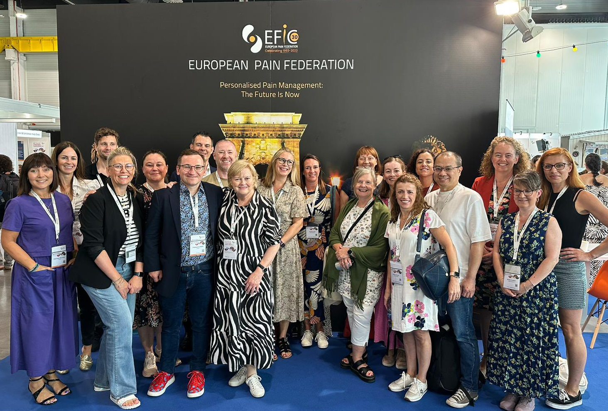
Education Events
Annual Conference: Advancing and Exploring Practice in Pain Management
Specialist Masterclasses (APSIG): Gabapentoid Masterclass
Transitional Pain
Workshops: Topics like Prescribing in Pain
Access: Recordings available for members

Slide 7
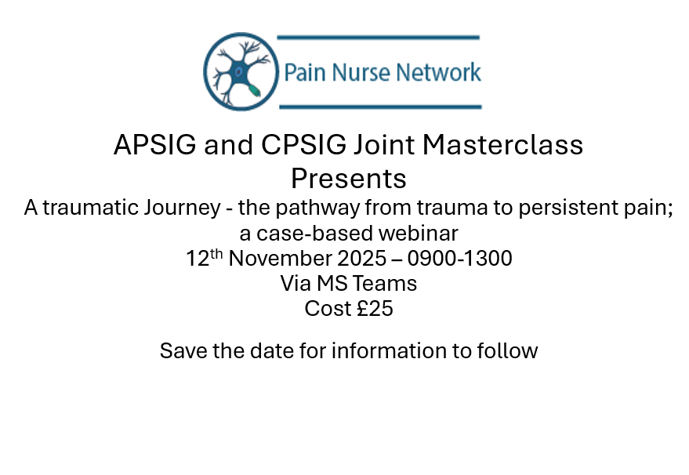

Slide 8
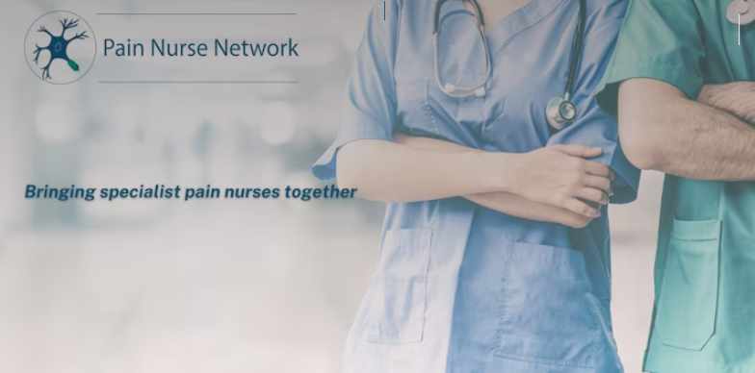
How to Join
Website: pain-nurse-network.mn.co
Membership: Open to specialist pain nurses worldwide
Social Media:
@RNPainNet on X / Twitter
Pain Nurse Network on Linked in

