Slide 1


Management of Orofacial Pain in a multidisciplinary clinic
Miss Deepti Bhargava
Consultant Neurosurgeon
Mr Francis O‘Neill
Consultant Oral Surgeon
Prof Bernhard Frank
Consultant in Pain Medicine

Slide 2
Objectives
• Explore the multidisciplinary nature of facial pain
• Review the diagnostic classifications
• Review common presentations and treatments
• Highlight the importance of interdisciplinary approaches

Slide 3






Conflicts of interest
Medical advisory board
Received funding from
Speaker’s fees

Slide 5
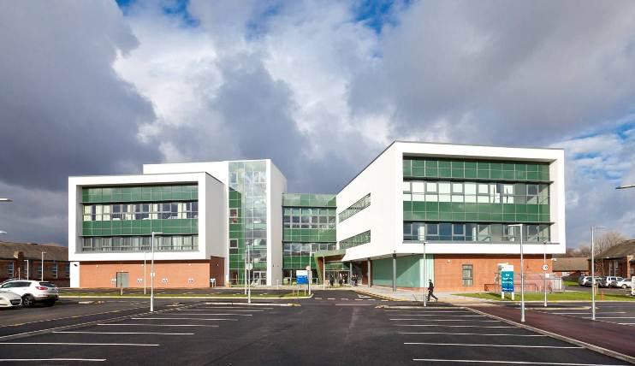

Slide 6
Composition of MDT team
Walton facial pain clinic
Started >25 years ago by Paul Eldridge (Neurosurgeon) and Turo Nurmikko (Pain Medicine)
Liverpool Dental Hospital facial pain clinic
Oral medicine, Restorative, Oral surgery and Psychiatry

Slide 7
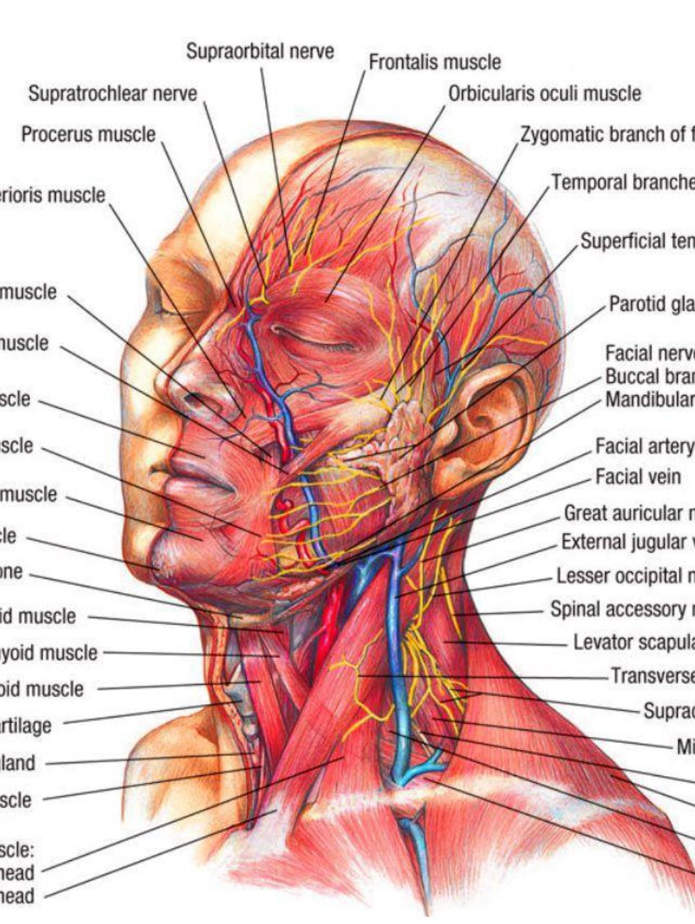
Anatomically and functionally complex region

Slide 8

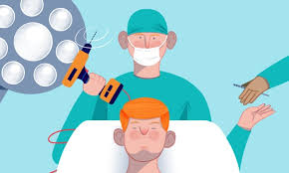

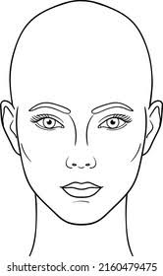
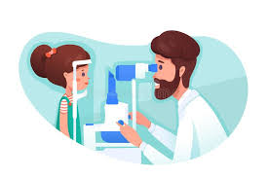

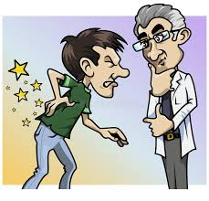
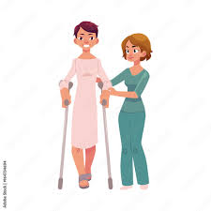
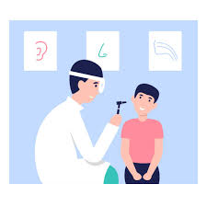

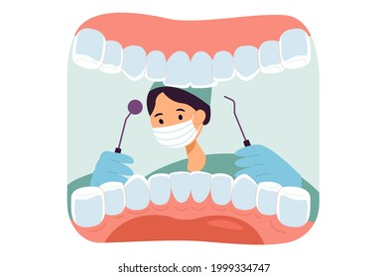
Specialties Involved in Facial Pain
Neurosurgery
Psychiatry/
Psychology
Neurology
Ophthalmology
Plastic surgery
Pain Physician
ENT
Physiotherapy
Oral + Maxillofacial
Surgery
Dentistry

Slide 9



Classifications of pain

Slide 10

Joint collaboration between
International Headache Society (IHS)
Orofacial and Head Pain Special Interest Group (OFHP SIG) of the
International Association for the Study of Pain (IASP),
International Network for Orofacial Pain and Related Disorders Methodology (INfORM),
American Academy of Orofacial Pain (AAOP)

Slide 11
1. Orofacial pain attributed to disorders of dentoalveolar and anatomically related structures 2. Myofascial orofacial pain
3. Temporomandibular joint (TMJ) pain
4. Orofacial pain attributed to lesion or disease of the cranial nerves 5. Orofacial pains resembling presentations of primary headaches 6. Idiopathic orofacial pain
7. Psychosocial assessment of patients with orofacial pain

Slide 12
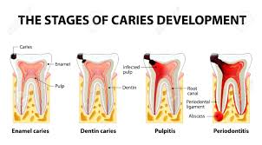
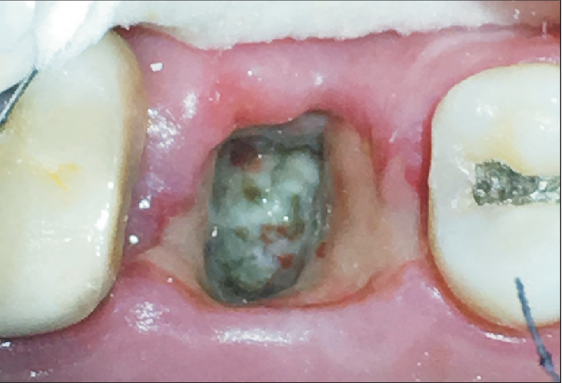
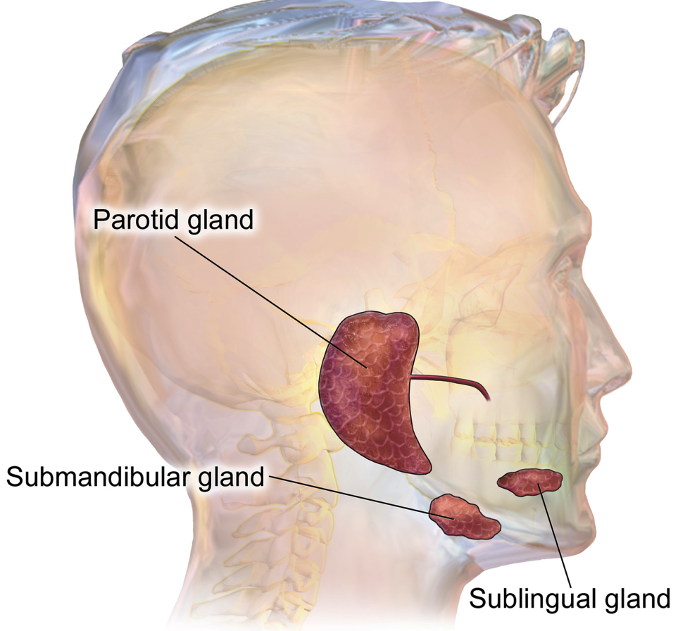
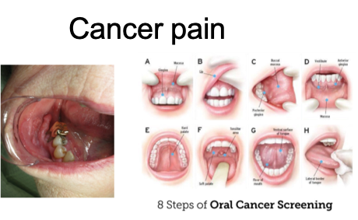
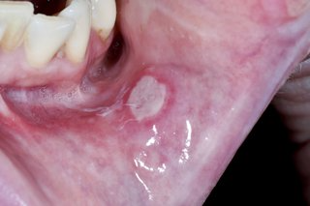
Most common oral pains
Bone pain
Salivary gland pain
Mucosal pain

Slide 13
Mostly seen by
General dental practitioners
Oral surgeons
Oral and maxillofacial surgeons
Oral Medicine

Slide 14
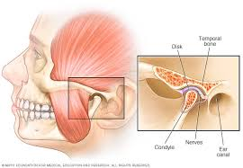
Temporomandibular Disorders most common chronic orofacial pain
1 in 15 UK population
Muscles
Joint
both

Slide 15
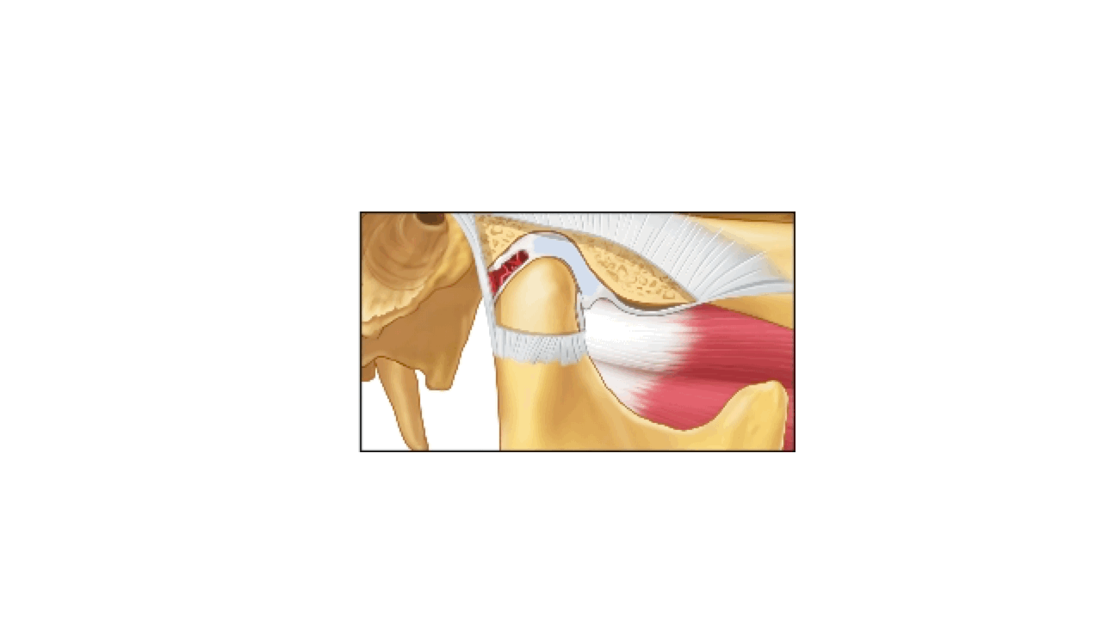
Normal function of TMJ and disc

Slide 16

Anterior disc displacement with reduction

Slide 17

Anterior disc displacement
without reduction

Slide 18
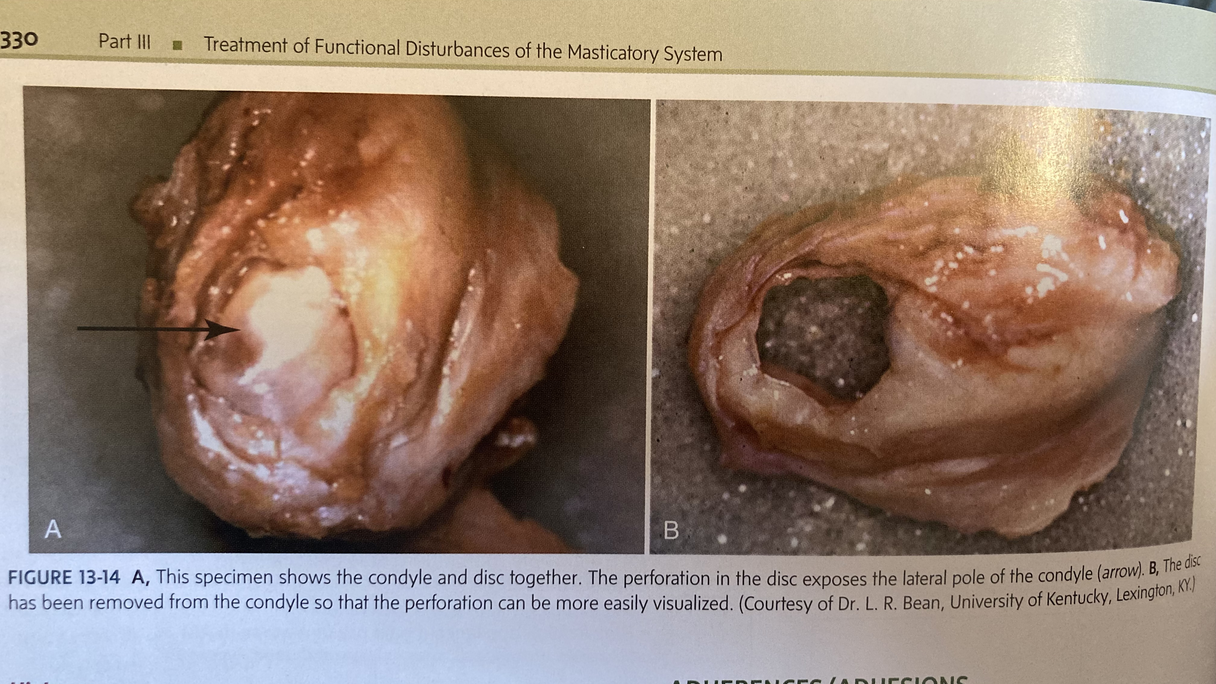
Disc perforation

Slide 19
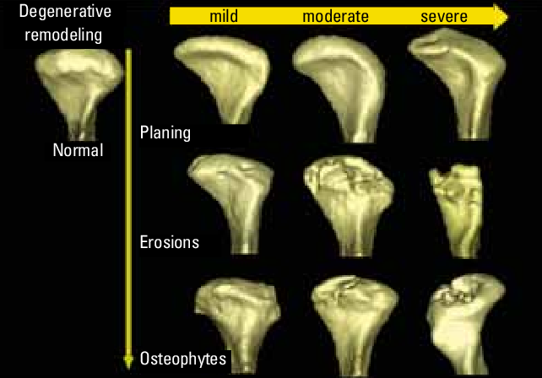
Degenerative changes in TM joint

Slide 20
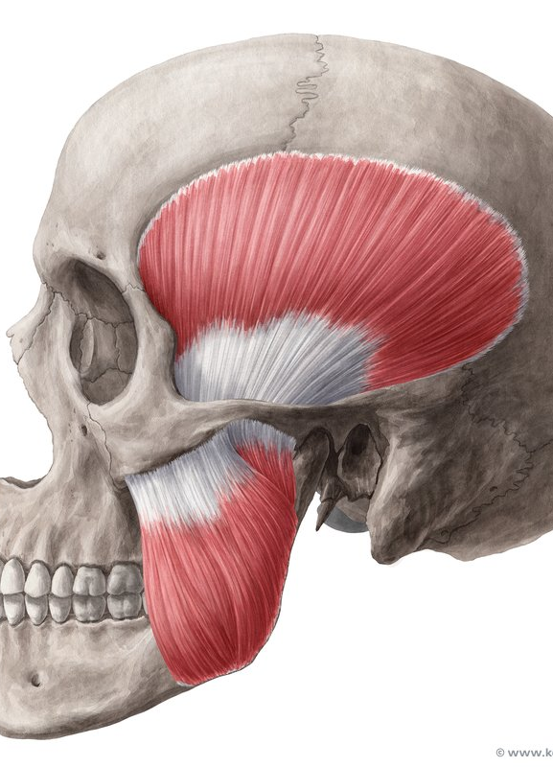
Myogenous TMD
Evidence for extra segmental hyperresponsiveness and generalized hyper-excitability in chronic TMD
Polymorphisms in COMT were significantly associated with TMD
And methylation of the genes FMOD, PM20D1, ZNF718 ZFP57, and RNF39

Slide 21
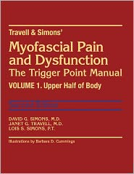
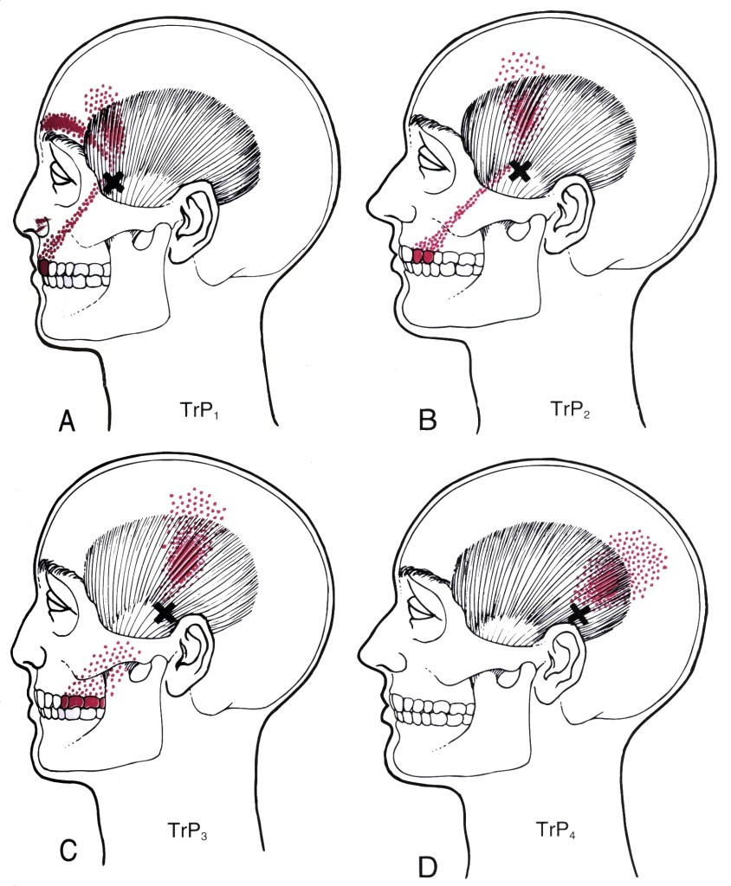
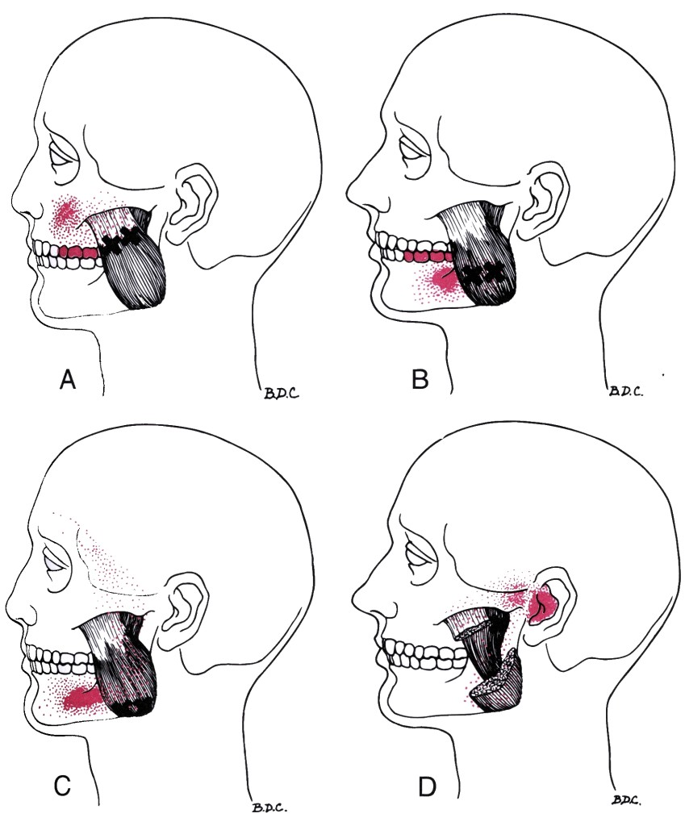
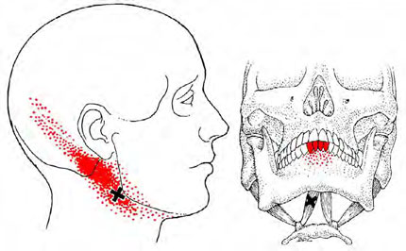
Myofascial referral

Slide 22



Management of painful Temporomandibular disorder in adults
NHS England Getting It Right First Time (GIRFT) and Royal College of Surgeons’ Faculty of Dental Surgery.

Slide 23
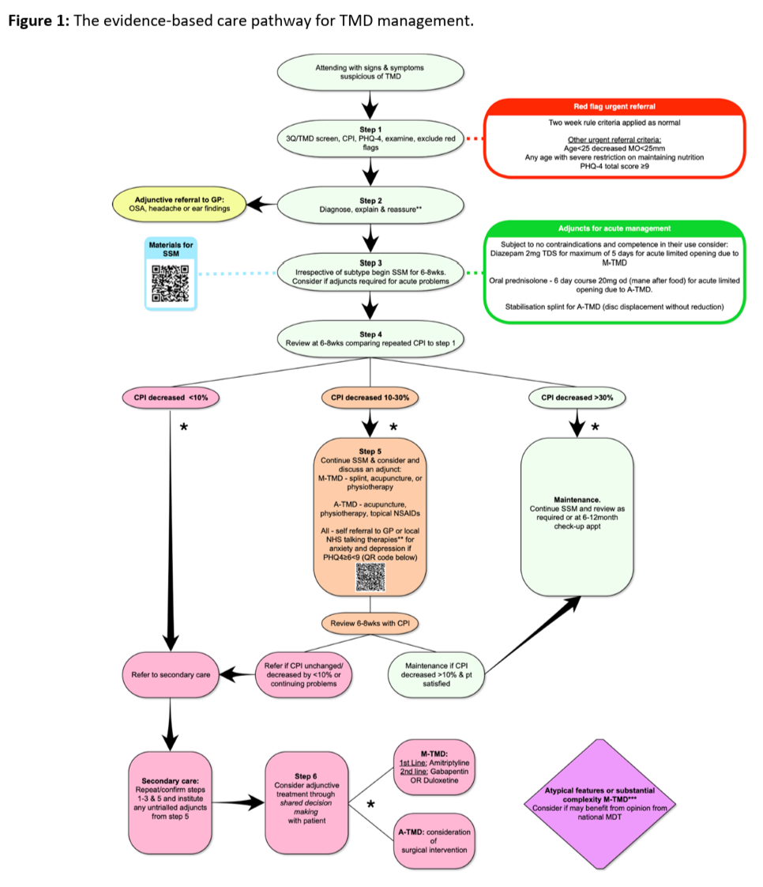
Education
Self supported management
Physio
Splint therapy
Topical NSAIDs
Possible
Diazepam M-TMD
Prednisolone A-TMD
If no better
Amitriptyline/Gabapentin
M-TMD
Possible surgery A-TMD

Slide 24
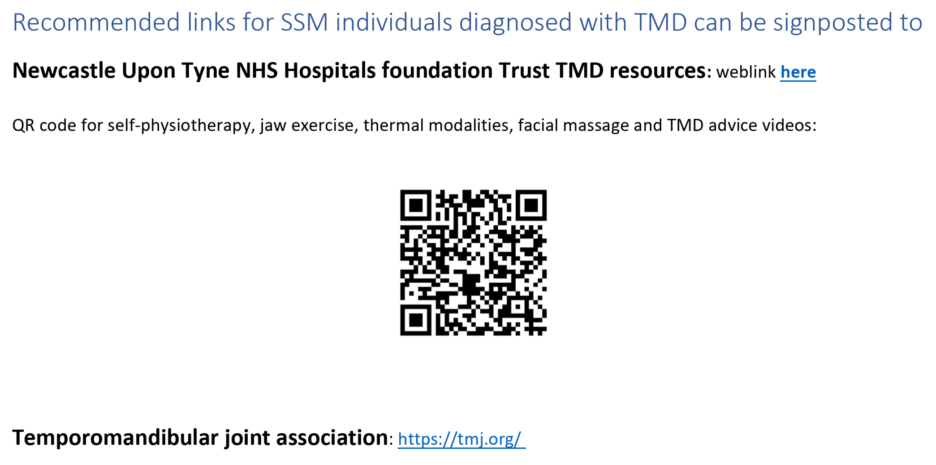

Slide 25




Managing chronic Myalgia Temporomandibular Disorder: a pragmatic randomised controlled trial of Botulinum toxin type A, lidocaine, and amitriptyline/gabapentin, with internal pilot and cost-effectiveness analysis

Slide 26
TMD Comorbid or secondary?
Migraine is comorbid in 55.3% of TMD patients and TTH in 30% Franaco et al. (2010) J Orofac Pain. 24(3):287-92

Slide 27
This section in ICOP is for patients who have pain exclusively in the facial region resembling
primary headaches but with no head pain. All others should be coded according to ICHD-3.

Slide 28
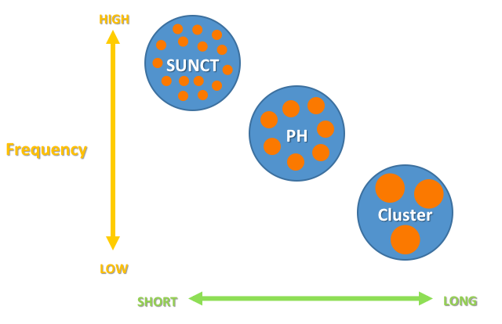
Orofacial pain resembling 1^{y} headaches
Multiple related conditions
1. Migraine (+/- aura)
2. Trigeminal Autonomic Cephalalgias
Cluster headache
Paroxysmal hemicrania
Hemicrania continua
SUNCT/SUNA

Slide 29
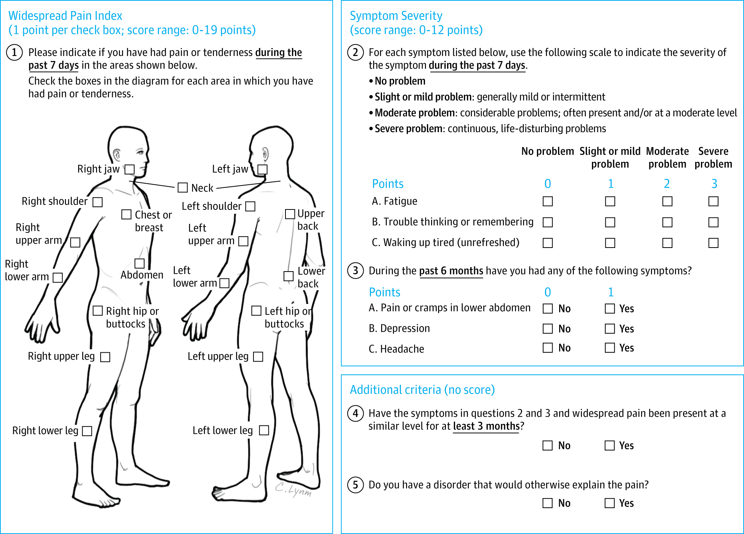

Slide 30
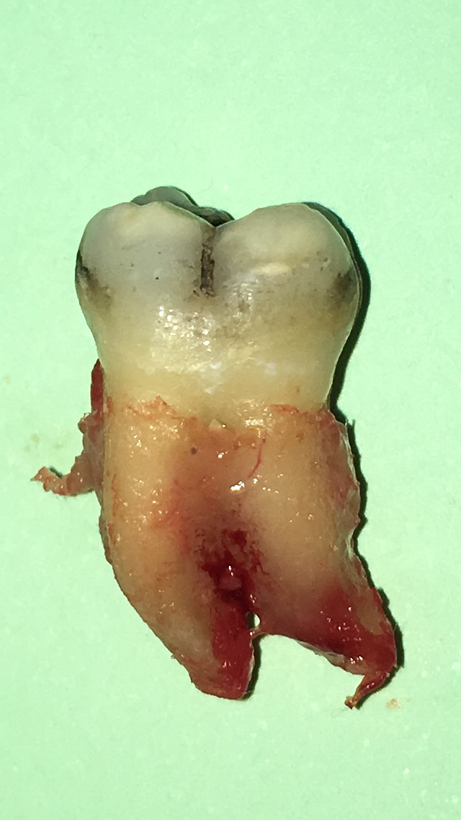
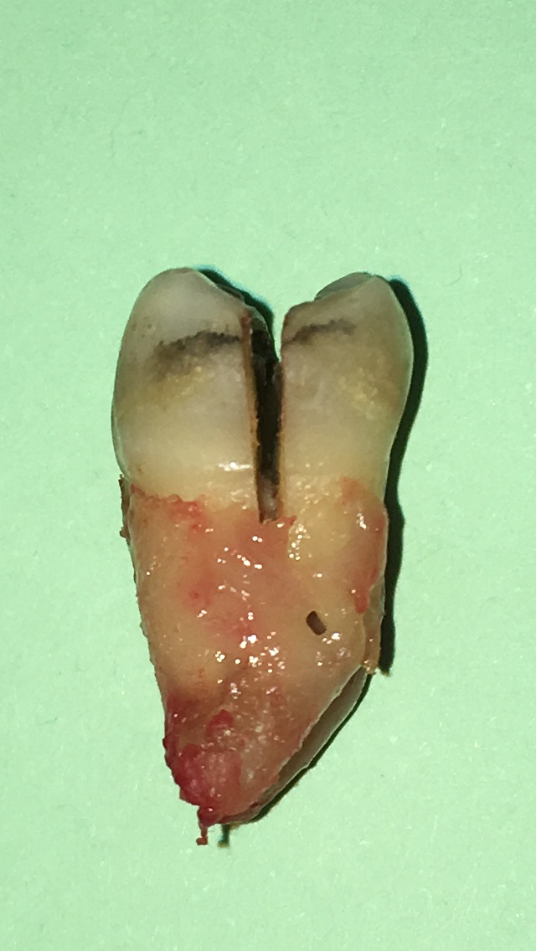
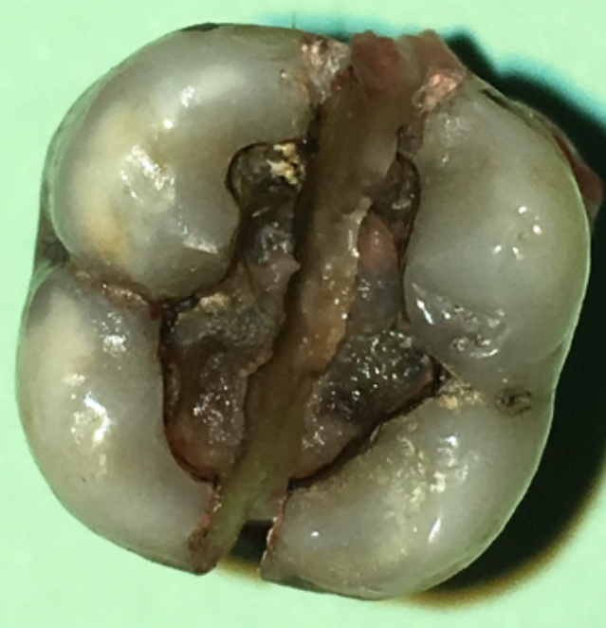
Cracked tooth syndrome

Slide 31
Mechanism of cracked tooth pain
On loading-
Relatively slow opening allows tubular fluid to fill crack -
Relatively painless

Slide 32
Mechanism of cracked tooth pain
On unloading-
Rapid closure forces tubular fluid through tubules into pulp -
Very painful

Slide 33
Cracked tooth symptoms
Short lasting, sharp pain in one tooth - one branch of trigeminal nerve
Last few seconds to minutes
Severe - stuns patient
Sharp, shooting, electric shock type pain
Worse with cold liquids, chewing

Slide 34
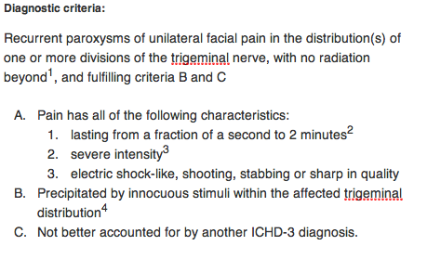
ICHD-3 Trigeminal Neuralgia

Slide 35
Causes of dental neuropathy
Root canal related
Implant related

Slide 36
Wisdom tooth related nerve injuries

Slide 37
Management of Orofacial Pain in a multidisciplinary clinic
Miss Deepti Bhargava
Consultant Neurosurgeon
Mr Francis O‘Neill
Consultant Oral Surgeon
Prof Bernhard Frank
Consultant in Pain Medicine

Slide 38
Declaration of Interests
Company Director
Pain Medicine Consultancy and Training Ltd
The company received fees and honoraria for
presentations at educational meetings and participation on advisory board meetings
from
Gruenenthal, UK

Slide 39
Notes:
A flowchart approach to facial pain disorders and treatment options. §: Facial pain corresponding to the chapter of the
International Classification of Orofacial Pain (ICOP). ENT: Ear, Nose, and Throat; Na-Blocker: sodium channel blocker;
SUNCT: Short-lasting unilateral pain attacks with conjunctival injection and tearing; SUNA: Short-lasting unilateral pain attacks with
autonomic symptoms.

Slide 40
Notes:
Diagnostic clues of orofacial pain disorders based on the chronological pattern. Dental orofacial facial pain (including pain
associated with other dentoalveolar and adjacent structures) can present with any chronic pattern. A common history in patients with
idiopathic facial pain is a previously inadequately-treated secondary facial pain, e.g. dental pain. TMJ: temporomandibular joint; SUNCT:
Short-lasting unilateral pain attacks with conjunctival injection and tearing; SUNA: Short-lasting unilateral pain attacks with autonomic
symptoms.

Slide 41
Definition of TN
Accord­ing to the third edition of the International
Classification of Headache Disorders, trigeminal neuralgia
is defined by recurrent severe paroxysmal pain restricted to
the tri­geminal territory, lasting from a fraction of a second
up to 2 min, with the pain described as electric shock-like,
stab­bing, or sharp, and being triggered by innocuous
stimuli.
Notes:
Francis already shown this definition

Slide 42
Epidemiology of Trigeminal Neuralgia
Population-based European studies found a lifetime prevalence of 0·16–0·3%16,17 of trigeminal neuralgia and an incidence of 12·6–27·0 per 100 000 person-years.
Trigeminal neuralgia affects women (60%) more than men (40%).
The average age of onset was reported to be 53–57 years.

Slide 43
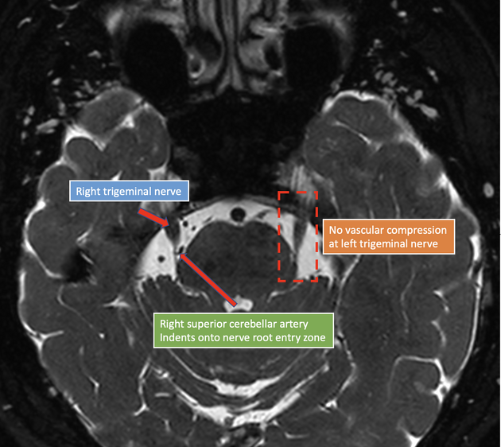
Definition of classical TN
Demonstration of vascular compression with morphological changes of the trigeminal nerve root on MRI or during surgery (pure paroxysmal/with concomitant continuous pain)

Slide 44
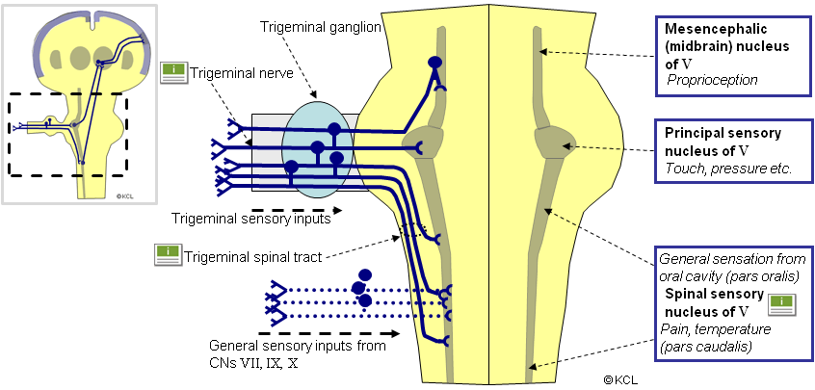
Notes:
Explain dense concentration of nuclei and preganglionic and post ganglionic portion of the trigeminal nerve. With lower end of brainstem the potential are which can be manipulated with high cervical SCS.

Slide 45
Definition of idiopathic TN
no diagnostic tests confirming lesion or disease that
can explain trigeminal neuralgia (pure paroxysmal/with concomitant continuous pain)
Definition of secondary TN
Demonstration of underlying disease known to be able to cause neuralgia by MRI or other diagnostic test—eg, tumour in the cerebellopontine angle, arteriovenous malformation, and multiple sclerosis (bilateral TN)

Slide 46
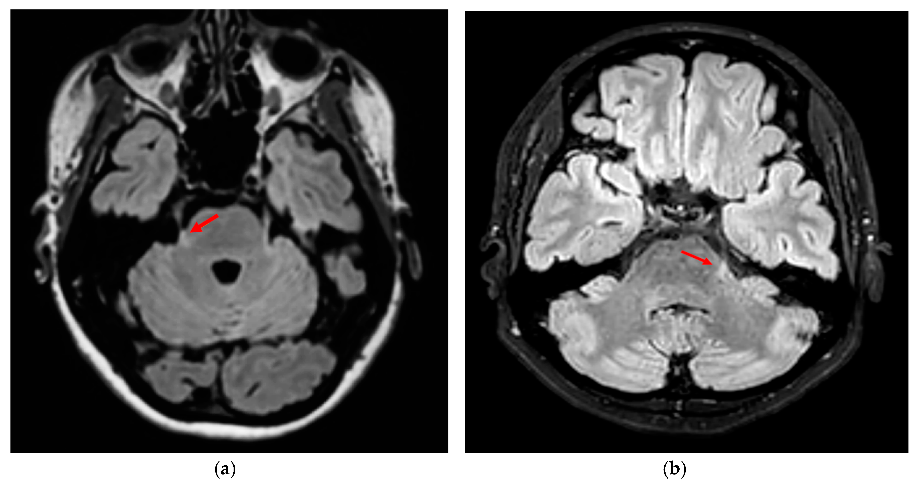

Slide 47
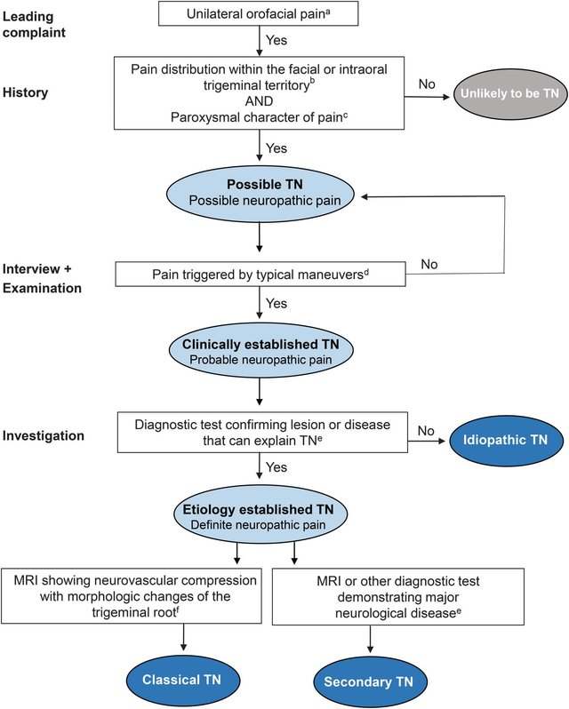

Slide 50
Clinical Titration Oxcarbazepine
Week | Morning (10 am) | Night (10 pm)
1 | 150mg | 150mg
2 | 150mg | 150mg
3 | 300mg | 300mg
4 | 300mg | 300mg
5 | 450mg | 450mg
6 | 450mg | 450mg
7 | 600mg | 600mg
8 | 600mg | 600mg
9 | 750mg | 750mg
10 | 750mg | 750mg
11 | 900mg | 900mg
12 | 900mg | 900mg
13 | 1050mg | 1050mg
14 | 1050mg | 1050mg
15 | 1200mg | 1200mg
16 | 1200mg | 1200mg
Oxcarbazepine can be titrated to a maximum of 2400mg if there are not side effects at 1200mg/day. If no benefit after 2 to 3 months stop or cross taper to lamotrigine.
https://www.medicines.org.uk/emc/product/8483/smpc

Slide 52
Clinical Titration Lamotrigine
Week | Morning (10 am) | Night (10 pm)
1 | 0 | 25 mg
2 | 25mg | 25mg
3 | 25mg | 50mg
4 | 50mg | 50mg
5 | 50mg | 75mg
6 | 75mg | 75mg
7 | 75mg | 100mg
8 | 100mg | 100mg
9 | 100mg | 125mg
10 | 125mg | 125mg
11 | 125mg | 150mg
12 | 150mg | 150mg
13 | 150mg | 175mg
14 | 175mg | 175mg
15 | 175mg | 200mg
16 | 200mg | 200mg
I check levels at the review appointment and would continue titration to at least 600mg/day. If no benefit stop, no down titration needed. Warn about rush and stop immediately if it occurs.
https://www.medicines.org.uk/emc/product/4736/smpc

Slide 53
Clinical Titration of Gabapentin in mg
Week | Morning (6 am) | Lunch (2 pm) | Night (10 pm)
1 | 300 | 300 | 300
2 | 300 | 300 | 600
3 | 600 | 300 | 600
4 | 600 | 600 | 600
5 | 600 | 600 | 900
6 | 900 | 900 | 900
7 | 900 | 900 | 1200
8 | 1200 | 900 | 1200
9 | 1200 | 1200 | 1200
10 | 1200 | 1200 | 1200
Try for 2 to 3 months and if there is no benefit start tapering again probably faster than titration but do not stop immediately to avoid triggering anxiety attacks
https://www.medicines.org.uk/emc/product/3195/smpc
https://fpm.ac.uk/sites/fpm/files/documents/2021-04/Gabapentin%202021.pdf

Slide 54
Clinical Titration of Pregabalin in mg
Week | Morning (10 am) | Night (10 pm)
1 | 75 | 75
2 | 75 | 150
3 | 150 | 150
4 | 150 | 225
5 | 225 | 225
6 | 225 | 300
7 | 300 | 300
8 | 300 | 300
Try for 2 to 3 months and if there is no benefit start tapering again probably faster than titration but do not stop immediately to avoid triggering anxiety attacks
https://www.medicines.org.uk/emc/product/10302/smpc
https://fpm.ac.uk/sites/fpm/files/documents/2022-09/Pregabalin-leaflet-2022.pdf

Slide 55
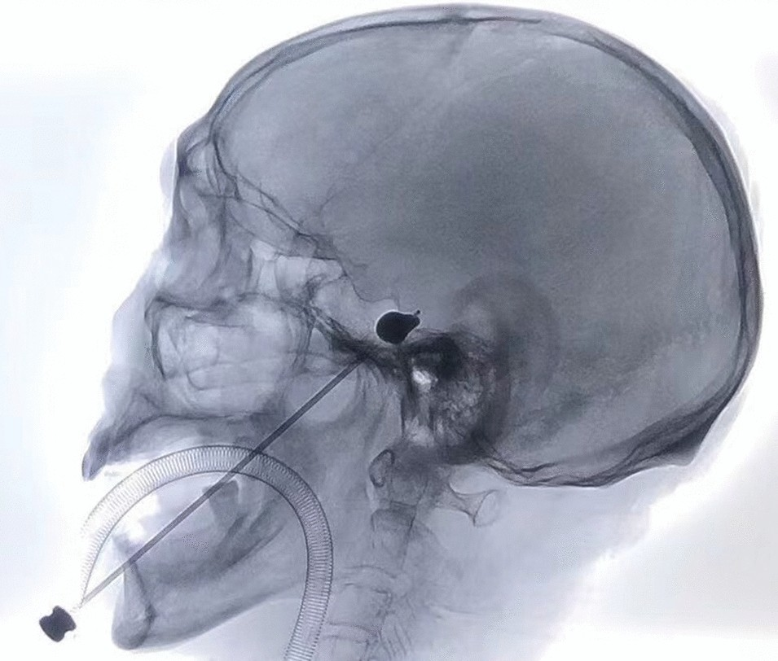
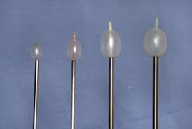

Slide 56
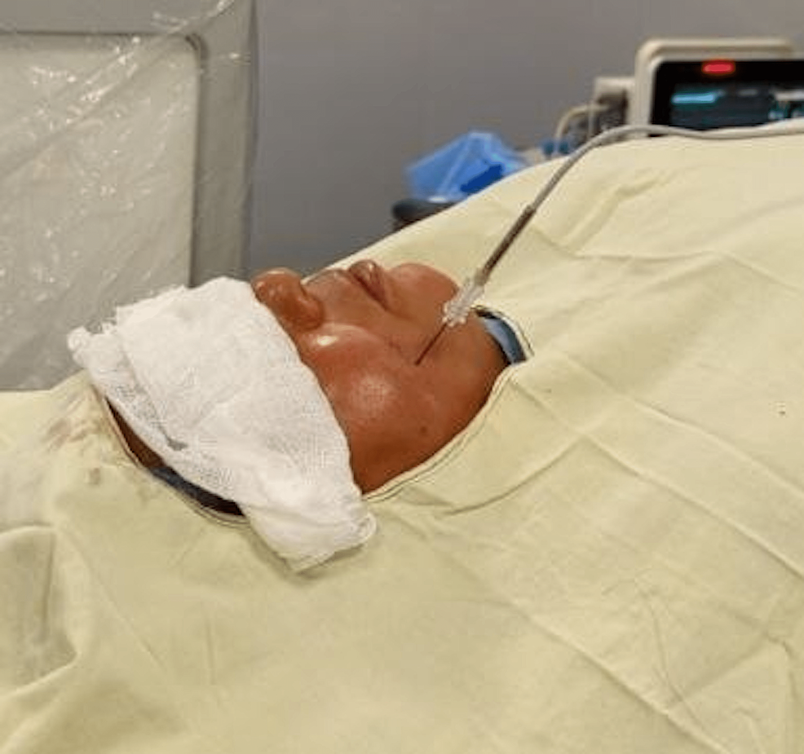
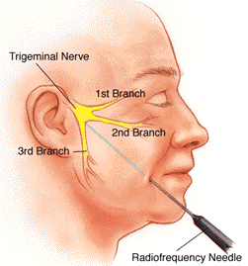

Slide 57
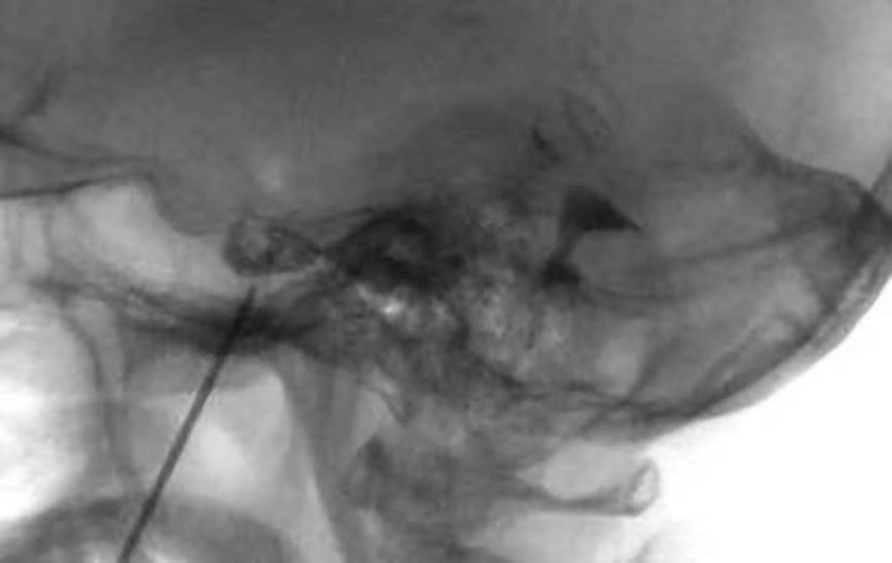
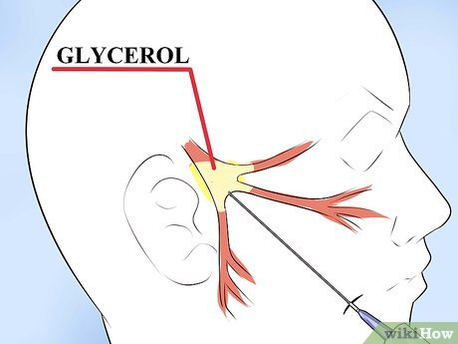

Slide 58
Gamma Knife Surgery
For the radiosurgical treatment of trigeminal neuralgia, the target can be either the proximal root entry zone of the trigeminal nerve (Fig. 4A,4B,4C) or the distal (retrogasserian) portion (Fig. 5). In theory, the portion of the nerve closer to the brainstem is myelinated by oligodendrocytes and therefore should be more sensitive to irradiation than the retrogasserian portion of the nerve, which is myelinated by Schwann's cells [2]. The proximal root entry zone is irradiated such that no more than 20% of the 50% isodose curve includes the brainstem. However, recent data suggest that the retrogasserian portion of the trigeminal nerve is also an adequate target. Because the 20% isodose curve is at the brainstem surface when this target is used, higher doses (90 Gy, as compared with 70-80 Gy for the proximal root entry zone) can be given to the nerve, resulting in less exposure to the brainstem [3]. Onset of therapeutic effect begins from 3 weeks to 3 months after treatment. In our experience, no changes were identified in the trigeminal nerve or brainstem at 3-6 months posttreatment except in two patients with multiple sclerosis (a known cause of trigeminal neuralgia) (Figs. 4A,4B,4C and 5).

Slide 59
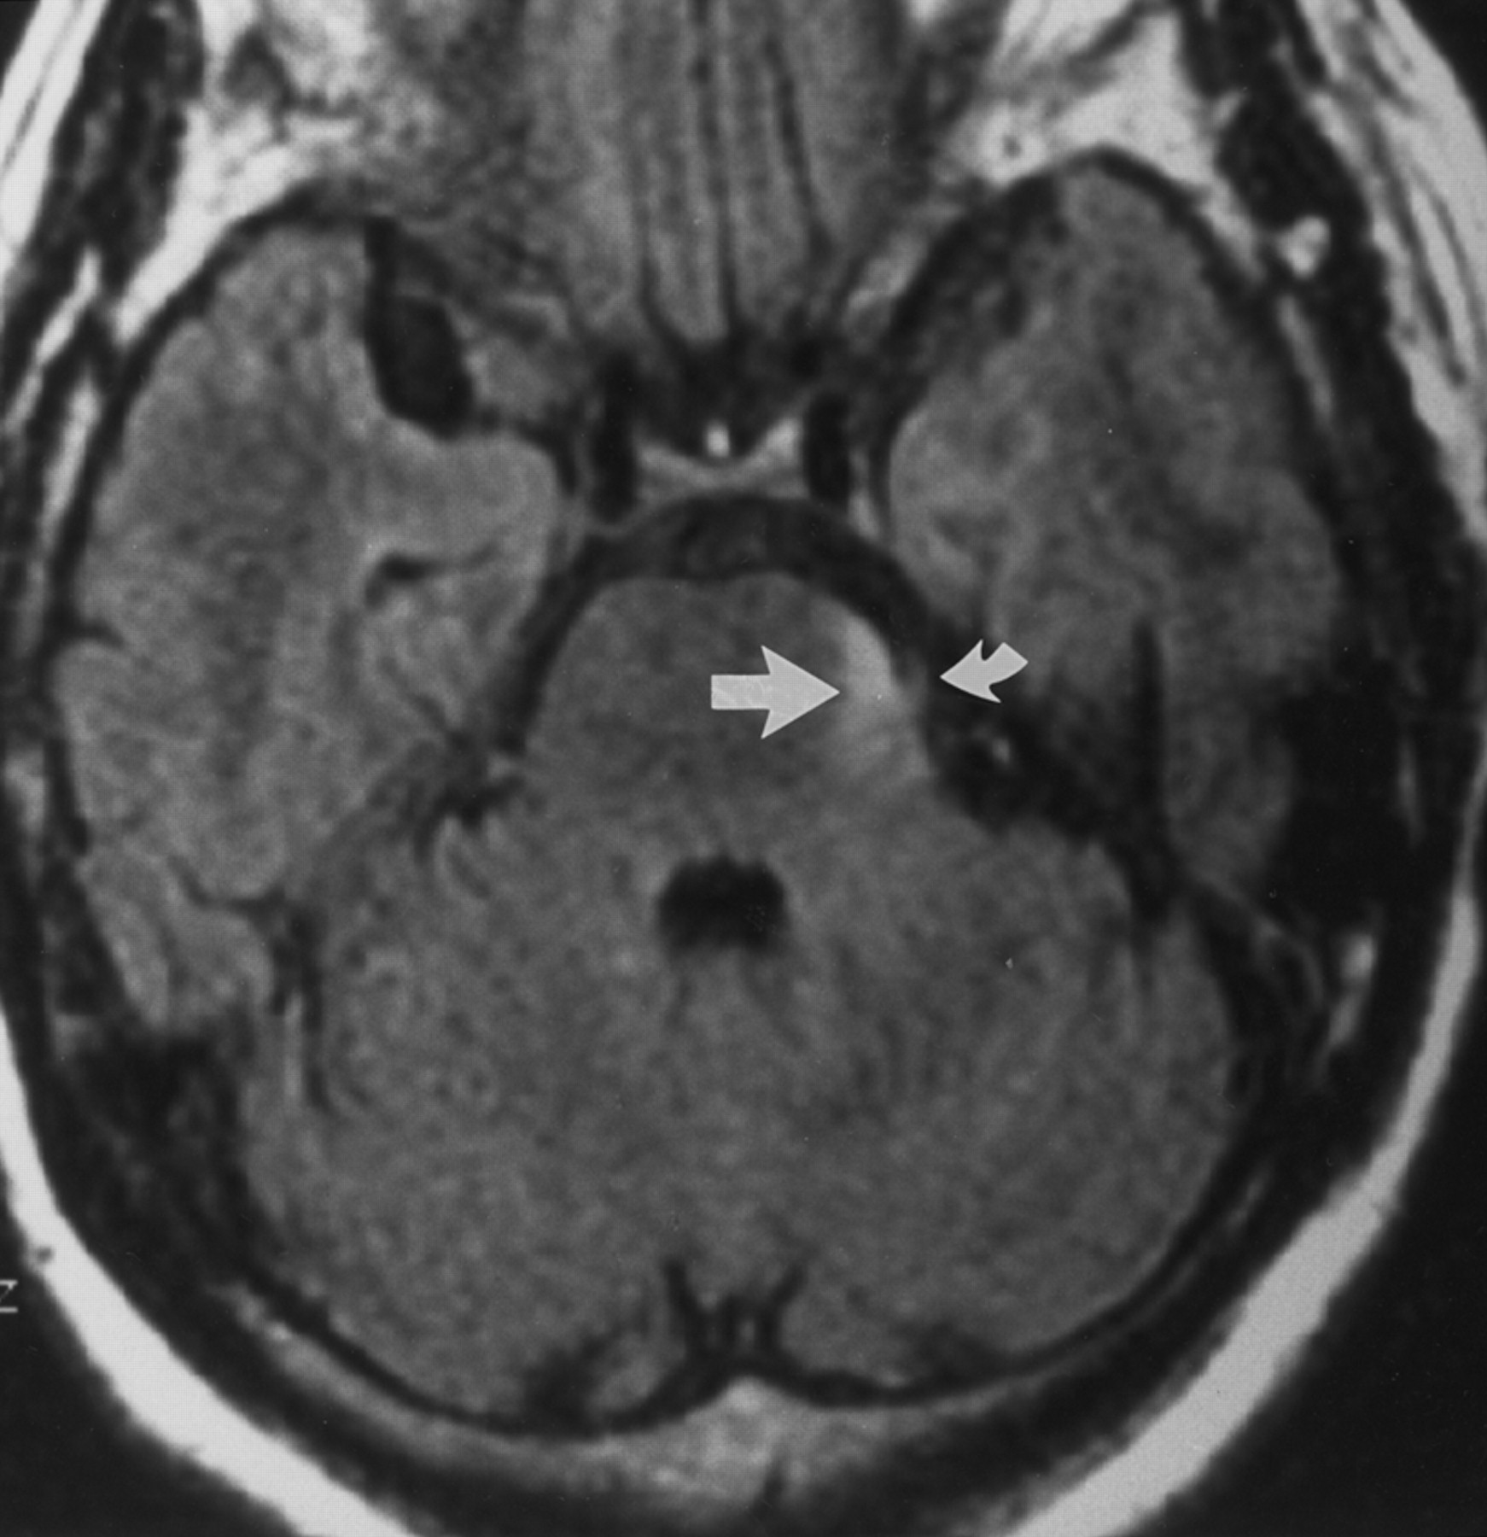
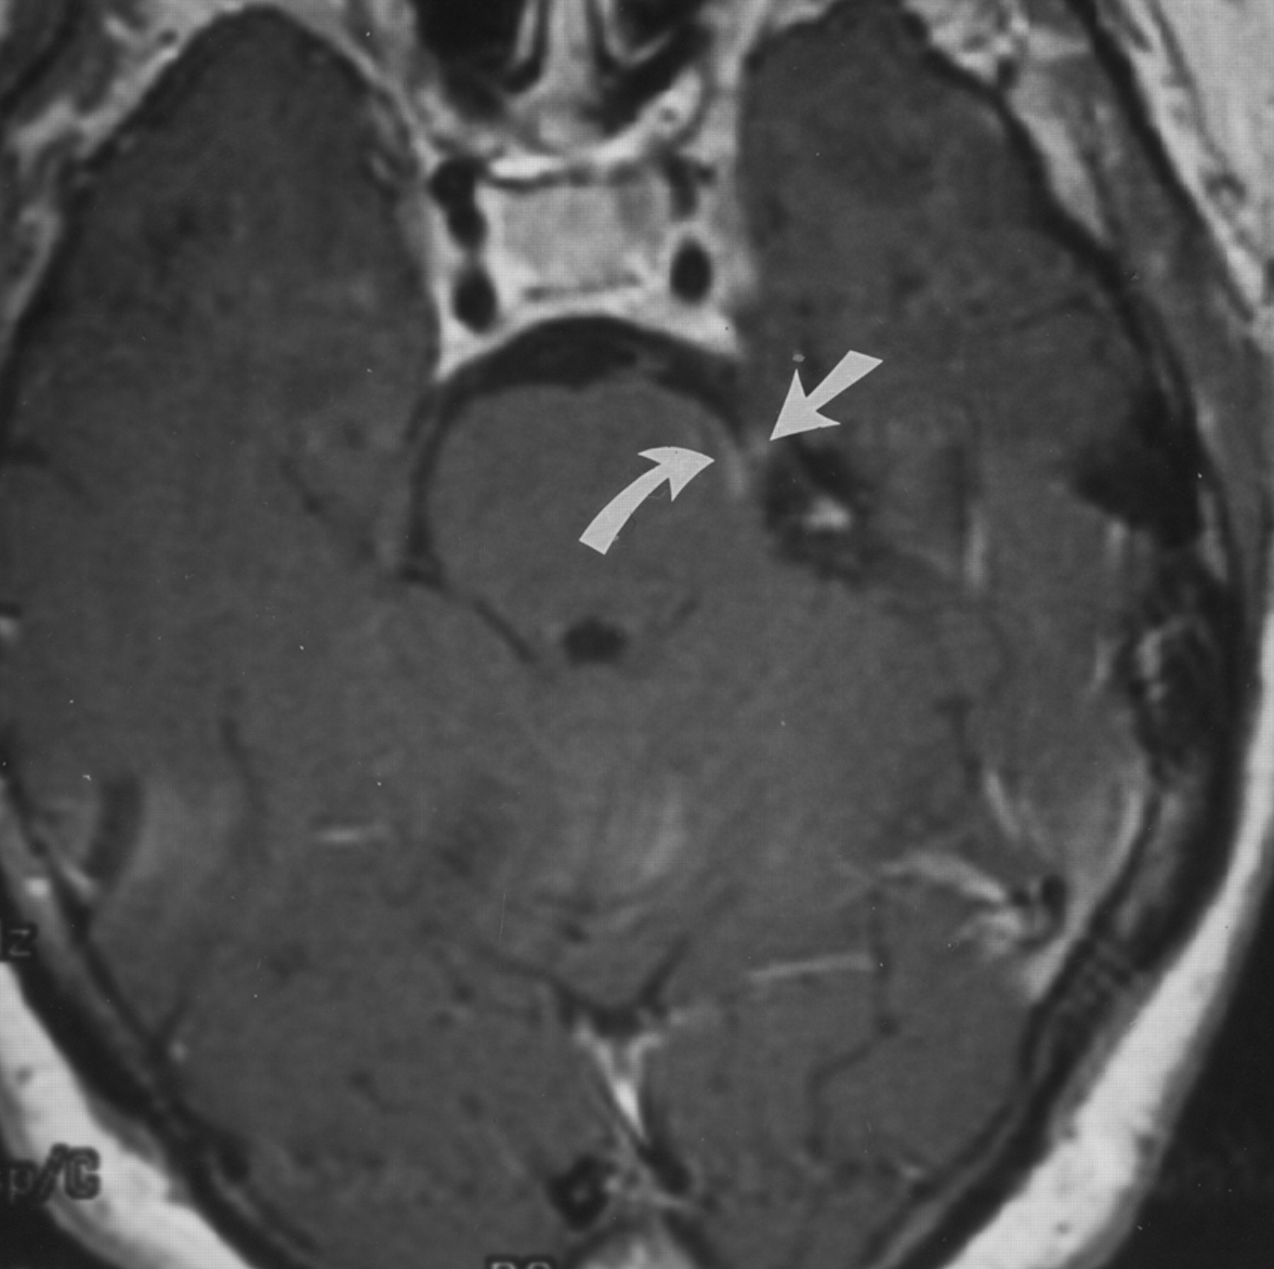
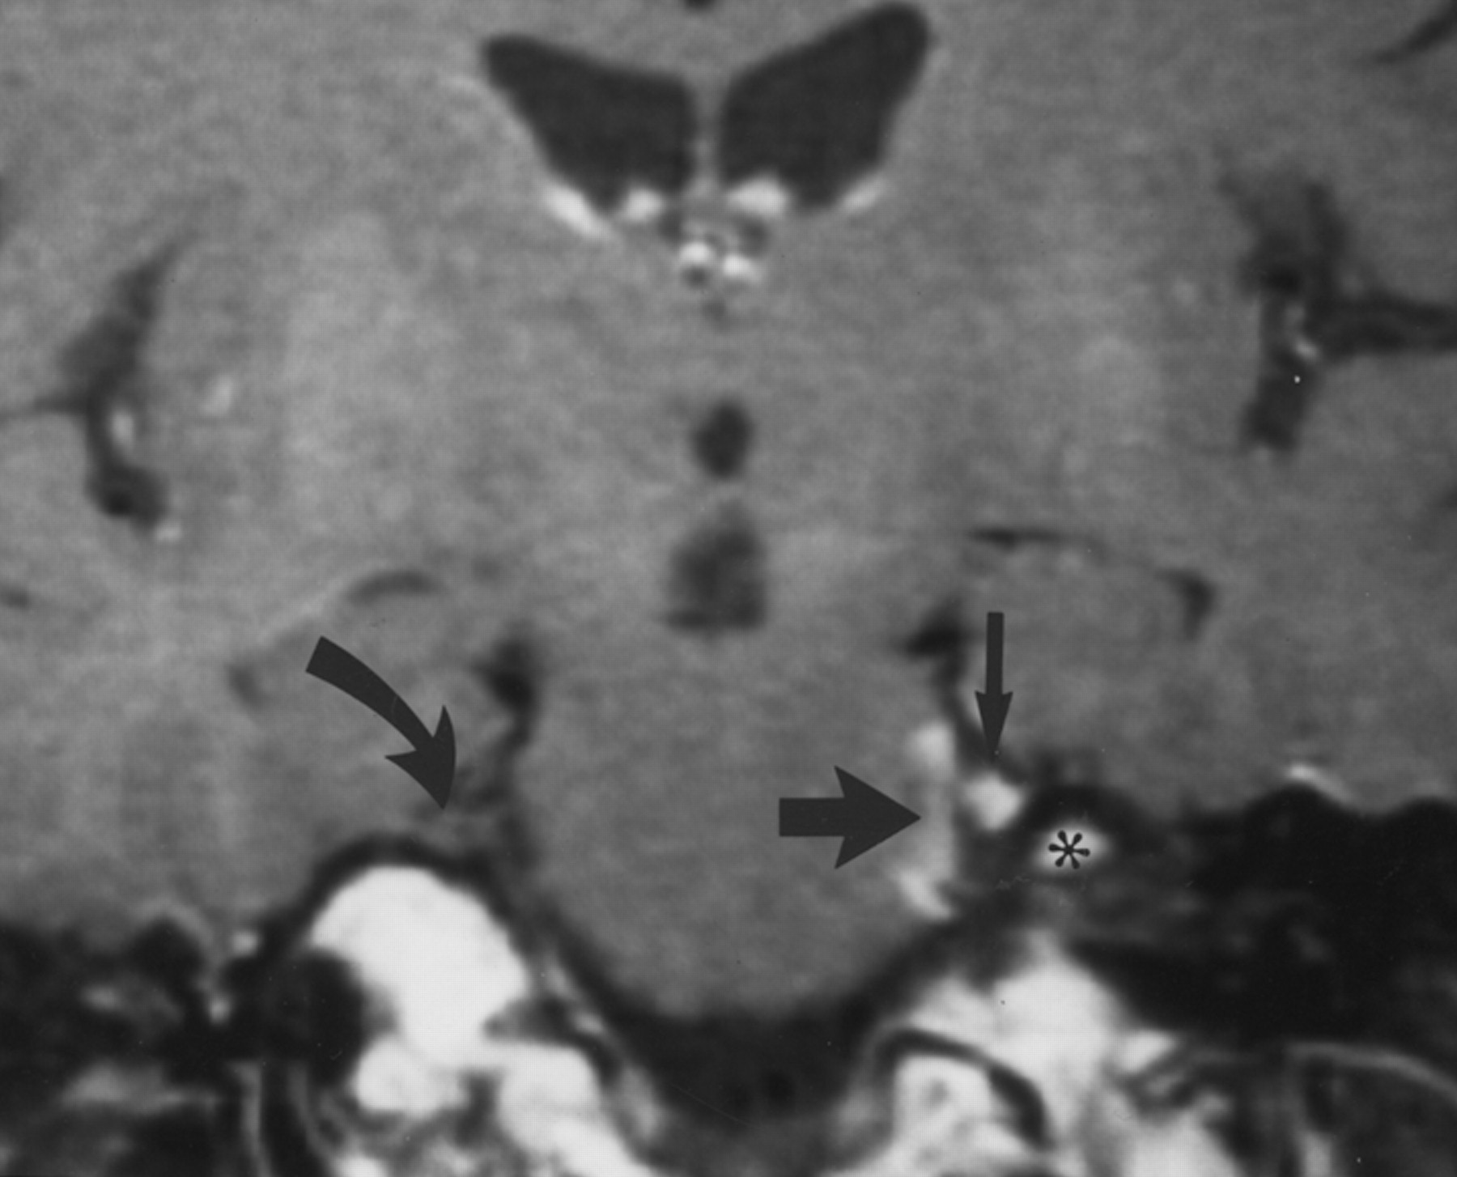
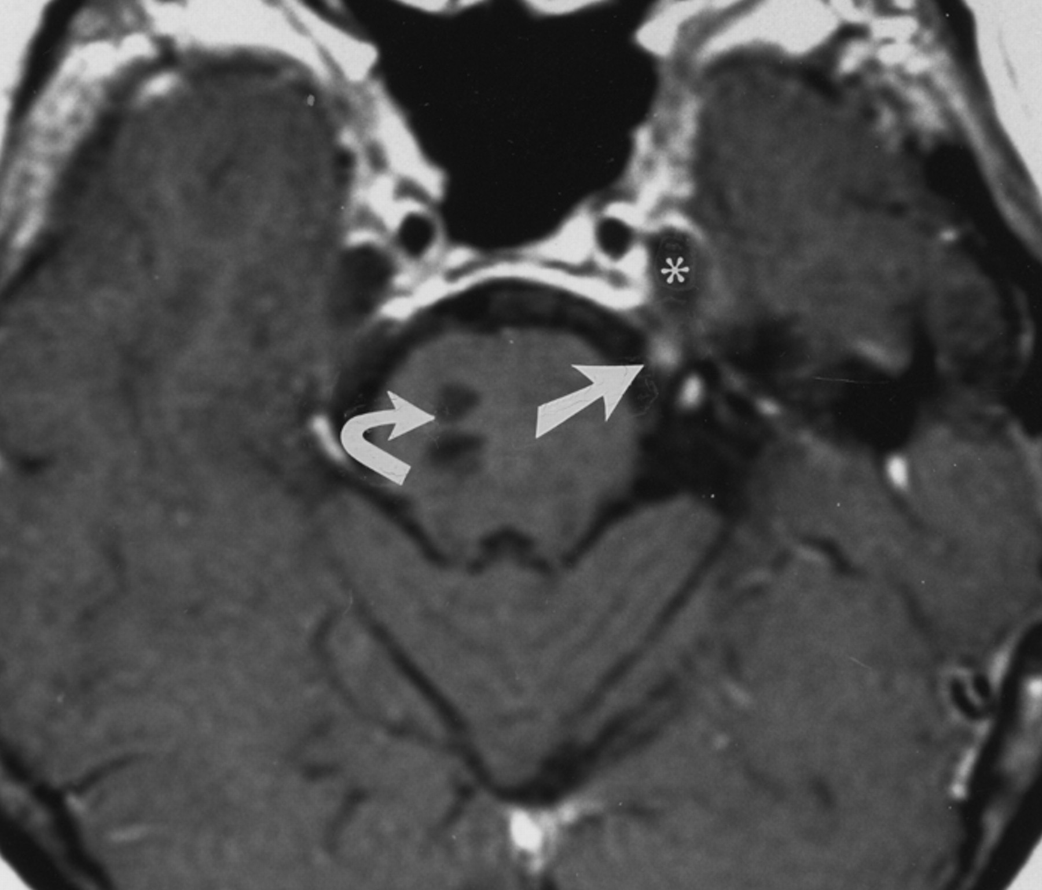
Notes:
Fig. 4A. —Radiosurgical treatment of root entry zone of trigeminal nerve in 56-year-old woman with left trigeminal neuralgia resulting from multiple sclerosis. Axial fluid-attenuated inversion recovery MR image (10002/142, TR/TE) shows hyperintensity (edema) in left pons (straight arrow). Left trigeminal nerve (curved arrow) is incompletely seen on image.
Fig. 4B. —Radiosurgical treatment of root entry zone of trigeminal nerve in 56-year-old woman with left trigeminal neuralgia resulting from multiple sclerosis. Enhanced axial T1-weighted MR image (616/13) shows abnormal enhancement in root entry zone of left trigeminal nerve (straight arrow) and adjacent pons (curved arrow).
Fig. 4C. —Radiosurgical treatment of root entry zone of trigeminal nerve in 56-year-old woman with left trigeminal neuralgia resulting from multiple sclerosis. Enhanced coronal T1-weighted MR image (550/13) shows abnormal enhancement in left trigeminal nerve (thin straight arrow) and adjacent pons (thick straight arrow). Treated nerve is enlarged as compared with right trigeminal nerve (curved arrow). Asterisk denotes hyperintense fatty marrow in skull base.
Fig. 5. —56-year-old woman with left trigeminal neuralgia caused by multiple sclerosis who underwent radiosurgical treatment of retrogasserian portion of trigeminal nerve. Enhanced axial T1-weighted MR image (400/15, TR/TE) shows abnormal enhancement in retrogasserian portion of left trigeminal nerve (straight arrow). Enhancement indicates radiation-induced breakdown of blood—nerve barrier. Chronic plaques are identified in right pons (curved arrow). Asterisk denotes cerebrospinal fluid in Meckel's cavity.

Slide 60
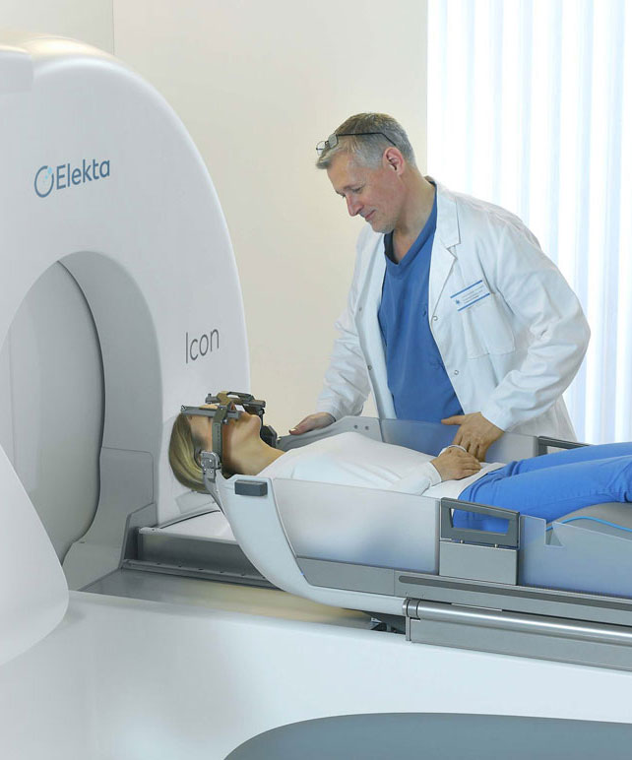

Slide 61
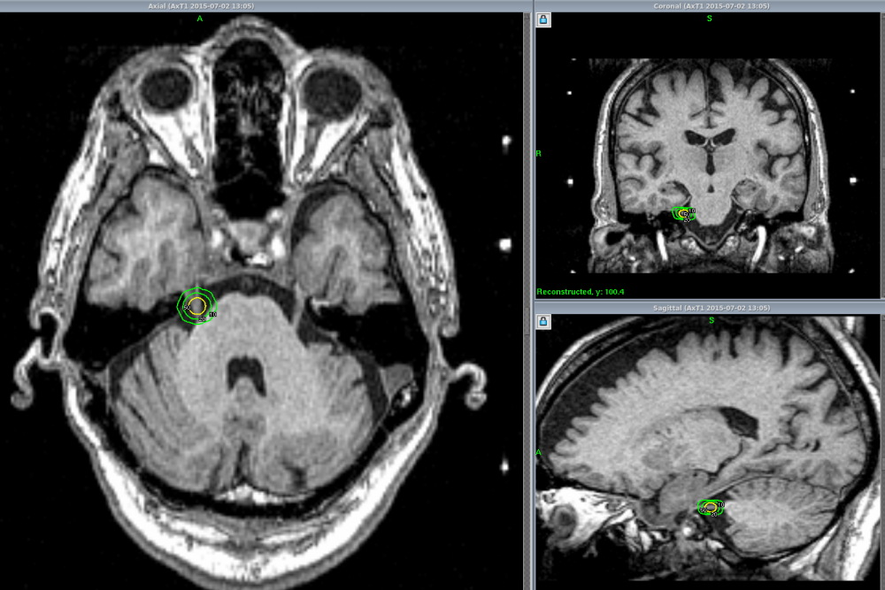
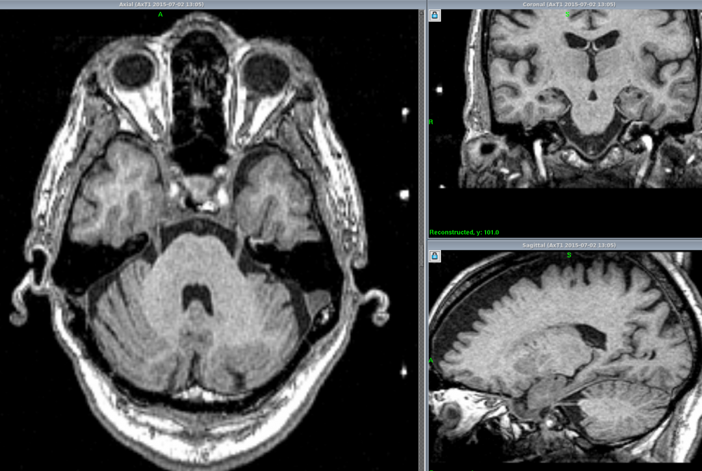
High resolution imaging provides excellent definition of the trigeminal nerve. The smallest of the collimators on the Gamma Knife (4mm) is used to irradiate the proximal trigeminal nerve at its entry into the pons (superior part of the brainstem). The results are very promising, though there still remains a role for open surgery (microvascular decompression). However, Gamma Knife treatment is more effective and less invasive than the percutaneous “injection” or radiofrequency lesions.
The first image on the page shows an MRI slice with the Trigeminal Nerve's clearly visible, the second image (seen by clicking on the next button at the base of the image) shows the radiation plan positioned (in this case) on the right sided nerve. Lots of checks are made during the procedure to ensure that the correct nerve is identified for treatment.

Slide 62
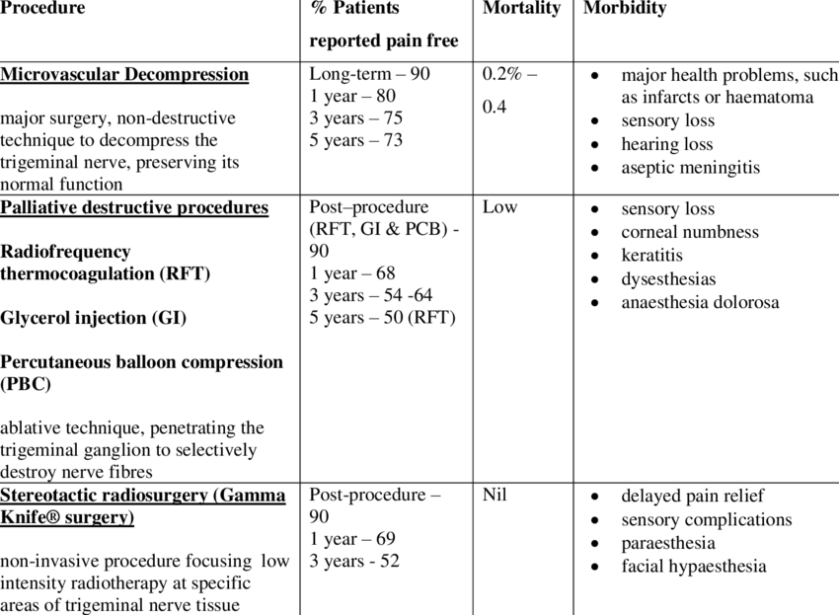
Notes:
Deepti slide

Slide 63
Epidemiology of Trigeminal Neuropathic Pain
Due to the heterogeneity of causes no clear data
Facial (V1 most commom) or ophthalmic PHN (5% of all PHN)
Post-traumatic trigeminal neuropathic pain (PTNP) with a prevalence of 1.55% to 13%
Dental provedures
Third molar removal
Implant surgery
Root canal therapy
Local anaesthetic placement
Zygoma fracture or blunt trauma to supraorbital and infraorbital nerve
Mandibular fracture or blunt trauma to mental nerve
Trauma to cutaneous branches of the trigeminal nerve
Diabetes and other systemic diseases affecting sensory nerves

Slide 64
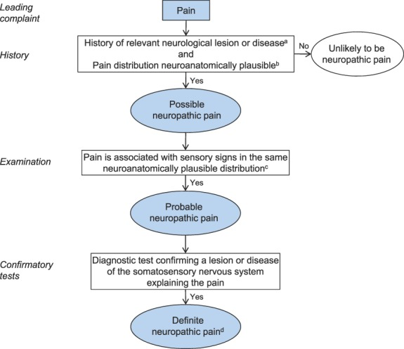

Slide 65
Trigeminal Neuropathy
PNS
High Cervical SCS
DBS
?Cryoneurolysis
?Cervical intrathecal Ziconotide

Slide 66



Slide 67



Notes:
Stereotactic placement of electrode into the central median nucleus/parafasciular complex (CMPF), the nucleus ventralis posteromedialis (VPM) and the nucelus ventalis posterolateralis (VPL) of the thalamus. Periventricular and periaqueductal grey of the brainstem (PAG/PVG)

Slide 68



Slide 69



Slide 70
Decision making in neuropathic/mixed pain
Confirm Diagnosis (MDT)
Has adequate trial of medication been done? Is pain medically refractory?
Botox if acceptable can be next less invasive step
Is pain peripheral or central origin, localized or widespread (b/l), secondary sensitization?
For focal, peripheral origin pain- PNS (or cryo)
For b/l pain peripheral origin- high cervical SCS for pure neuropathic or ITDDS if mixed pain
For central pain- DBS (ITDDS can be tried – not much literature, depends on patient acceptability of either treatment)

Slide 71
Persistent idiopathic facial pain
Formerly know as atypical facial pain.
Daily recurring pain for more than 2 hours, for more than 3 months, in the absence of any clinical neurologic deficit.
Dull, aching, nagging, burning, throbbing, and often stabbing.
Constant rather than episodic.
No Dermatomal pattern of the trigeminal territory and can spread to other regions.
Can be unilateral but 40% have bilateral pain without any autonomic features.

Slide 72
Tricyclic antidepressants
Nortriptyline (available in 10mg and 25mg tablets)
Main active metabolite of amitriptyline with more NA than SER reuptake inhibition.
Titrate slow and aim for 50mg nocte at least, if no side effects I continue titration to 75mg or even 100mg two hours before bed before weaning off if there is not benefit.
Imipramine (available at 10mg and 25mg tablets as well as 25mg/5ml solution)
Titrate slow and aim for 50mg nocte at least, if no side effects I continue titration to 75mg or even 100mg two hours before bed before weaning off if there is not benefit.
Amitriptyline (10 to 100mg) has lots of other pharmacological action and less well tolerated than NT. Can be tried if patient responded well to NT for cost reasons.
Clomipramine (10 to 100mg)
Lofepramine (70 to 210mg)
Trimipramine (10 to 100mg) quite sedative
I suggest to study the SPC for the individual TCA as they all have active metabolites except NT and slightly different S/E profiles. https://www.medicines.org.uk/emc/
Here the links to the FPM leaflets: https://www.rcoa.ac.uk/system/files/FPM-Nortriptyline_0.pdf
https://www.rcoa.ac.uk/system/files/FPM-Amitriptyline_0.pdf

Slide 73
Clinical Titration Nortriptyline, Amitriptyline and Imipramine
Week | Evening (8 pm)
1 | 10mg
2 | 10mg
3 | 10mg
4 | 10mg
5 | 25mg
6 | 25mg
7 | 25mg
8 | 25mg
9 | 35mg
10 | 35mg
11 | 35mg
12 | 35mg
13 | 50mg
Try for 2 to 3 months and if there is no benefit start tapering again probably faster than titration but do not stop immediately to avoid triggering anxiety attacks. Titration can be slower just using 10mg tablets.
https://www.medicines.org.uk/emc/product/13894/smpc
https://fpm.ac.uk/sites/fpm/files/documents/2022-09/nortriptyline-leaflet-2022.pdf

Slide 74
Serotonin and noradrenaline reuptake inhibitors (SNRIs)
Duloxetine (available in 20mg and 30mg versions).
Titrate slow and aim for 60mg nocte at least, if no side effects I continue titration to 60mg bd before weaning off if there is not benefit.
Venlafaxine (available at 37.5mg SR version).
Titrate slow by 37.5mg every two weeks in the morning.
To get the analgesic balance between the SRI and NRI effect patient need to be able to tolerate 225mg better 300mg.
I often due overlapping rotations from SSRI instead of weaning and restarting.

Slide 75
Clinical Titration Duloxetine 20mg
Week | Morning (10 am) | Night (10 pm)
1 | 0 | 20mg
2 | 0 | 20mg
3 | 0 | 40mg
4 | 0 | 40mg
5 | 0 | 60mg
6 | 0 | 60mg
7 | 20mg | 60mg
8 | 20mg | 60mg
9 | 40mg | 60mg
10 | 40mg | 60mg
11 | 60mg | 60mg
12 | 60mg | 60mg
Try for 2 to 3 months and if there is no benefit start tapering again probably faster than titration but do not stop immediately to avoid triggering anxiety attacks.
https://www.medicines.org.uk/emc/product/15006/smpc
https://fpm.ac.uk/sites/fpm/files/documents/2023-02/duloxetine-leaflet-2022-v3.pdf

Slide 76
Clinical Titration Venlafaxine
Week | Morning (8 am)
1 | 37.5mg
2 | 37.5mg
3 | 75mg
4 | 75mg
5 | 112.5mg
6 | 112.5mg
7 | 150mg
8 | 150mg
9 | 187.5mg
10 | 187.5mg
11 | 225mg
12 | 225mg
Try for 2 to 3 months and if there is no benefit start tapering again probably faster than titration but do not stop immediately to avoid triggering anxiety attacks. I increase it sometimes to 300mg if well tolerated but no clear benefit at 300mg before giving up on it.
https://www.medicines.org.uk/emc/product/9983/smpc

Slide 77


Slide 78
https://www.ncbi.nlm.nih.gov/pmc/articles/PMC4549742/
Notes:
(A) Illustrated mechanism of peripheral and central nerve system sensitization. Noxious stimulation may lead to peripheral sensitization through release of neuropeptides and inflammatory mediators. The peripheral sensitization may result in sensitization of the central nerve system. SP indicates substance P; CGRP, calcitonin gene-related peptide; TRPV1, transient receptor potential vanilloid 1. (B) The antinociceptive mechanism of botulinum neurotoxin (BoNT) in the treatment of neuropathic pain including decrease in peripheral SP, CGRP, glutamate, TRPV1 receptor translocation, leading to direct block of peripheral sensitization. As substance P and CGRP secretion are blocked within central nerve system, central sensitization is also indirectly reduced.

Slide 79
Notes:
BoNT uptake mechanism and targets: BoNT consists of heavy chain (HC) and light chain (LC). Heavy chain binds to the ganglioside and protein receptors (1) and is endocytosed (2,3). The acidic environment in the endosomes leads to conformational changes resulting in membrane insertion of the HC and LC translocation into the cell cytosol (4). In the cytosol, the disulfide bond linking HC and LC is reduced, releasing the LC into the cytosol. The LC of BoNT-B/D/F/G specifically cleaves VAMP on the vesicle, BoNT-A/C/E cleaves SNAP-25 and BoNT-C also cleaves syntaxin on plasma membranes (5), thus inhibiting the vesicular fusion and blocking the neurotransmitter release (6). Not shown is the potential role of cytosolic SNAREs mediating the trafficking of receptor and channel subunit protein to the membrane in lipid raft scaffolding.

Slide 80
https://www.ncbi.nlm.nih.gov/pmc/articles/PMC4663519/
Notes:
Schematics of possible mechanisms of action of peripherally applied BoNT/A1 and /B1 upon nociceptive processing: (A) Periphery: (1) At the site of injection BoNTs are endocytosed into the local peripheral afferents, where they cleave SNAREs, thereby inhibiting vesicular fusion and exocytosis of neurotransmitters. This in turn would block vasodilation, plasma extravasation, and activation local inflammatory cells. (2) BoNTs may also regulate SNARE-mediated cell surface expression of a variety of receptors and channels implicated in peripheral sensitization (e.g., TRPV1). (3) Another hypothesis is that BoNTs may enter local resident cells (e.g., mast cells) or migrating cells (e.g. neutrophils) otherwise evoked by injury or inflammation and may directly block the release of cytokines or pro-inflammatory molecules. These release products can activate and sensitize local small afferent terminals. (B) Spinopetal transport: (4) Following endocytosis in the peripheral terminals, some of the BoNT appears to undergo retrograde transport along the axon. (5) These transported BoNTs reach the dorsal root ganglion (DRG) neuron and cleave SNAREs in the DRG neurons to block vesicular release of neurotransmitters into the extracellular milieu of the DRG, which would otherwise activate and (6) excite the neighboring sensory neurons or (7) closely associated satellite cells. (8) BoNT may further undergo intra-vesicular axonal trafficking to the central terminals, where again by truncating respective SNAREs, it would inhibit neurotransmitter release, thereby preventing the activation of second order neurons and neighboring glial cells. (C) Trans-synaptic actions: BoNTs can undergo long axonal transport in intact form in non-acidic endosomes and may possibly undergo transcytosis centrally either to the (9) second order neurons or (10) glial cells. Activated glial cells release a plethora of pro-algesic substances (cytokines, chemokines, lipids, amino acids) serving to initiate and maintain central sensitization. (11) BoNTs may also get transcytosed to excitatory (glutamatergic) or inhibitory (GABA/glycinergic) interneurons and may act to block their neurotransmitter release resulting in a loss of excitatory drive or inhibitory control, respectively). Cleaved SNAREs in the second order neurons may interfere with fusion of endosomes that carry the receptors to the membrane. (12) Though speculative, if there is transcytosis to second order projection neurons, it is a reasonable hypothesis that these BoNT are transported to distal terminals which lie in the brainstem and further block the neurotransmission into the brainstem and higher centers.

Slide 81


Slide 82
Notes:
Go through the titration process slowly but into therapeutic range.

Slide 83
Botulinum toxin type A
11 RCTs evaluated the efficacy of a single administration of BTX-A (25–300 units intracutaneously/subcutaneously in the painful area) in peripheral neuropathic pain. TN studies excluded (NNT of 2.7 (1·8–5-1) for 9 studies) with a low placebo effect. Safety was generally excellent.
Lancet Neurol. 2025 Feb;14(2):162-73

Slide 84
Lancet Neurol. 2016;15(6):555-65.

Slide 85
Ann Neurol. 2008;64(3):274-83.

Slide 86


Slide 87


Slide 88


Slide 89


Slide 90



Slide 92
Outcome from botox injection up to 22.05.2025
Started with first patient in January 2017
Steady increase with significant increase after joining the facial pain clinic
258 patient in total so far
163 Facial Pain patients
We use a 7-point Likert Scale to evaluate outcome
Very much worse to Very much improved
The main reason for not having a second injection is a facial drop
Some people did not tolerate the injection of did not want a second one
Reason for stopping not recorded in current spreadsheet but will look into this in a flow chart tracking patient through the injections
12 patient have passed away due to their underlying condition (cancer) or old age
9 patients are injected on the dental list as they need local anaesthetic block

Slide 93
Facial Pain Diagnosis
Diagnosis | Number | Percent
Auricular neuropathic pain | 3 | 1.8
Cluster Tic | 1 | 0.6
First Bite Syndrome | 2 | 1.2
MVD Scar Pain | 1 | 0.6
Nervus Intermedialis Neuralgia | 1 | 0.6
Post Herpetic Neuralgia | 32 | 19.6
Persistent Idiopathic Facial Pain | 6 | 3.7
SUNCT | 1 | 0.6
Trigeminal Neuralgia | 23 | 14.1
Trigeminal Neuropathic Itch | 1 | 0.6
Trigeminal Neuropathic Pain | 92 | 56.4
Total | 163 | 100

Slide 94
Outcomes based on PIC
Outcome | Number | Percent
Awaiting Second Injection | 11 | 6.7
Improved | 8 | 4.9
Much improved | 29 | 17.8
No benefit | 74 | 45.4
Very much improved | 41 | 25.2
Active Treatment | 71 | 43.6
Treatment Stopped | 92 | 56.4
Treatment Stopped (deceased excluded) | 80 | N/A
Male | 60 | 36.8
Female | 103 | 63.2
Second Injection Not done | 21 | 13

Slide 95
Demographics
 | N | Minimum | Maximum | Mean
Age | 163 | 18 | 94 | 58.47
Units 1st Injection | 163 | 15 | 250 | 110.5
Units 2nd Injection | 130 | 25 | 200 | 108
Day between injection | 130 | 56 | 1004 | 131.8

Slide 96
Cost implications
I do these injections as day case procedures on Jefferson which incorporates the cost for Botox in the tariff which can be quite high depending on co-morbidities many of these patients have.
Compared to high dose capsaicin (£500+VAT) and lidocaine patches (£185 to £652+VAT) 200 IU of BOTOX A (£276.4+VAT) every three months are cheap. WCFT gets a discount for BOTOX.
Alternative treatments are having there own problems and added costs:
Opioids (no evidence beyond short term, dependency etc).
Neuromodulation (no evidence, need for trial, post implant care, scanning etc).

Slide 97
Future Developments
Better toxins via genetic redesign that are not paralytic (higher dose can be used).
Better patient selection via sensory profiling and phenotyping.
This would reduce the trial and error approach.
Earlier treatment might improve patients significantly without the need for repeated injections.

Slide 98

Further Reading and References
Wall & Melzacks’s Textbook of Pain, Stephen McMahon et al, 6th Edition 2014, Section Vi: Chapter 56-60, pages 792 to 859
Zakrzewska and Nurmikko: Trigeminal Neuralgia and Other Cranial Neuralgias, Oxford Pain Management Library, 2022
Truong et al: Botulinum Toxin Therapy, Third Edition, Cambridge University Press, 2023, Chapter 30 – Use of Botulinum Neurotoxin in Neuropathic Pain
Bendtsen et al: Advances in diagnosis, classification, pathophysiology, and management of trigeminal neuralgia, , Lancet Neurology 2020
Peng and Oppermann: Orofacial pain disorders: An overview and diagnostic approach, Cephalgia Reports, 2022
Wei et al: The efficacy and safety of botulinum toxin type A in treatment of trigeminal neuralgia and peripheral neuropathic pain: A meta-analysis of randomised controlled trials
Meredith Barad and Marcela Romero-Reyes: Orofacial Pain, Neurology, 2024
Soliman et al: Pharmacotherapy and non-invasive neuromodulation for neuropathic pain: as systematic review and meta-analysis, Lancet Neurology, 2025

Slide 99
Thank you for your attention!
Any Questions?

