Slide 1

Multidisciplinary Management of Chronic Pelvic Pain
Dr Selina Johnson
NEPMG
Friday 20th June, 2025
Selina.johnson@nhs.net

Slide 2
What's coming up
CPP and its impact
Case for multidisciplinary care
Challenges
MDT in action

Slide 3


‘persistent pain in the lower abdomen or pelvis lasting at least 3-6 months’ EAU

Slide 4
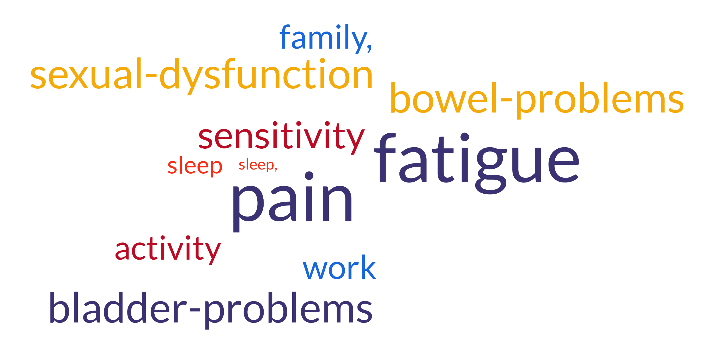
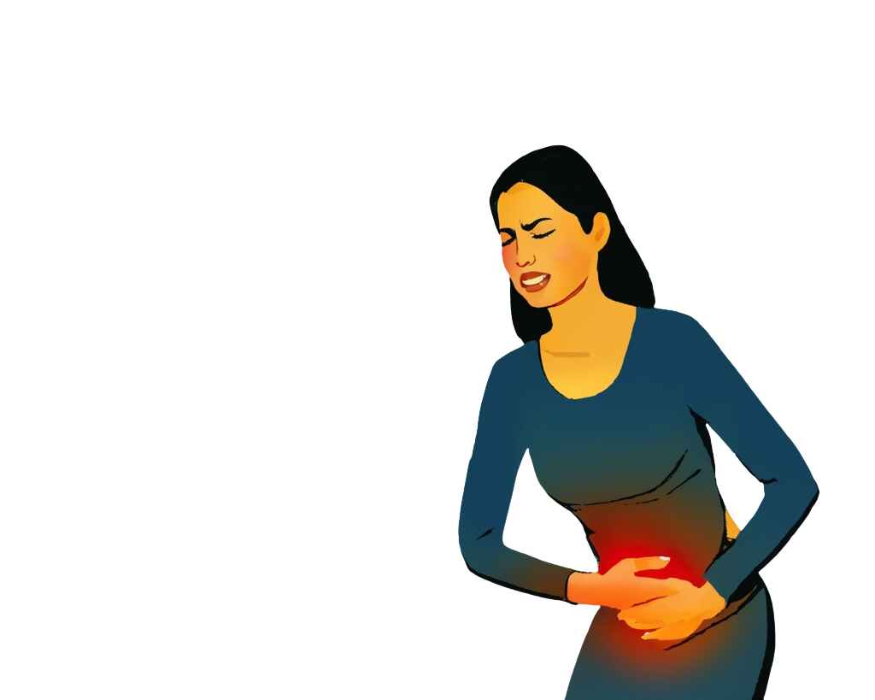
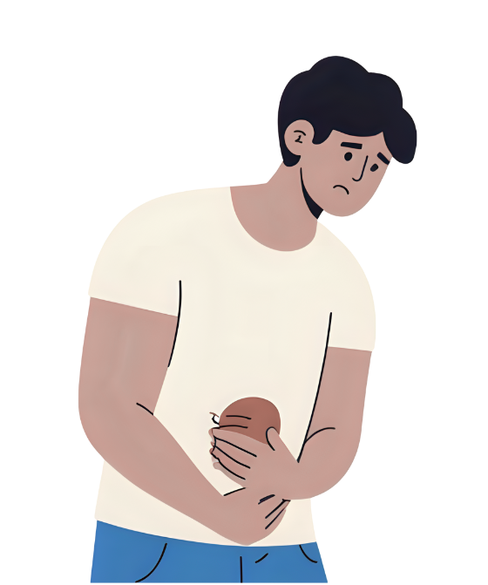
Stigma/ shame
Relationships
Identity
‘Unable to function at life, existing not living’
‘demoralising, alone, hopeless’
‘interfering with life activities, mentally exhausted’
‘no end, no control’
Notes:
Living with CPP can be extremely deliberating and people report many challenges.
Whilst many of themes are similar to other chronic pain conditions there are certain themes that are more prevalent and relevant in CPP.

Slide 5

endometriosis, adenomyosis, pelvic inflammatory disease, polycystic ovaries, Prostatitis, pudendal neuralgia
Neuropathic
nerve entrapment, injury
Nociceptive
tissue injury, inflammation
Poor correlation between disease burden/ tissue damage and symptom severity Coxon 2018
No pathology
Notes:
CPP is often associated with various underlying pathologies such as endometriosis, adenomyosis, pelvic inflammatory disease, polycystic ovaries, etc.
And whilst mechanisms such as neuropathic and nociceptive pain describe initiating mechanism(s)
We also understand there is poor correlation between disease burden and actual tissue damage.
We also understand it can exist without any identifiable underlying pathology, in up to 55% of cases.

Slide 6
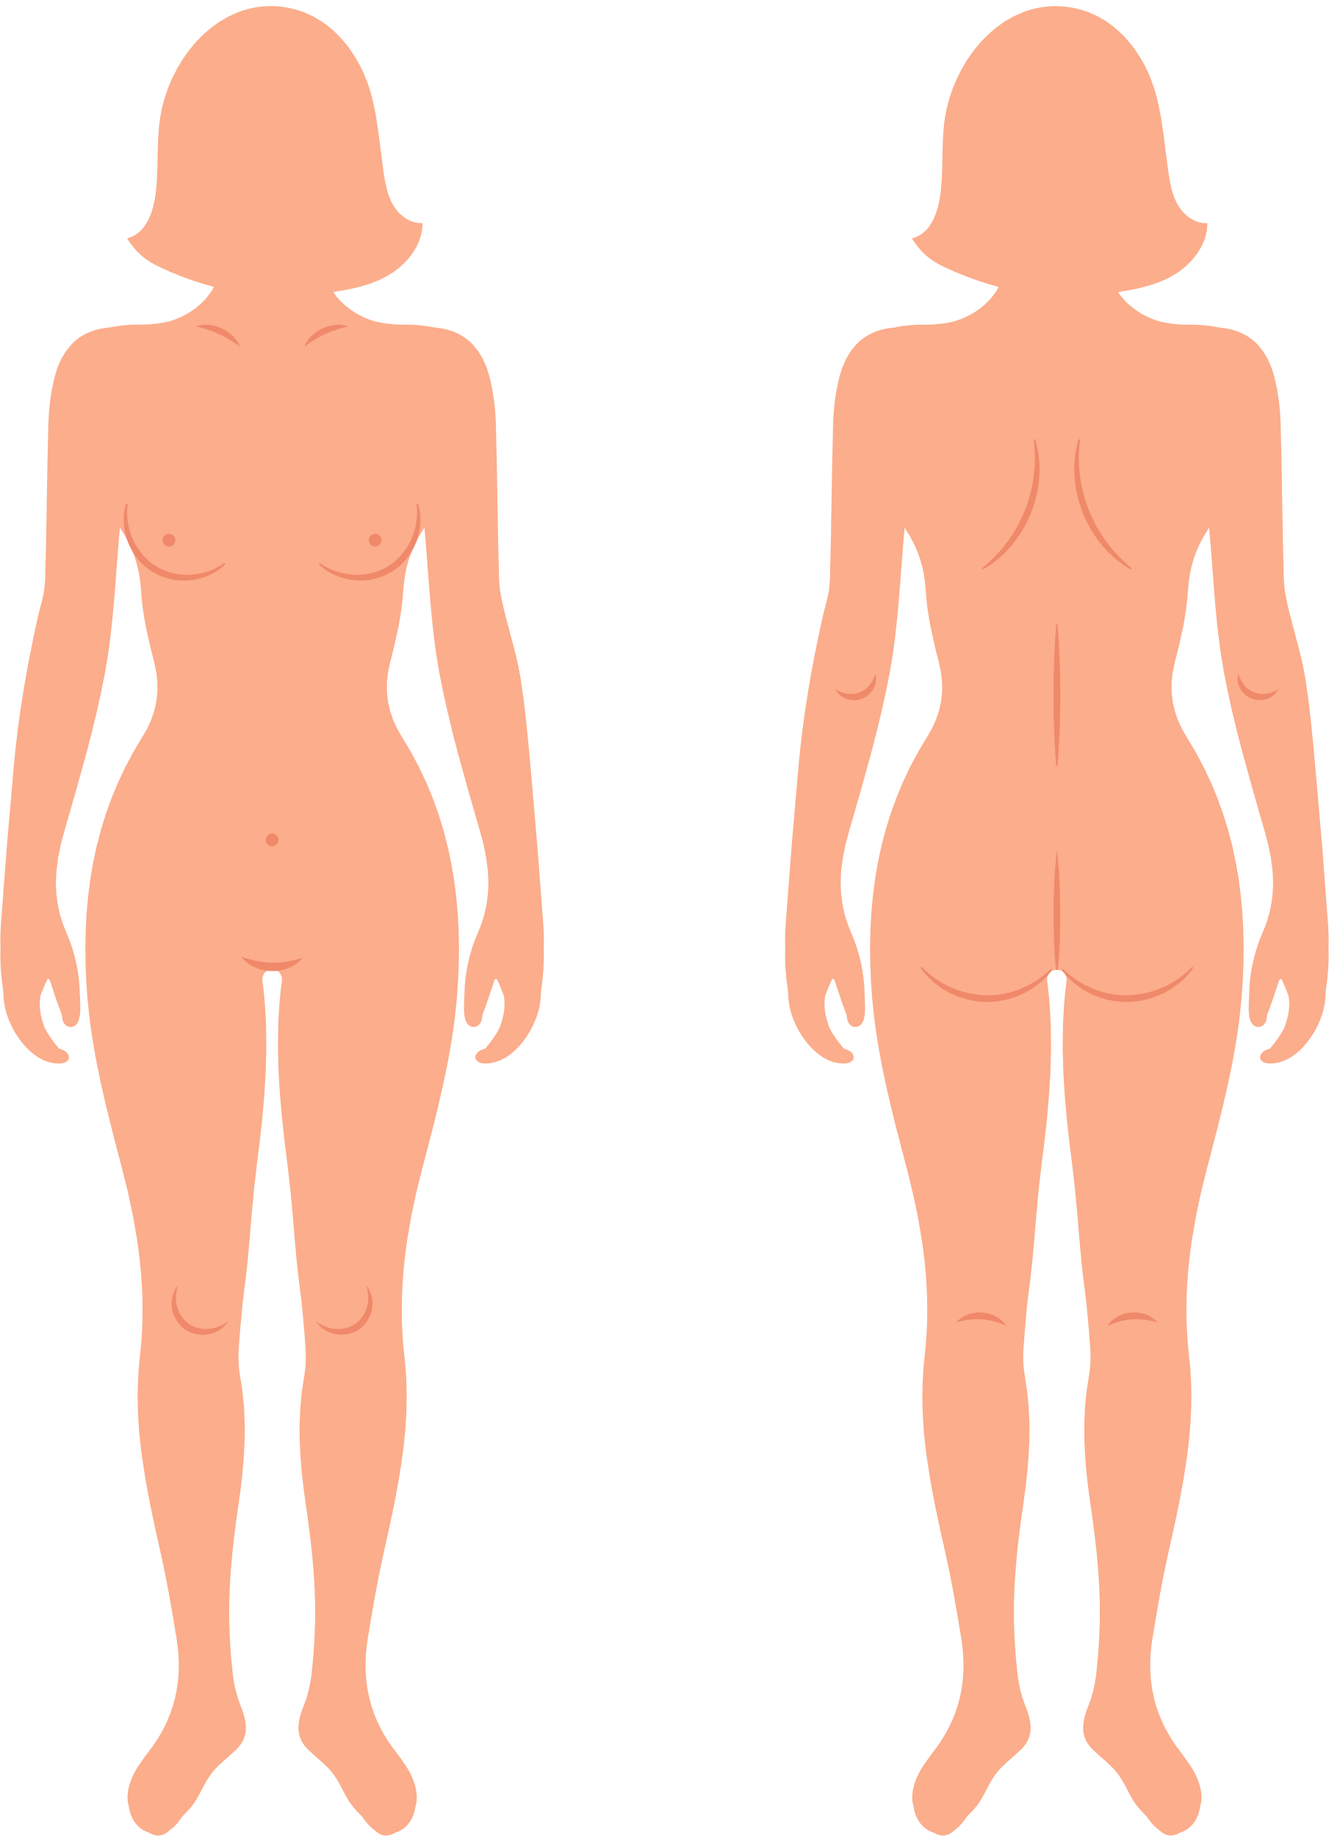


Nocioplastic
Altered nociception despite no clear tissue damage
CPP associated with pain in 3 + sites= less responsive to med, hormonal treatments and localised treatments in isolation
Orr 2022
Dysmenorrhea*
Dysuria*
Dyspareunia*
>60 % report pain in 3+ body regions
n=303, Till et al 2023.
Notes:
Recent evidence suggests that 60 % of women with CPP report pain in three or more body regions (Till et al., 2023). In such cases the region of pain is more widespread than that which can be explained by an identifiable neuropathic or nociceptive origin. Classification of Nociplastic pain is generally considered(Till et al., 2023).
It is therefore unsurprising that CPP associated with pain in 3 + sites are less responsive to medications, hormonal treatments and localised treatments (Orr et al., 2022).
However, hormonal treatment and surgical management remain the main focus of many treatment pathways especially for conditions like endo.
What is worth noting is that symptoms of dysmenorrhea, dysuria and dyspareunia were found to be more commonly associated with nociplastic mechanisms than localised tissue/ structural dysfunction(Orr et al., 2022; Till et al., 2023).

Slide 7

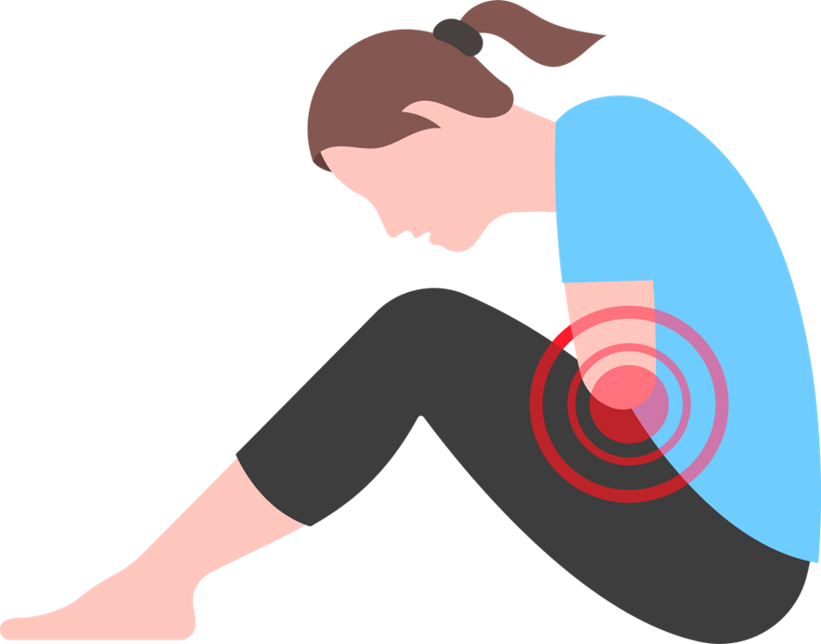

Biological
Social
Biological
Inflammation
Pelvic floor dysfunction
Peripheral sensitization
Central sensitisation
Hormonal fluctuations
Social
Stigma and Taboo
Cultural/Societal beliefs
Healthcare access/experiences
Social groups
Psychological
Psychological
Beliefs/expectations/ experience
Emotions- shame
Hypervigilance- medicalised
Body image- bloat, B&B, bleed, sex
Widespread sensitisation/ hyperarousal
Notes:
It's generally accepted that other factors also influence and drive central nervous system sensitivity, and contribute to widespread sensitisation and hyperarousal of the pain system.
Whilst the biopsychosocial model that encapsulates this isn’t new to anyone in this room
Its worth considering the biopsychosocial factors that are particularly relevant to CPP.
changes in pelvic floor muscle reactivity can lead to altered bladder and bowel function, loss of core stability, painful sex, sensitisation in area.

Slide 8
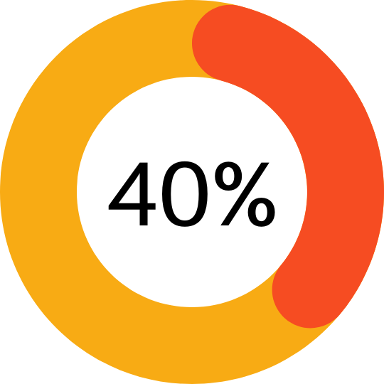
The Case for a Multidisciplinary Approach
Biological
Social
Respond to medical Rx
Low evidence for standalone therapies
Psychological
Starzec-Proserpio, 2024
Notes:
When multiple factors can drive and sensitise the pain system
It is little wonder why isolated treatments are only marginally effective.
Understanding the multiple factors that can amplify and reduce pain signals presents a great opportunity to support patients in changing their pain.
And helps to illustrate why a biopsychsocal approach and interdisciplinary approach that considers and attempts to modfiy this multiple influences and drivers is needed.
Given that there are specific themes and issues that more prevalent in CPP than our general CP populations there is also a need to provide specialist support that is tailored to these needs

Slide 9
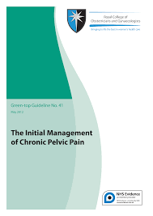
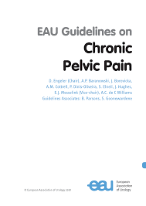
Guidelines
Recognise the multifactorial nature of pain
Advocate for the Biopsychosocial approach
For conditions such as endometriosis hormonal and surgical treatment first line
Notes:
Current guidelines for the management of CPP
Recognise this and suggest management should recognise the multifactorial nature of pain and treatment should be based on a biopsychosocial model and address the relevant factors salient to individual.
NICE and ESHRE guidelines for endo only focus on surgical and hormonal treatment!!

Slide 10


Challenges
8 years
Long and painful road 2024
82% of women with chronic pelvic pain have endometriosis (Coxen 2018)
Notes:
One of the biggest challenges is that there is no standard pathway for people with CPP.
And this represents a typical patient journey.

Slide 11

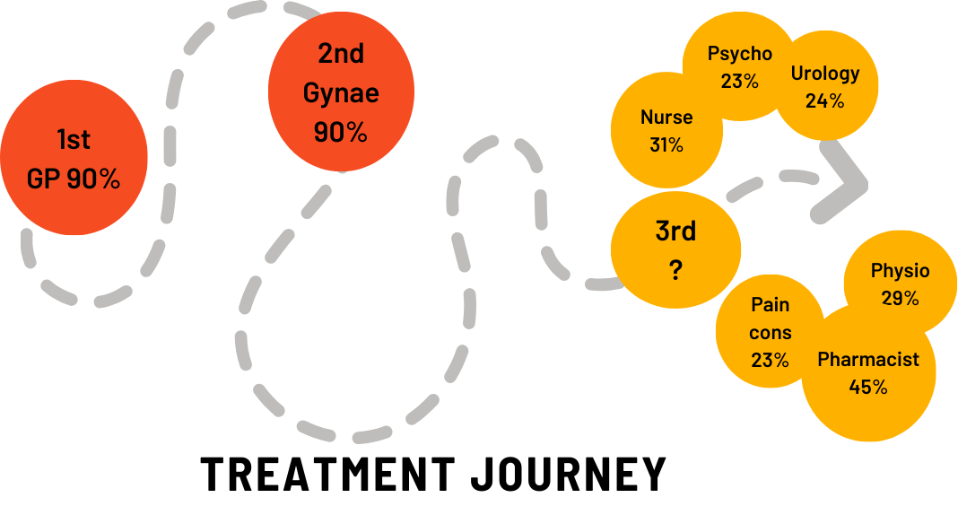
Johnson S, Evans E, Hapangama DK. Chronic pelvic pain treatment understanding what matters: a social media survey. Reprod Fertil. 2025 Jan 10;6(1):e240038. doi: 10.1530/RAF-24-0038. PMID: 39826244; PMCID: PMC11795530.
Frustration
Low satisfaction
Medicalisation
Anxiety
Disability
Opportunity and need
Notes:
Most women 1st point contact was- substantial variation after

Slide 12
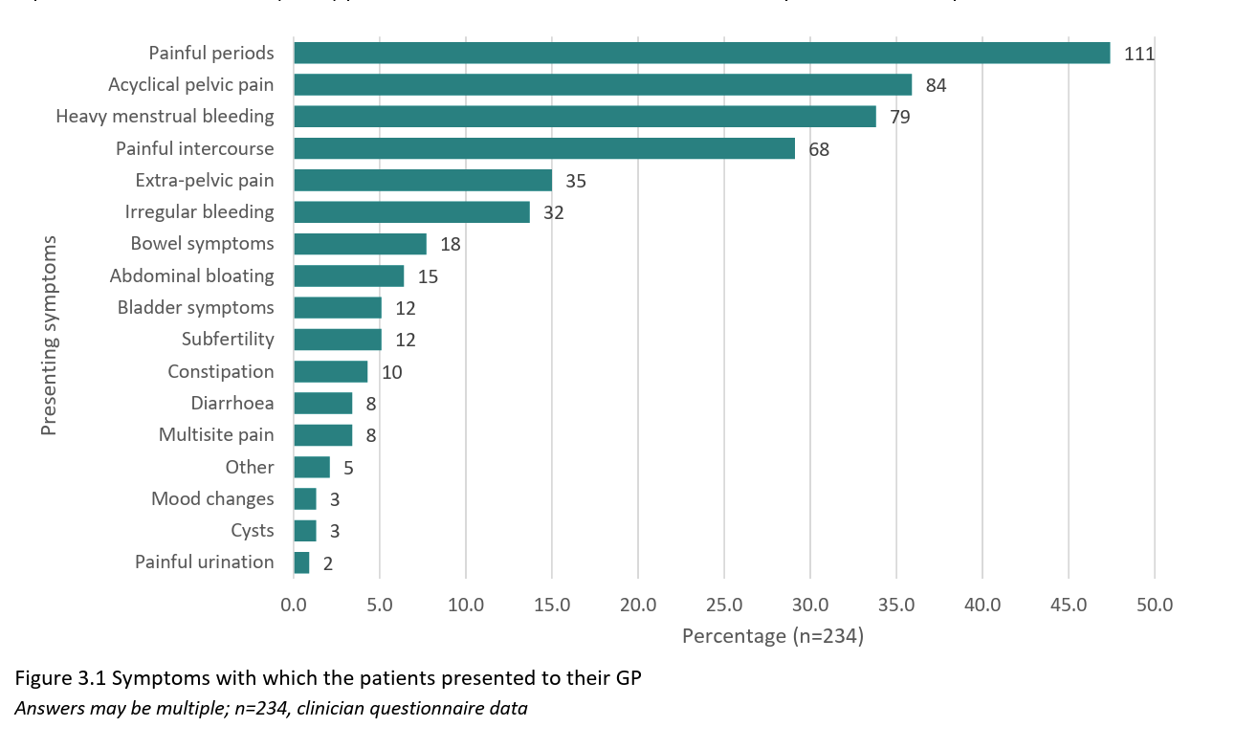
Taboo and societal/medical acceptance
“Many doctors, including gynaecologists, still believe that a painful period is normal, painful intercourse needs a psychosexual counsellor, and painful defecation means irritable bowel syndrome.” (Quote from the clinician’s survey in response to reasons for a delay in diagnosis)
Ask about:
Painful periods- impact on function
Heavy bleeding
Intercourse
Painful bowel and bladder movements
Notes:
Another challenge in CPP is how symptoms are reported and managed.
The challenge is that the symptoms are often considered taboo, and societal and medical acceptance of many symptoms as being part of being female.
But reporting problems with intimacy, bladder and bowel function can be equally as challenging for men.
So, part of addressing challenges is making sure we ask- break taboo and ensure patient feels can discuss issues that may matter

Slide 13
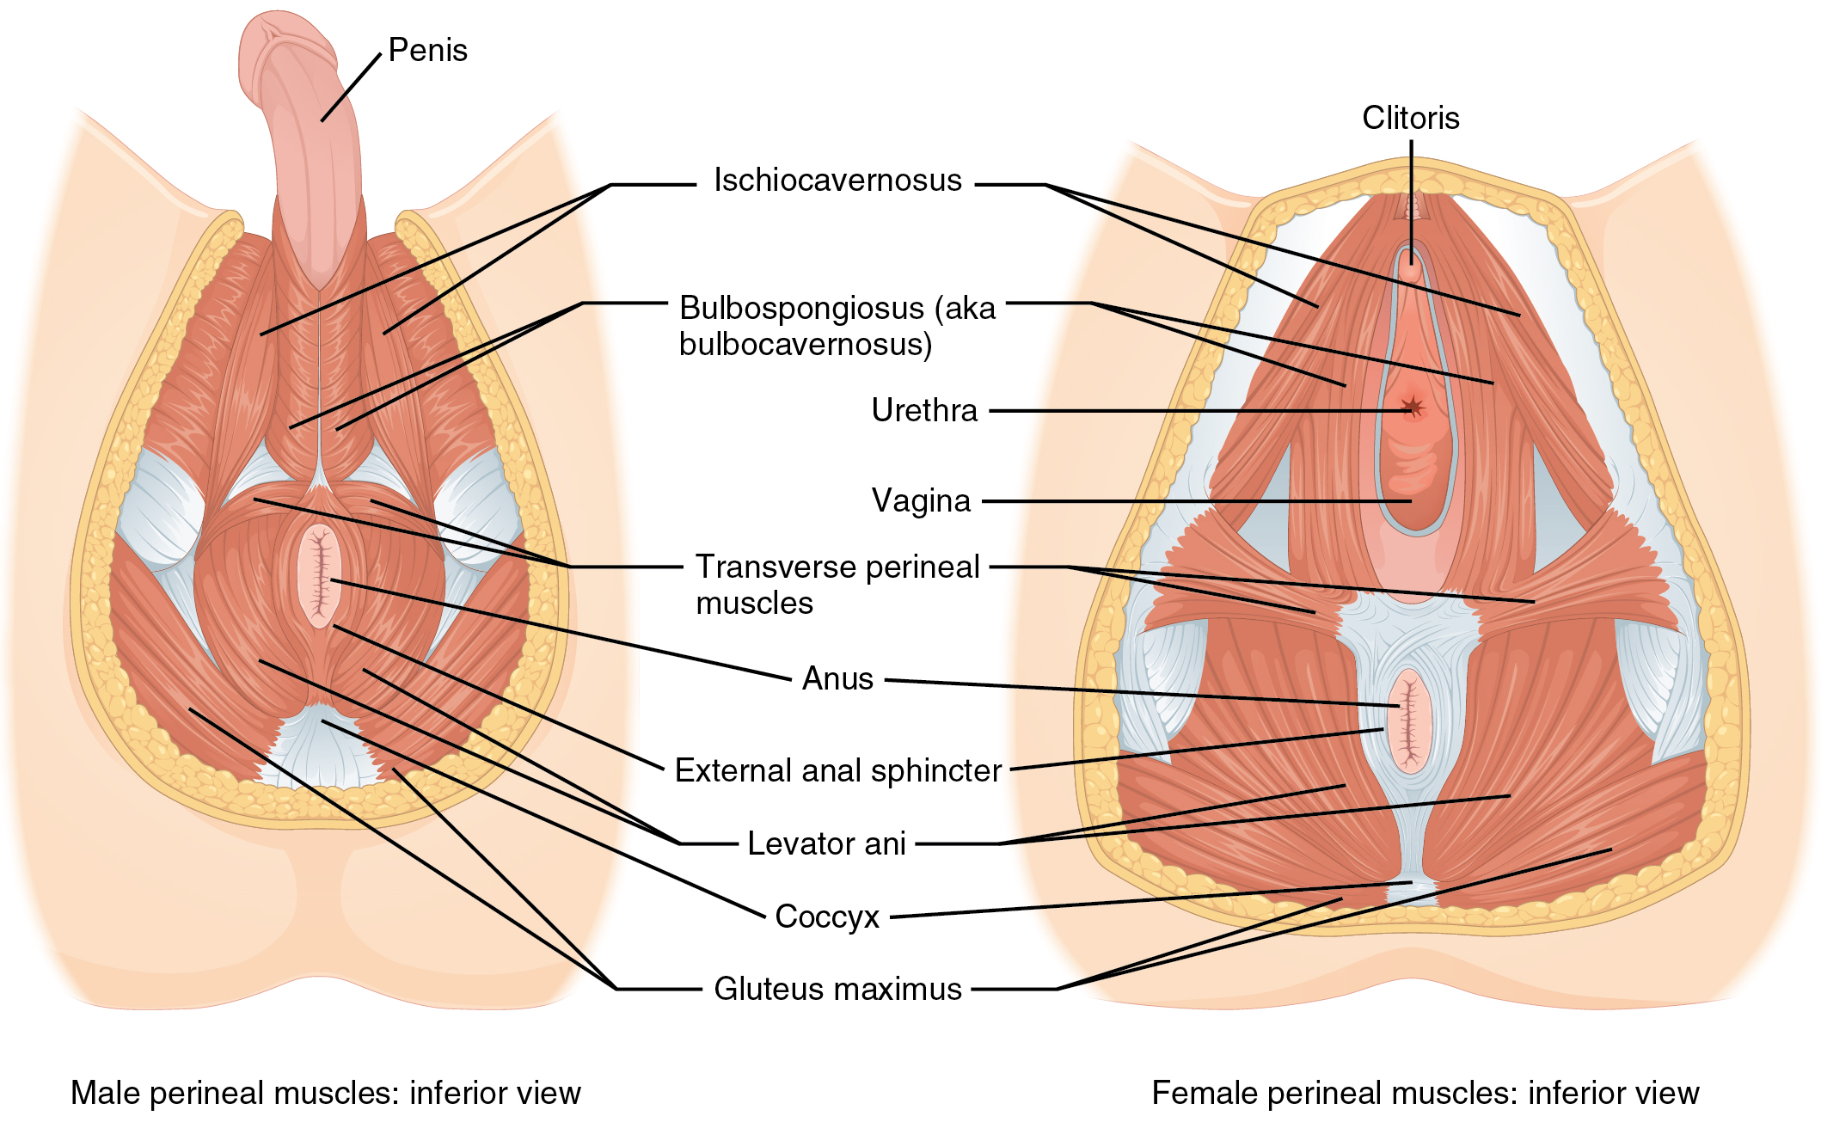

Clinician confidence

Slide 14

Pelvic pain pathway
Pelvic Pain Consultant Clinic
Pharmacology
Investigation/ Interventional recommendations
Pain Physio OP
Pain Psychology OP
(Or both)
MDT
Case
Discussion
&
Treatment Planning
PMP Out-patient Clinics
(OT, Physio, Psych)
Discharge
Pelvic MDT clinic
Gynaecology, Pain Psychology &
Pain consultant
Female Pelvic/ other PMP
Follow up
MDT PMPAC
Referral to other service
(e.g. CMHT, IAPT, Aintree)
Discharge – No treatment
Referral to other service
(e.g. CMHT, IAPT, Aintree)
Referrals from:
General practitioners
Secondary Care women’s health clinics (e.g. Aintree or Southport & Ormskirk Gynea clinics)// Urology, Colorectal, Pelvic floor physio
Secondary care Pain clinics
Specialist centres (e.g. The Women’s Liverpool, London hospitals)
Notes:
Recognising these challenges and gaps in our service- some time ago we developed a specialist pathway as we felt that this would better meet the needs of our patients and address some of these challenges recognised, we had gaps in terms of what we were supporting.
So, this is what the WCFT pathway looks like.
Pain clinics consider if pain is significantly impacting physical, psych and social well being
Pain clinics offer MDT input and both individual and group-based treatment.
Group-based rehabilitation in form of a PMP.
PMP- support people to manage impact of pain

Slide 15
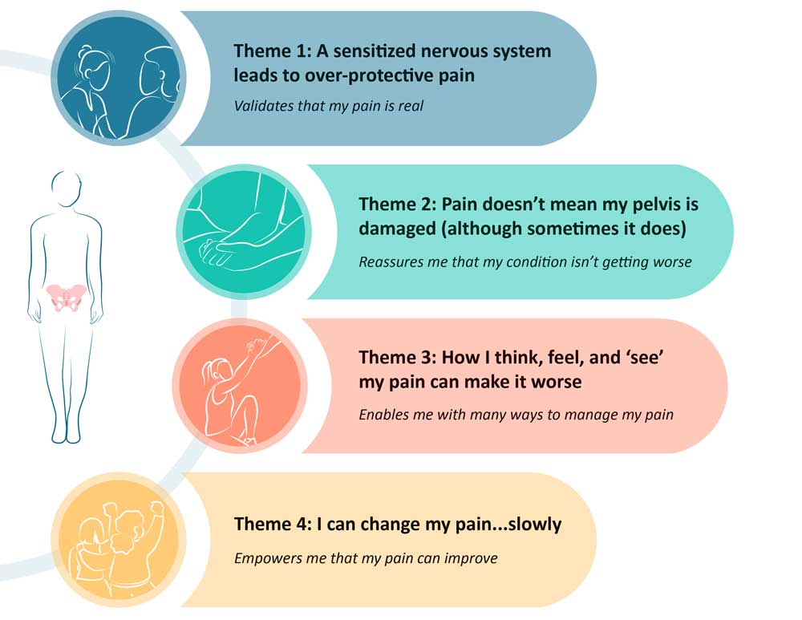

Understanding pain- what do patients need
Overprotective
Shift the blame for their pain from themselves
Misunderstanding pain > tissue damage = poor QoL.
Belief that pain must relate to pathology reinforced by HCPs
Learning a range of contributors helps management
PSE needs to be supported by active management strategies
Pain is not a permanent state and can be changed for the better
Changing pain= ‘rewiring’ the nervous system
Importance of persistence
Reduce fear,
Empower self-management.
Active NOT passive
Mardon 2023
Notes:
Throughout the pathway, all clinicians must recognise and support what patients need to understand and manage their pain.
Fantastic study by Oz group- summarises this.
Explored in group of patients who where successfully managing pain what they needed to do this.
Key themes were……

Slide 16









Resources to support knowledge
Data from the clinician questionnaire reported that 19.7% of patients were provided with information within primary care (Long & Painful Road, 2024).
Reliable Information resources (Johnson 2025)
Notes:
To help people understand and engage with treatments
Patients need resources to support knowledge and understanding for themselves and wider support networks.
Evidence shows patients don’t often receive this
We have done research that also shows patients felt hard to independently ID reliable resources
These resources recommended throughout pathway.

Slide 17
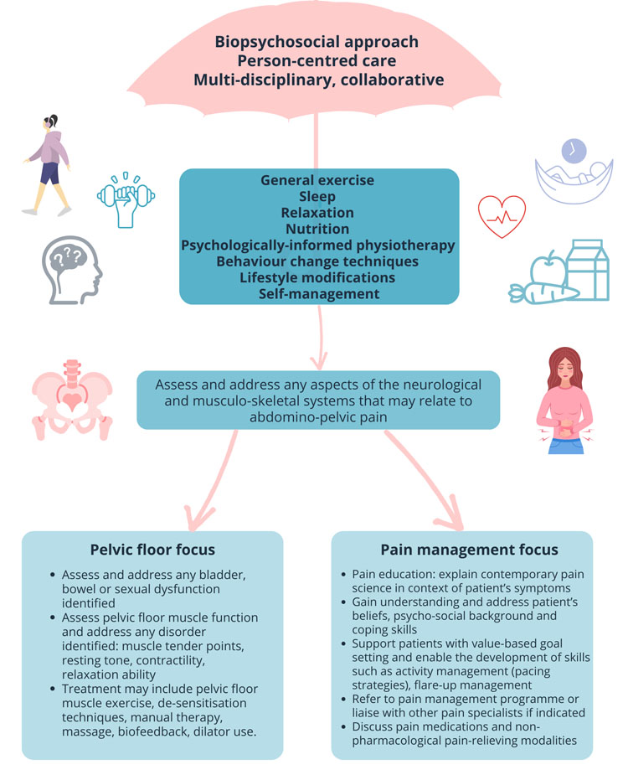
Physiotherapy
Biopsychosocial approach
Mange condition, increase activity and improve QoL
Ax relevant neuro/MSK factors
Sexual dysfunction (dyspareunia);
Urinary/ bowel urgency
Pelvic floor dysfunction/anxiety
Rx may include desensitisation, biofeedback, dilator
Making sense of pain
Exposure- value based activity
Flare up management
Support engagement
Anxiety
Fatigue
Adapted from Frawley H, Peterson K, Glob Libr Women's Med ISSN: 1756-2228; DOI 10.3843/GLOWM.418263
Notes:
Develop skills to help manage their condition, increase their activity and improve their quality of life
Exposure involves working with the patient to approach different activities and movements without pain, fear and muscle guarding so activity becomes easier.

Slide 18
How
Pain
Sensitisation
Protect
Increased effort, pain & less success
Anger, frustration
Loss of normal function
CBT/ACT/Cognitive Functional Therapy
Find ways of making things safe- reduce hyperarousal
Change sensory and cognitive input to change pain output
Reform relationship with painful area – trust their body
Common activity areas:
Bladder and bowel function
Reestablish/ introduce exercise routine- yoga
Intimacy
Flare-up management
ACTIVITY

Slide 19
Psychology in Pain Management
Reconnecting with values and psychological barriers to this
Acceptance / Adjustment to living with a chronic condition
Challenging unhelpful beliefs & perceptions & associated behavioural patterns
Developing self-compassion
Relapse prevention and long-term maintenance
Emotional regulation / Mood / Mental Health
Notes:
Patients experience range of emotions in response to pain
Frustration and anger,
low mood, guilt, shame
decreased confidence and anxiety
Psychology about understanding how these affect CP and what can do to manging this impact- very practical.

Slide 20

Most common psychological themes
Pre-existing and concurrent emotional problems
Pain-Related Fear
Pain Acceptance
Injustice
Shame, guilt, Humiliation
Coping and self efficacy

Slide 21

Pelvic PMP
Medic
Psychology
Physio
OT
Physio | OT | Medic | Psychology
Graded exercise and movement sessions | Mindfulness based pain sessions | Pain mechanisms/pain education (joint with physio) | Biopsychosocial impact of Chronic pain
Pelvic floor education and exercises | Activity Management & value-driven targets | Pain and Anatomy, bodily systems, diagnosis (joint with Physio) | Values & Acceptance
Flare up management | Communication | Medications | Relationships & Intimacy
Sustaining activity | Work and employment |  | Mood states and emotions
 | Maintaining change (joint with psych) |  | Self-compassion
Specialist group- based multidisciplinary rehabilitation
1 day per week x 7 weeks
Twiddy H, Lane N, Chawla R, Johnson S, Bradshaw A, Aleem S, Mawdsley L. The development and delivery of a female chronic pelvic pain management programme: a specialised interdisciplinary approach. Br J Pain. 2015 Nov;9(4):233-40. doi: 10.1177/2049463715584408.

Slide 22
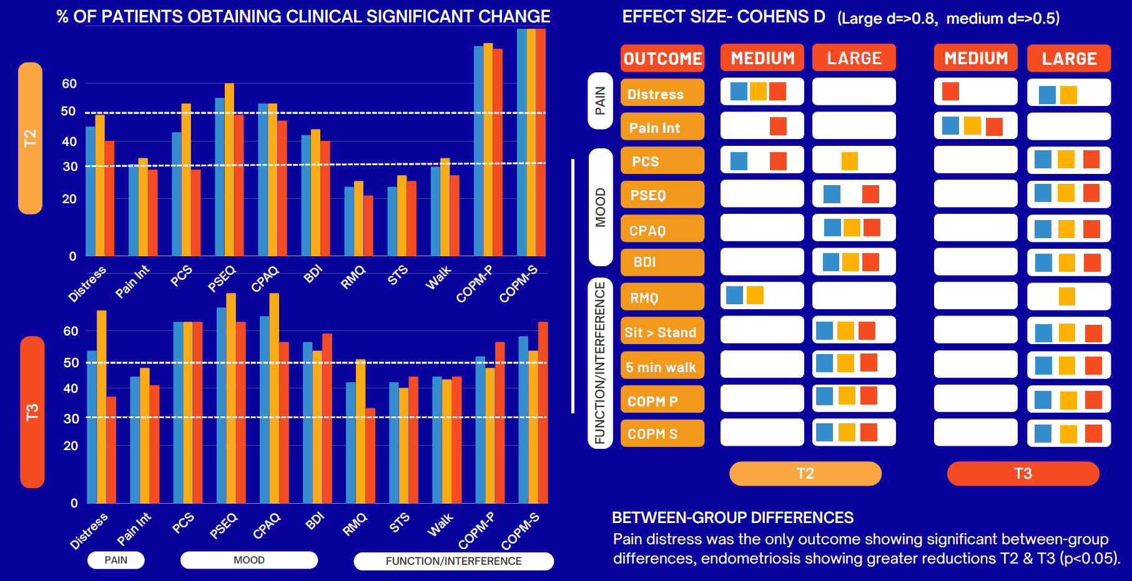

Slide 23
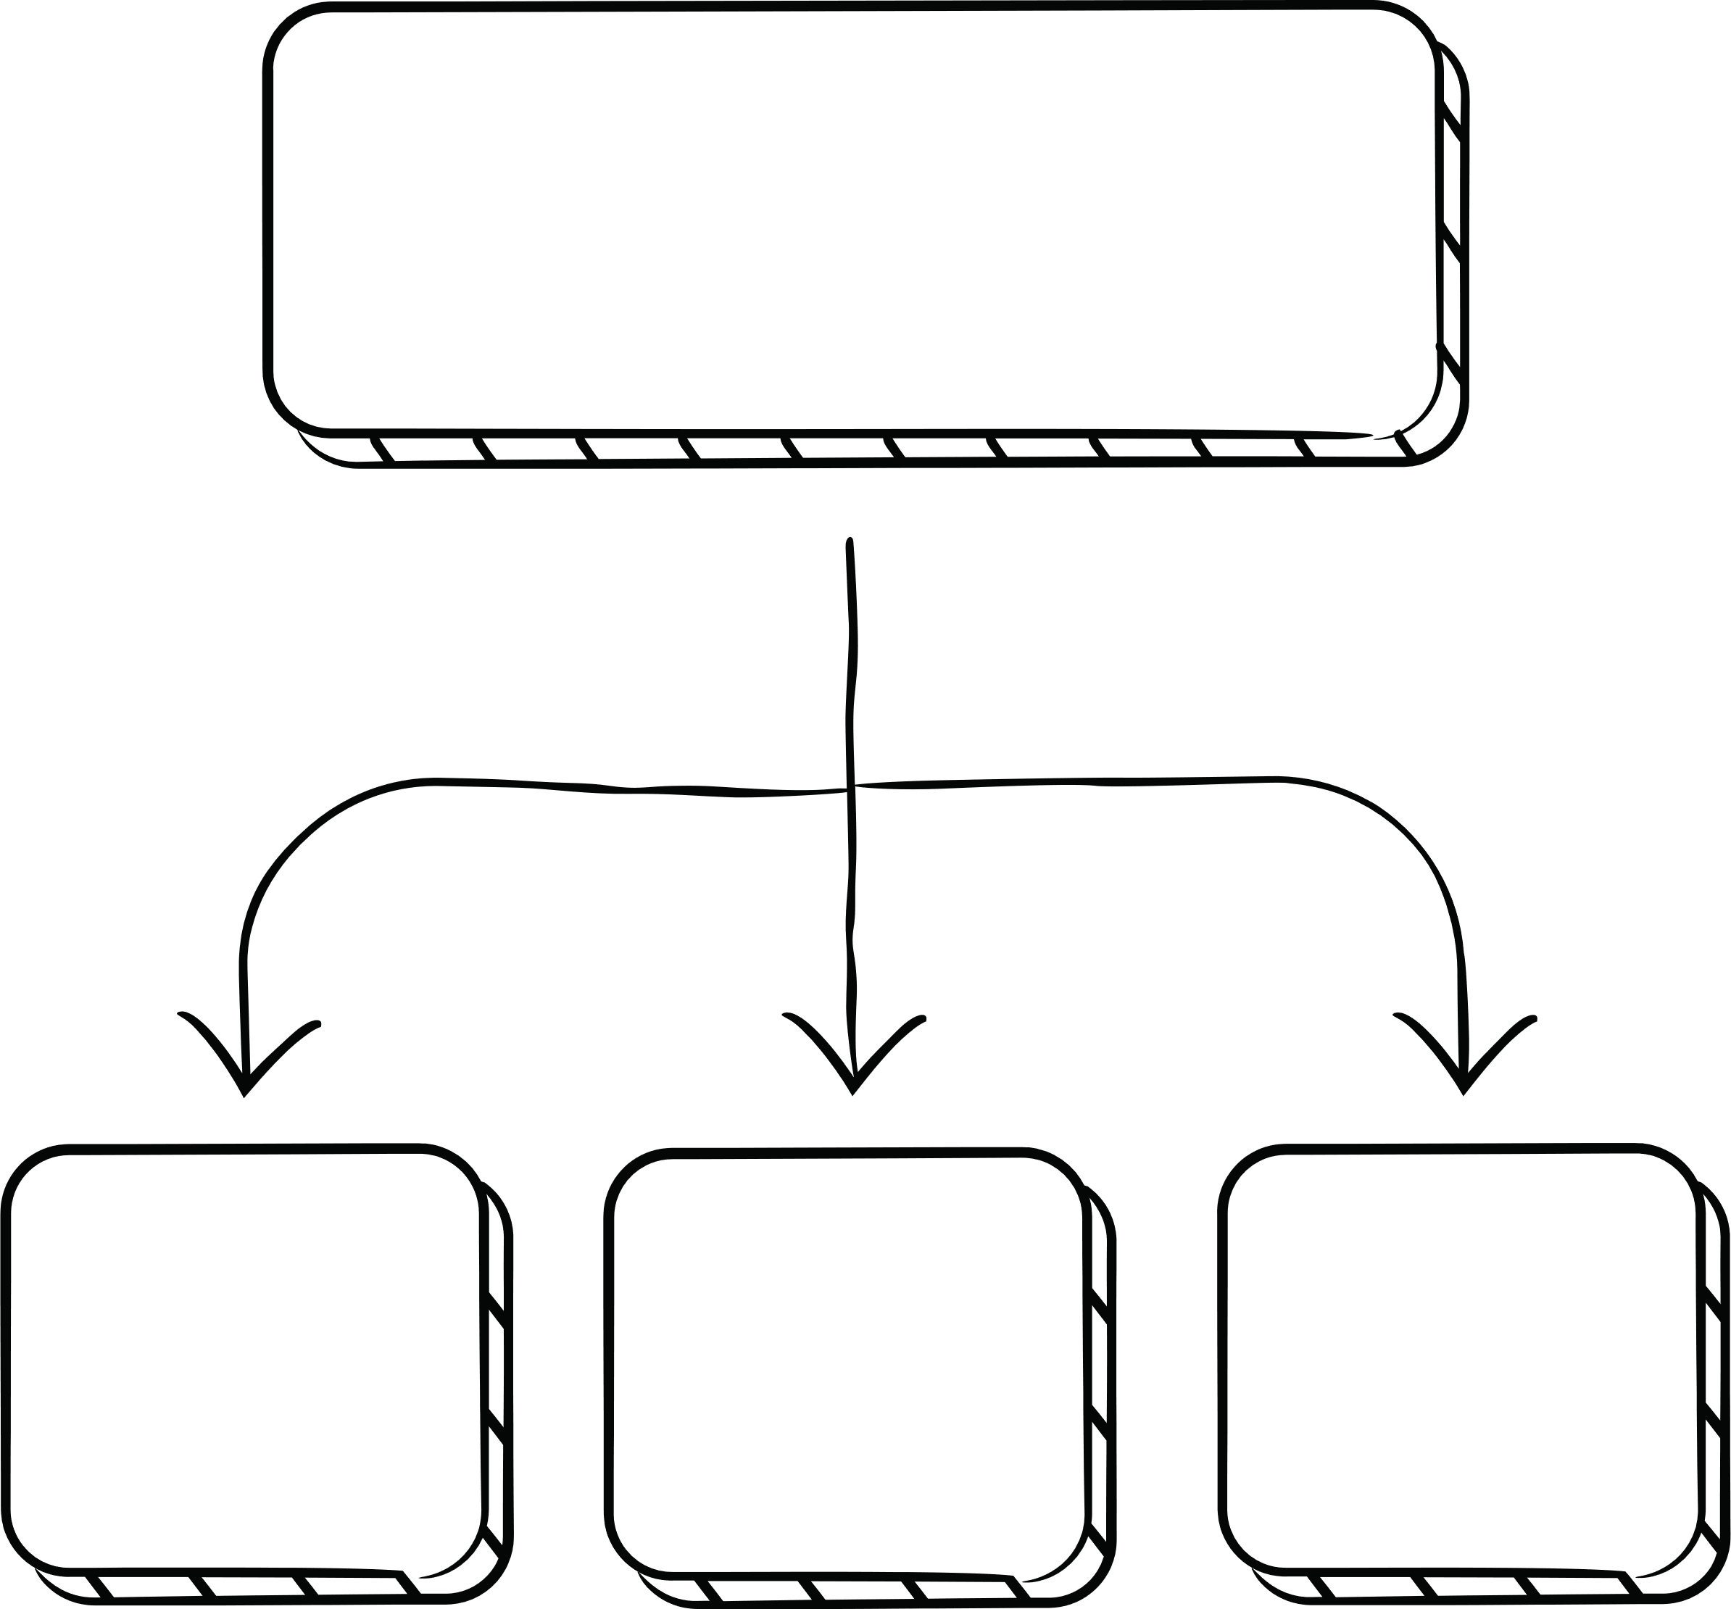
When to consider a specialist pathway?
Primary pain compromised QoL is of pelvic origin
Specific functional issues- Pain with sex, menstruation, bladder/bowel function, or fertility concerns
Trauma related to reproductive, sexual, or gynaecological experiences (may benefit from trauma-informed pelvic-specific care).
PROM to support referral and assessment outcomes/ ? Adapted STarT back tool
Assessment of Risk
Based on pain, disability and
psychological distress
Low
Self
management
Med
Physio
and PSE
High
MDT should
include physio
and psych

Slide 24
 | Individual | Group-Based Care
Pain complexity | Complex pain with multiple conditions (e.g.endo + trauma), needs foundation work | Stable chronic pain, previous individual input; ready for maintenance or reinforcement
Pelvic floor dysfunction | Needs internal assessment | No indication for hands-on or specialist assessment
Psychological readiness and safety | Active trauma, significant distress, or psychological barriers to group participation (sigma/social anxiety) | Stable mood, open to group
Goals of care | Highly individualised goals (e.g. returning to intimacy, fertility, trauma work) | Generalised goals (e.g. pacing, movement, pain education, coping skills)
Language / communication needs | Language barriers, communication disorders, neurodivergence, or cognitive difficulties | Able to participate in group discussions and activities

Slide 25

Future
Multidisciplinary education
Collaborative working

Slide 26
Take home messages
Pelvic pain is often under-recognised and misattributed, so specific services may better address stigma, validation, and identity concerns.
The biopsychosocial framework underpins pain management
Physiotherapy when activity and QoL compromised
Psychology is important in managing impact mood, wellbeing- but can be initially challenging,
MDT pain management recommended for pain-related disability and reduced QoL

Slide 27

Any questions

Slide 28
Useful references not already included
Beales D, Slater H, Palsson T, O'Sullivan P. Understanding and managing pelvic girdle pain from a person-centred biopsychosocial perspective. Musculoskelet Sci Pract. 2020 Aug;48:102152. doi: 10.1016/j.msksp.2020.102152. Epub 2020 May 6. PMID: 32560860.
Vandyken C., Hilton S. 2017. Physical Therapy in the Treatment of Central Pain Mechanisms in Female Sexual Dysfunction. Sex Med Rev 5: 20-30
Hilton S, Vandyken C. 2011. The puzzle of pelvic pain. A rehabilitation framework for balancing tissue dysfunction and central sensitization, I: Pain physiology and evaluation for the physical therapist. JWHPT 35:103-113.
Vandyken C, Hilton S. 2012. The puzzle of pelvic pain. A rehabilitation framework for balancing tissue dysfunction and central sensitization, II: A review of treatment considerations. JWHPT 36:44-54.
O'Sullivan PB, Caneiro JP, O'Keeffe M, Smith A, Dankaerts W, Fersum K, O'Sullivan K. Cognitive Functional Therapy: An Integrated Behavioral Approach for the Targeted Management of Disabling Low Back Pain. Phys Ther. 2018 May 1;98(5):408-423. doi: 10.1093/ptj/pzy022. Erratum in: Phys Ther. 2018 Oct 1;98(10):903. PMID: 29669082; PMCID: PMC6037069.
Kent P, Haines T, O'Sullivan P, Smith A, Campbell A, Schutze R, Attwell S, Caneiro JP, Laird R, O'Sullivan K, McGregor A, Hartvigsen J, Lee DA, Vickery A, Hancock M; RESTORE trial team. Cognitive functional therapy with or without movement sensor biofeedback versus usual care for chronic, disabling low back pain (RESTORE): a randomised, controlled, three-arm, parallel group, phase 3, clinical trial. Lancet. 2023 Jun 3;401(10391):1866-1877. doi: 10.1016/S0140-6736(23)00441-5. Epub 2023 May 2. Erratum in: Lancet. 2023 Jun 17;401(10393):2040. Erratum in: Lancet. 2023 Sep 16;402(10406):964. PMID: 37146623.
Moseley GL, Butler DS. Fifteen Years of Explaining Pain: The Past, Present, and Future. J Pain. 2015 Sep;16(9):807-13. doi: 10.1016/j.jpain.2015.05.005. Epub 2015 Jun 5. PMID: 26051220.

