Slide 1
Outpatient Ketamine Infusions For Chronic Pain
Dr Graeme Fitzpatrick
Consultant in anaesthesia and Pain Medicine
Liverpool University Hospitals

Slide 2
How we got here
Started by a colleague
Growing number of CP patients uncontrolled pain
Aiming to address high dose opioids
Used to run in main theatre recovery
Limited control over capacity
Busier environment
Difference from other protocols
Bolus
Daycase
Resource reasons
Notes:
Large pancreatic surgical centre
Why bolus – to give longer at a therapeutic plasma concentration
Elimination half life 2.5 hours, 5 x half life to steady state – 12.5 hours of infusion (although clinical effects usually sooner (rapid effect site equilibrium – distribution into CNS)

Slide 3
Indications
Chronic Pancreatitis 60%
Other abdominal pain 15%
CRPS 15%
Neuropathic Pain 10%
OIH (usually secondary to one of above)
Notes:
Other abdominal pain includes a number of patients who previously had CP diagnoses but didn’t meet new diagnostic criteria

Slide 4
Contraindications
Psychosis
Severe Liver Disease
Severe Cardiac Disease
PTSD – relative

Slide 5
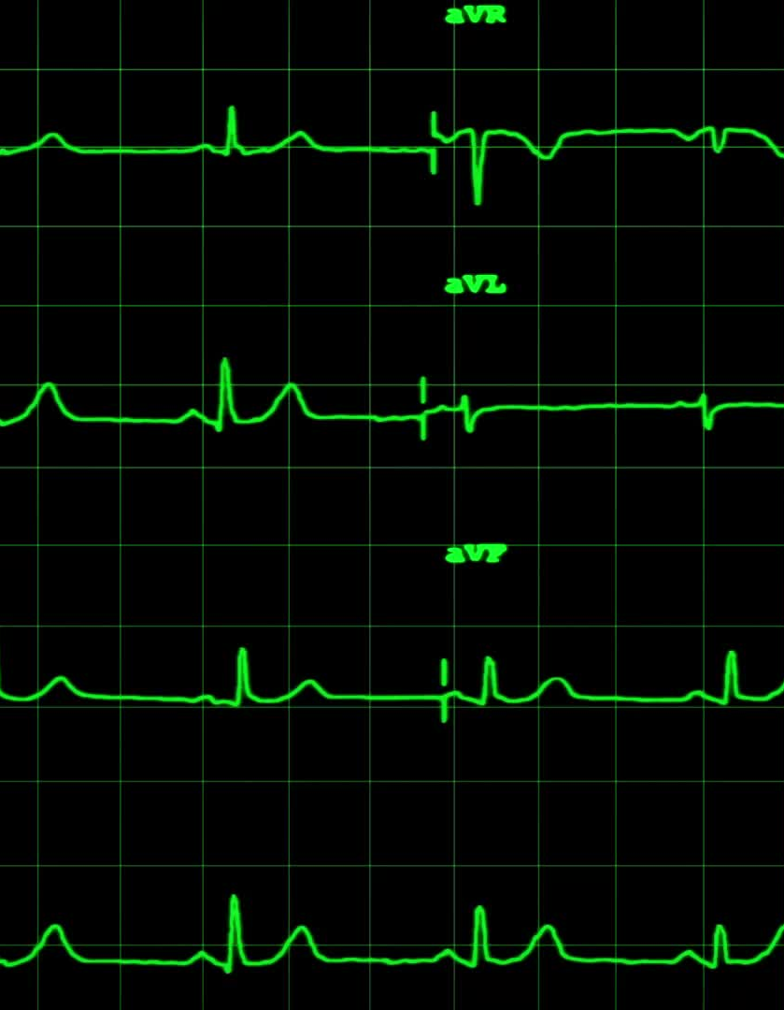
Protocol
Generally face to face review first
Fluids only after midnight
Admitted 0800
Trolley and Gown
Monitoring
Cont ECG, SpO2, BP (15 mins)
2 l/min NS O2

Slide 6
Protocol 2
2-3mg IV Midazolam
0.5mg/kg Ketamine
Brief LOC, Nystagmus
Commence infusion at 0.5mg/kg/hr for 6 hours
Pre-prescribe:
Paracetamol, Ondansetron, Cyclizine
IV Fluids running alongside (50 ml/hr)
Relatively rapid recovery
Eat and Drink
Home by 1700

Slide 7
Side Effects / Complications
Hallucinations / Agitation / Singing
Problematic 1-2%
Terminated 1 infusion due to agitation
N&V (15%)
Headache (12%)
CVS effects (HR/BP)
Problematic (4%)
Urinary Retention
Problematic <1%
No Ketamine Uropathy (so far!)
No Ketamine Cholangiopathy (so far!)

Slide 8
Hints / Tips
Calm quiet environment
No music!
Patient recovery staff
Hypertension / tachycardia usually settles

Slide 9
Outcomes
72% report improved QoL
59% report improved physical functioning
54% significant improvement in pain
Repeats
4-6 months sig improvement (pain / function)
Sustained reductions in opioids

Slide 10
W 48 M
10yr Hx CP (June 2023)
Daily average pain 8/10
175 mcg/hr Fentanyl patch - ‘Zombified’
SCS in situ – initially helpful
Prev treatments: Coeliac plexus Block, Gabapentinoids, Amitriptyline, Many opioids
V Poor nutritional intake - ~45Kg
Sleeping only on sofa leaning forwards
Developed pressure sore on right buttock
Not worked for 6 years
Too high risk for surgery
Notes:
SCS re-sited several times to no avail
Tried to utilise self management techniques (meditation) but struggled

Slide 11
W Outcome
4 Infusions (Since June 2023)
Average pain 4/10
Fentanyl 12mcg/hr
Pain relief lasts approx. 5-6 months
Improved function
Better able to cope
Requested pain psychology to aid with flare Mx
Notes:
Went on holiday to turkey for 2 weeks after first infusion – hadn’t been on holiday since early days of diagnosis (and been a few times since)
Done some light gardening
Slowly increasing amount of time spent out of the house
Pain still present but more manageable

Slide 12
T 56M
Crush injury on building site
Chronic Post Traumatic Pain / CRPS
PTSD / Depression / Anxiety
Significant anger – causing family difficulties +++
Previous Tx:
Pain Psychology, EMDR
All of the opioids (Tapentadol 250mg BD, Oramorph60mg/day) 60mg/day), Gabapentinoids, TCAs, Lamotrigine, Lumbar Sympathectomy
Requesting amputation
Physiotherapy
Notes:
Crushed and trapped under heavy plant machinery for several hours
Deeply traumatised by injury and had significant flashbacks
CPSP – also at some point had tentative diagnosis of CRPS

Slide 13
T Outcome
80-90% reduction in pain symptoms for 4-6 months
Tapentadol MR 100mg BD, No Oramorph
Improved function
Significant improvement in mood and anger
No longer wants an amputation
Struggled with urinary retention ++
Notes:
Found difficulty Puing very distressing thus for last infusion had catheter inserted pre and removed immediately post

Slide 14
What Ketamine Infusions aren’t…..
A miracle cure
A treatment that works for everyone
An excuse to not undertake the pain management aspects of treatment

Slide 15
Ketamine Infusions Are
Safe
A useful tool
Helpful reducing / eliminating opioids
For some patients truly lifechanging
Probably concomitantly treating other conditions in some
Notes:
Safe – as far as we know so far
Concomitatnt conditions:
Refractory depression
PTSD

Slide 16
Questions ?

Slide 17
References
Low-dose ketamine infusion to facilitate opioid tapering in chronic non-cancer pain with opioid-use disorder: a historical cohort study. Elyn et al.
http://orcid.org/0000-0003-2764-4351
Study protocol for a randomised, double-blinded, placebo-controlled, clinical trial of S-ketamine for pain treatment in patients with chronic pancreatitis (RESET trial).
Juel et al
Ketamine infusion for pain management in hospitalized patients with Chronic Pancreatitis: A case series. Ertem et al.
doi: 10.1016/j.pan.2023.04.003. Epub 2023 Apr 15.
Continuous ketamine infusion for the management of opioid-induced hyperalgesia following amputation. Cairns et al.
doi.org/10.1136/bcr-2023-255333
S-Ketamine Modulates Hyperalgesia in Patients With Chronic Pancreatitis Pain. Bouwense et al.
doi.org/10.1097/AAP.0b013e3182177022

Slide 18
References
Rosenbaum, Steven B., et al. "Ketamine." StatPearls [Internet]. StatPearls Publishing, 2024.
Orhurhu, Vwaire, et al. "Ketamine infusions for chronic pain: a systematic review and meta-analysis of randomized controlled trials." Anesthesia & Analgesia 129.1 (2019): 241-254.

