Slide 1




Ketamine Uropathy
Miss Alison Downey PGCertMedEd(dist), FRCS(Urol)
Consultant Urologist with subspecialist interest in Female, Functional, Reconstructive and Neuro-urology
MidYorks NHS Trust/Barnsley NHS Foundation Trust

Slide 2
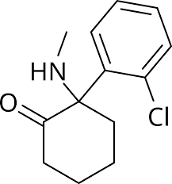
Ketamine
Non-competitive NMDA acid receptor complex antagonist
Licensed for use in the induction and maintainence of anaesthetic, refractory status epilepticus, acute and chronic pain and an antidepressant
Metabolised in the liver by cytochrome P450 to active metabolite nor-ketamine
Un-metabolised ketamine and norketamine are water soluble and excreted in the urine
Maximum medical dose is 600mg/day orally
Onset 3-5 mins, lasts 1hr
S/E: Hypertension, apnoea, airway obstruction, arrhythmia, respiratory depression

Slide 3
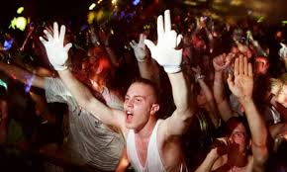
Illicit Use
1990’s became a popular “rave” culture drug
Relatively cheap - £20/g vs £50/g for cocaine, £45/g heroin
Age of first use in the population is around 16
3% of 16-24 year olds are using ketamine
Physiological dependence develops in 78.9% of users after 1 year
Relatively low risk of antisocial behaviour
Notes:
Takes effect in 10mins
Hoare et al Drug Misuse Report 2009/2010 –
2019 Home Office report – 3% of 16-24 year olds using ketamine

Slide 4
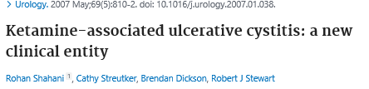


Slide 5

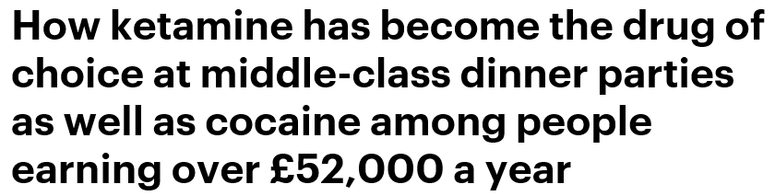
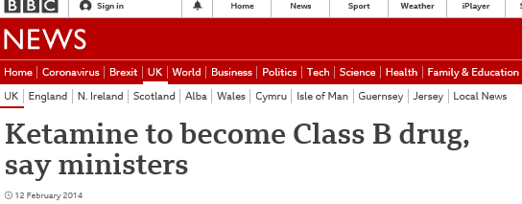
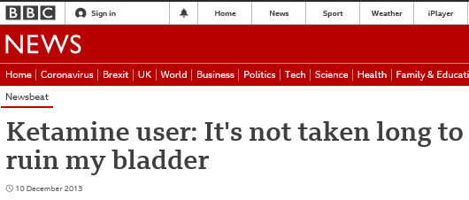

Slide 6
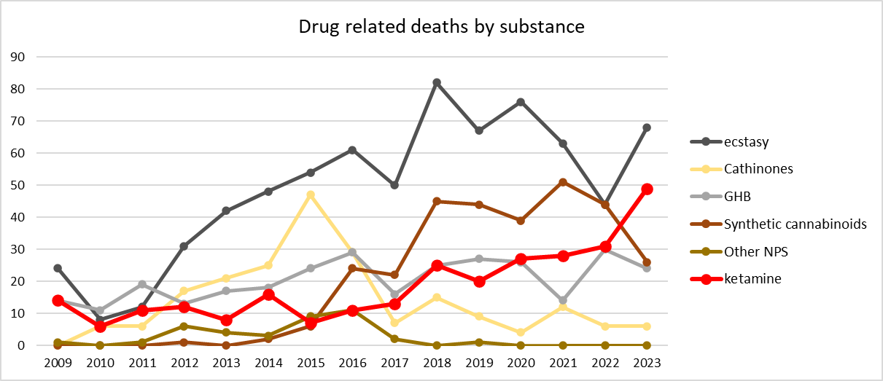

Slide 7
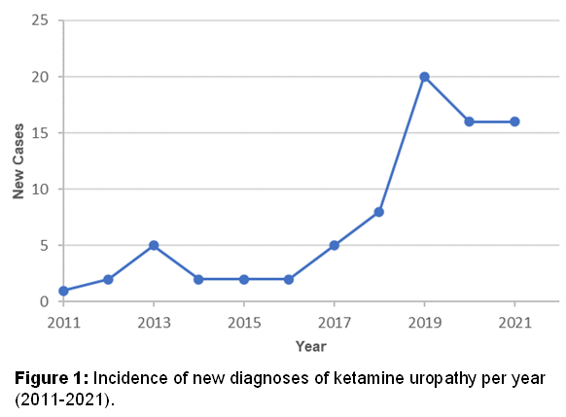
Background

Slide 8
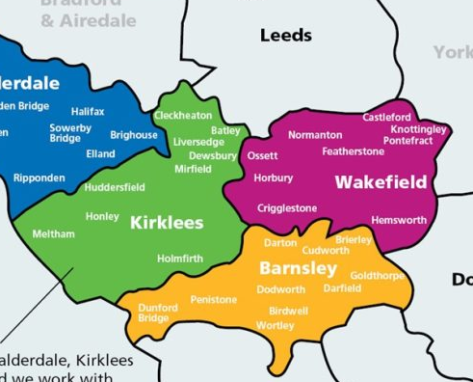
Local Geography
Cover a population of ~1million
2 hospital trusts (4 hospital sites with 3 A&E depts.)
2 ICBs
3 drug addiction services (BRS, TP, CGL)
3 councils

Slide 9
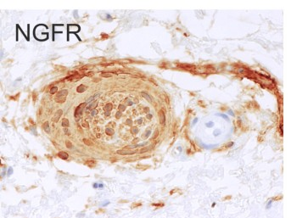
Mechanism of Damage
Direct toxic damage to the urothelium by ketamine and metabolites
Bladder barrier dysfunction: epithelial dysfunction with urinary leakage
Neurogenic inflammation
Eosinophilic infiltration - IgE mediated inflammation
NOS-COX mediated inflammation
Microvascular injury – NMDA receptors on endothelial cells
Notes:
Nature of receptor in bladder that ketamine works on is not identified due to the binding promisuity of ketamine
no NMDA receptors in bladder

Slide 10
Clinical Syndrome
Bladder
Upper Tract
Severe Storage LUTs
Urge Incontinence
Small capacity bladder
Painful Bladder
Visible Haematuria
Vesico-ureteric reflux
Ureteric Strictures
Papillary Necrosis
Renal Infarction
Chronic Renal Failure

Slide 11

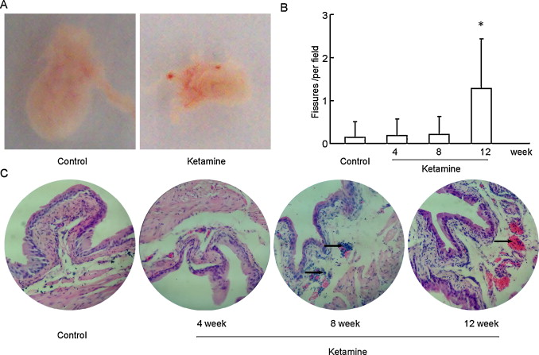

Slide 12
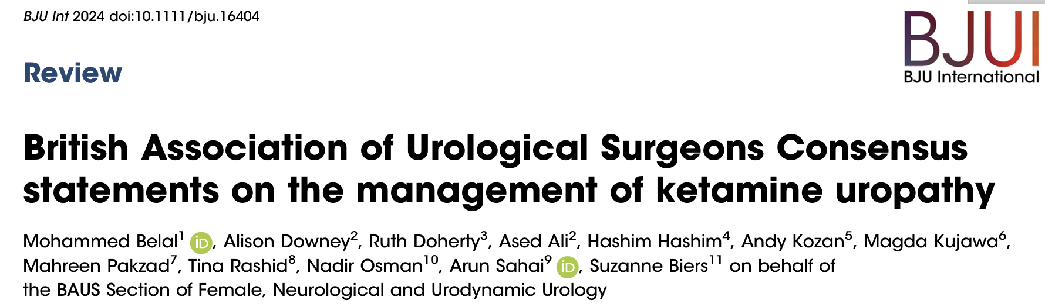

Slide 13
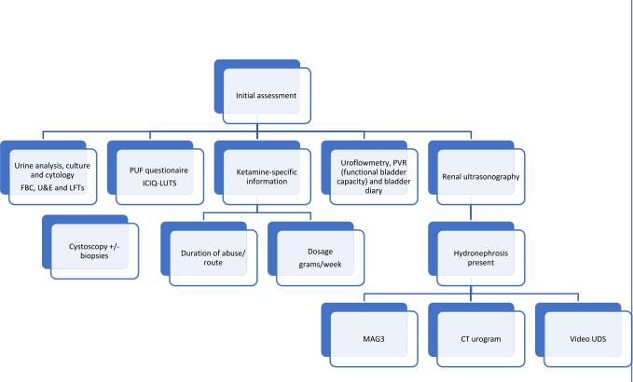
Notes:
Alison

Slide 14
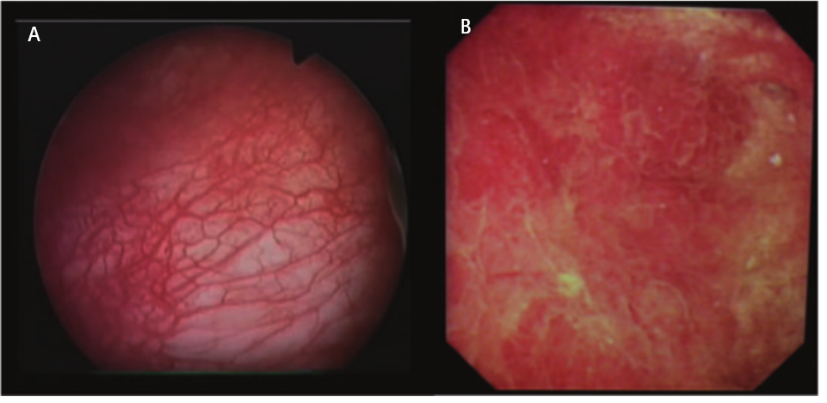
Cystoscopic Appearance

Slide 15
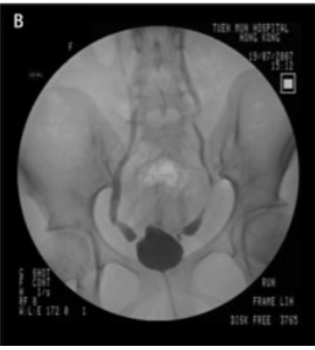
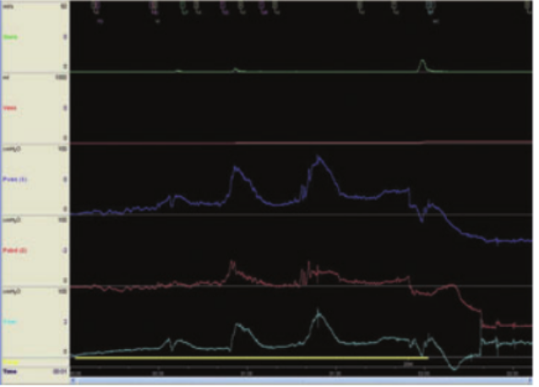
Video Urodynamics

Slide 16
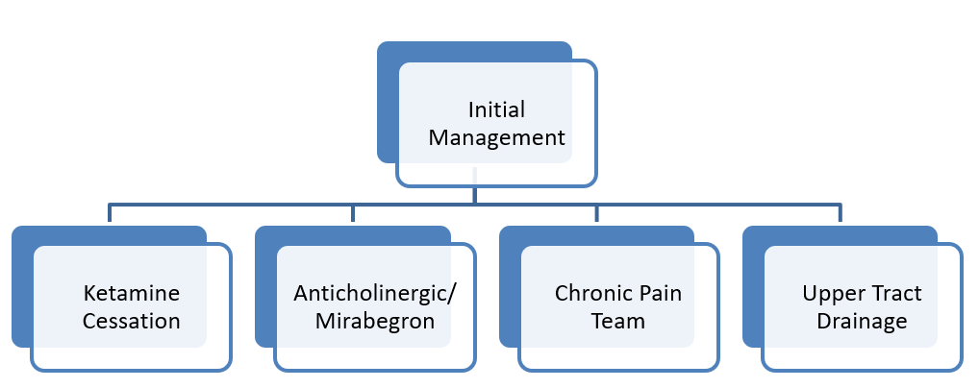

Slide 17
Harm Reduction Advice
Don’t use alone and
Take turns
Use small amounts
Stay hydrated
Don’t mix with other drugs or alcohol: particularly benzos or opioids
Don‘t share inhalation tubes or bank notes.
Don’t drug drive
Don’t use in water
Don't be afraid to call for help
Notes:
Advise to monitor for any changes to urinary frequency or pain and to seek help and disclose ketamine use.

Slide 18
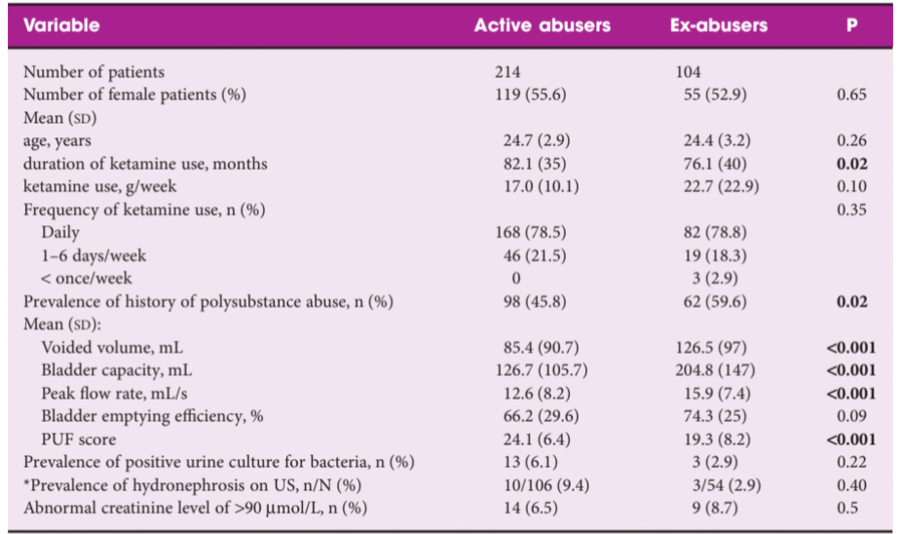
Notes:
2014 Tam et al - >4 months cessation

Slide 20
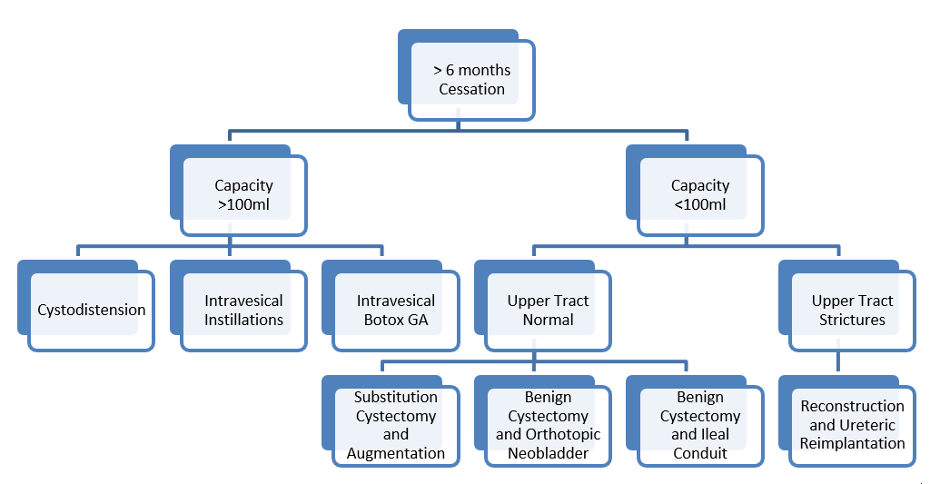

Slide 21
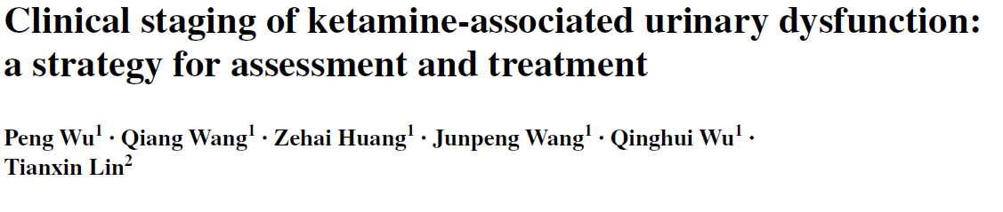
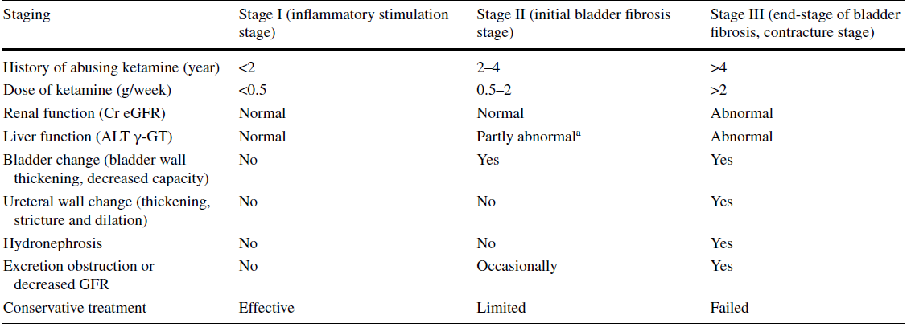
Notes:
81 patients
Severity of LUTS no significant

Slide 22
Reconstructive Surgery
Absolute pre-requisite to cease ketamine use
Careful patient and procedure selection
Psychology Input
Stoma Team input
Need to manage patient expectations

Slide 23
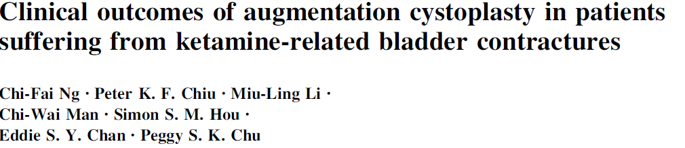
Post op capacity 450-500ml
All patients resumed ketamine use
2 developed ureteric strictures
Metabolic abnormalities with non-compliance with ISC
All 4 defaulted from follow-up
Notes:
HN due to reflux on imaging, not strictures
Patients may resume ketamine abuse following augmentation cystoplasty
Ketamine metabolites can be absorbed through the bowel patch and potentially lead to fatal overdose
Upper tract dysfunction (?M patch)

Slide 24
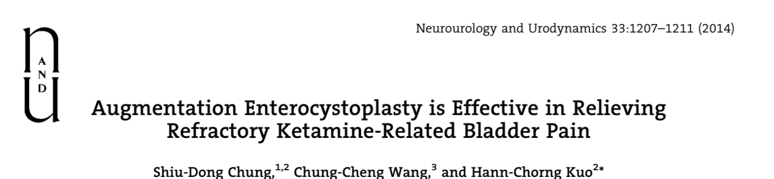
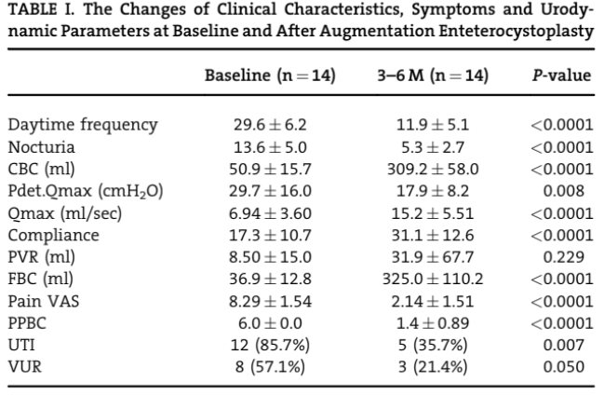

Slide 25

10 year retrospective review of ketamine uropathy patients
14 patients underwent major surgical reconstruction
Higher rate of post-operative complications than expected

Slide 26
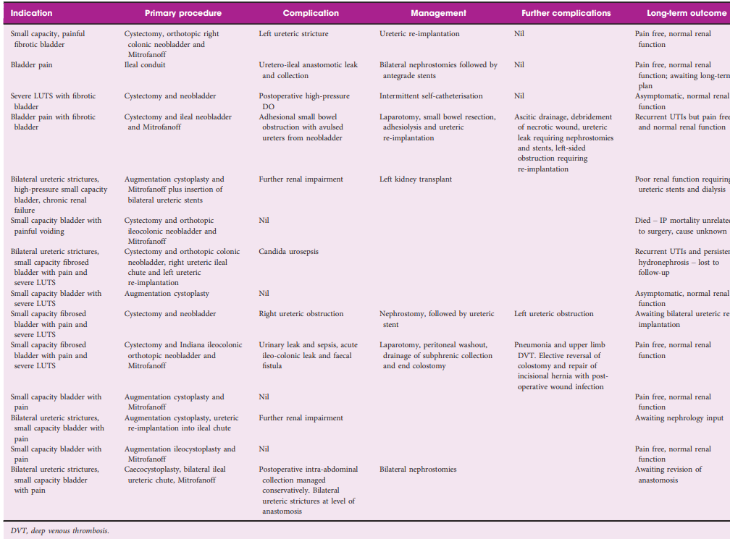
Complications Risk

Slide 27
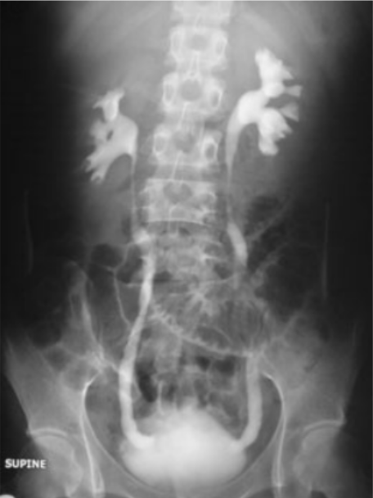
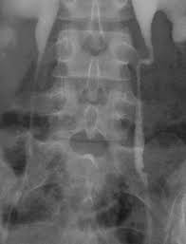
What about the upper tract?

Slide 28
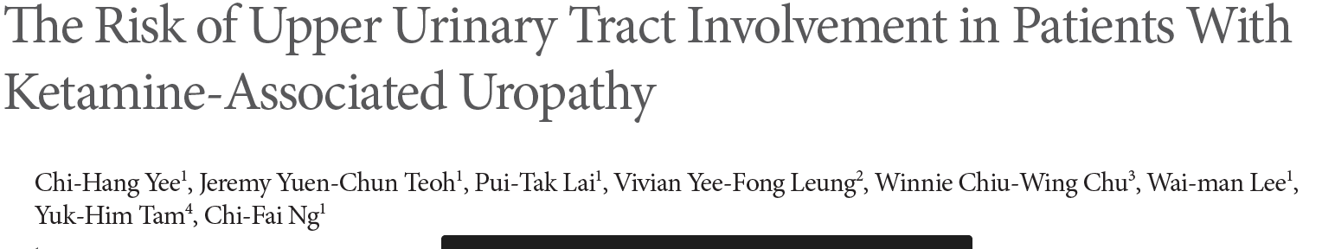
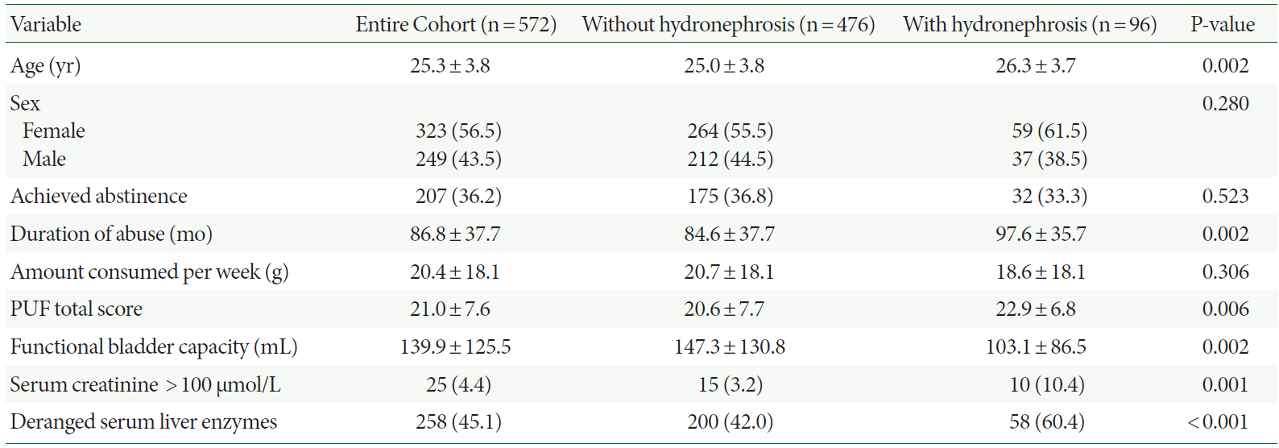

Slide 29

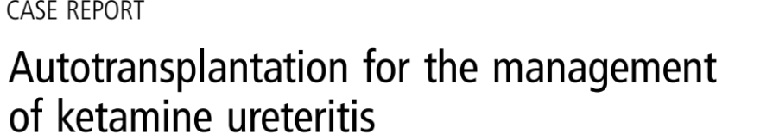
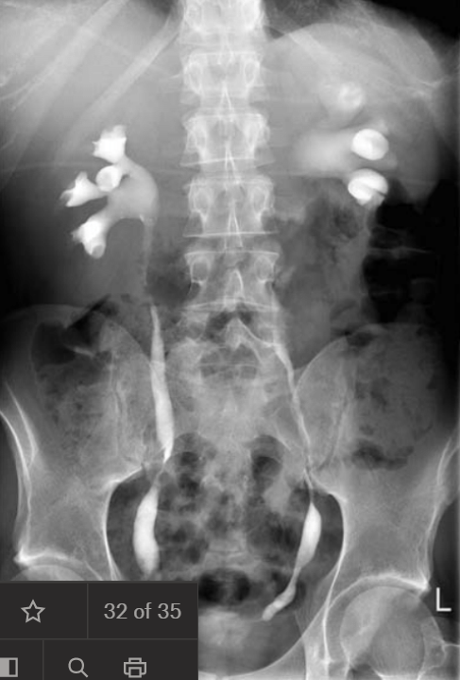
33yr old male
Initial imaging – no hydronephrosis
Underwent subtotal cystectomy and studer pouch
3 months post-op developed hydronephrosis and reduced eGFR
Initial attempt at refashioning left ureteric anastomosis failed – ongoing ketamine use
Ultimately required bilateral autotransplantation in staged procedures with significant complications
Now eGFR 20 and developed nephrogenic diabetes insipidis

Slide 30
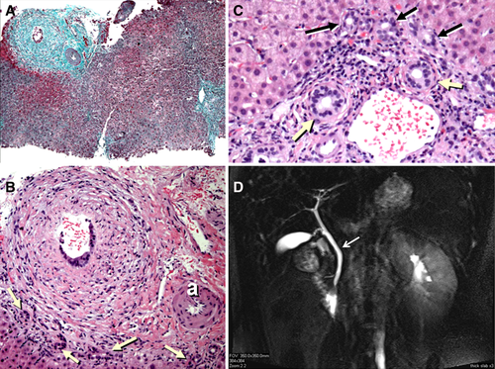
Other Effects
Sexual Dysfunction
GI Dysfunction
Hepatobiliary Dysfunction
Cognitive Impairment
Cardiac Dysfunction
??Potential Malignancy

Slide 31
